Slide 2
Instructions
Use this PowerPoint with your children to explore the learning intention ‘To know that numbers identify how many objects are in a set.’
The setting of the PowerPoint is Mr Cone’s ice cream van. He is very busy and would like the children to help him by adding the correct number of sprinkles on to each child’s ice cream.
On each slide, there is a picture of a dice. The children will try to identify the number that the pattern on the dice represents, then add that many sprinkles to the ice cream.
Encourage the children to click on the answer button to check their answers and to reveal how many sprinkles each child would like on their ice cream.
Click on ‘Mr Cone’, the ice cream seller, on each slide for some reasoning questions that you might wish ask the children.

Slide 3

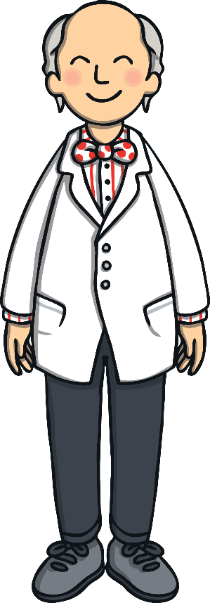

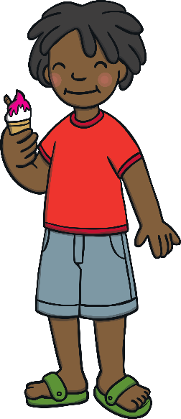
Counting Ice Cream Sprinkles
Hello children! I’m Mr Cone and this is my ice cream van. I am very busy today. Please could you help me to add the sprinkles on to the children’s ice creams?

Slide 4

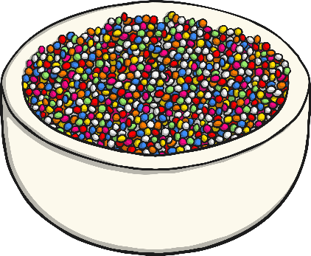
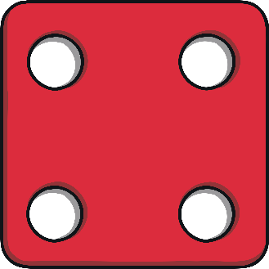

How many sprinkles would the first child like on her ice cream?
Can you add the sprinkles to the ice cream?
She would like 4 sprinkles today.
Click on a sprinkle to add it to the ice cream.
Click Mr Cone for a question!
Look at the dice. How will you know how many sprinkles to put on the ice cream?
Answer

Slide 5
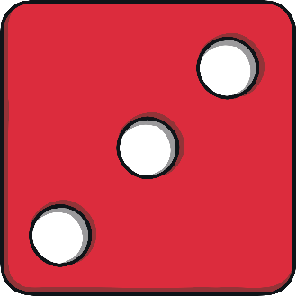
How many sprinkles would the second child like on his ice cream?
Can you add the sprinkles to the ice cream?
He would like 3 sprinkles today.
Click on a sprinkle to add it to the ice cream.
Click Mr Cone for a question!
If the sprinkles were in a different pattern, would it still be the same amount?
Answer

Slide 6

How many sprinkles would the third child like on her ice cream?
Can you add the sprinkles to the ice cream?
She would like 1 sprinkle today.
Click on a sprinkle to add it to the ice cream.
Click Mr Cone for a question!
I counted quickly and I think there are two spots on the dice this time. Do you agree?
Answer

Slide 7
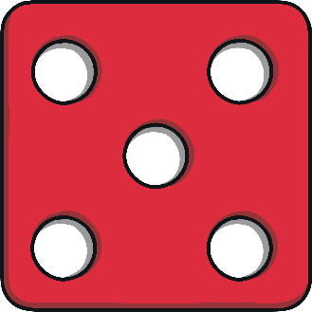
How many sprinkles would the fourth child like on their ice cream?
Can you add the sprinkles to the ice cream?
He would like 5 sprinkles today.
Click on a sprinkle to add it to the ice cream.
Click Mr Cone for a question!
How do you know how many sprinkles to put on the ice cream this time? Can you explain your answer?
Answer

Slide 8
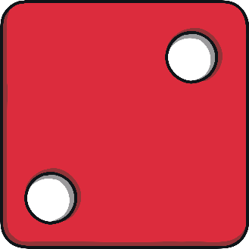
How many sprinkles would the next child like on her ice cream?
Can you add the sprinkles to the ice cream?
She would like 2 sprinkles today.
Click on a sprinkle to add it to the ice cream.
Click Mr Cone for a question!
The total was 5 last time, so it must be 5 every time. Is that true or false?
Answer

Slide 9
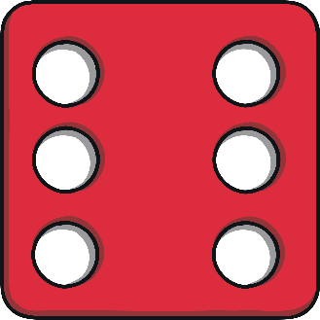
How many sprinkles would the next child like on her ice cream?
Can you add the sprinkles to the ice cream?
He would like 6 sprinkles today.
Click on a sprinkle to add it to the ice cream.
Click Mr Cone for a question!
6,5,4,3,2,1, the answer is definitely 1. There is 1 dot so he would like 1 sprinkle on his ice cream.
What do you think?
Answer

Slide 10
How many sprinkles would the last child like on her ice cream?
Can you add the sprinkles to the ice cream?
She would like 0 sprinkles today.
Click on a sprinkle to add it to the ice cream.
Click Mr Cone for a question!
There are no dots on the dice. Which number name do we use to describe no dots?
Answer

Slide 11
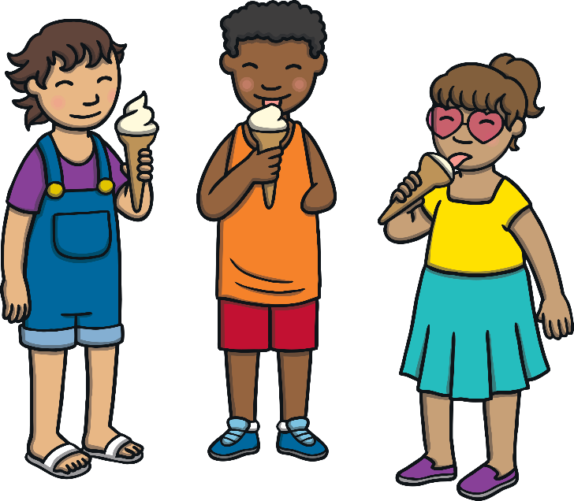
Excellent Counting!
Thank you for helping! You matched the number of sprinkles to the total on the dice.
How many sprinkles would you like on your own ice cream?

