Slide 1
Maths story
Numbers 1-5
Country

Slide 2

We’re going on a scavenger hunt
What will we find?

Slide 3
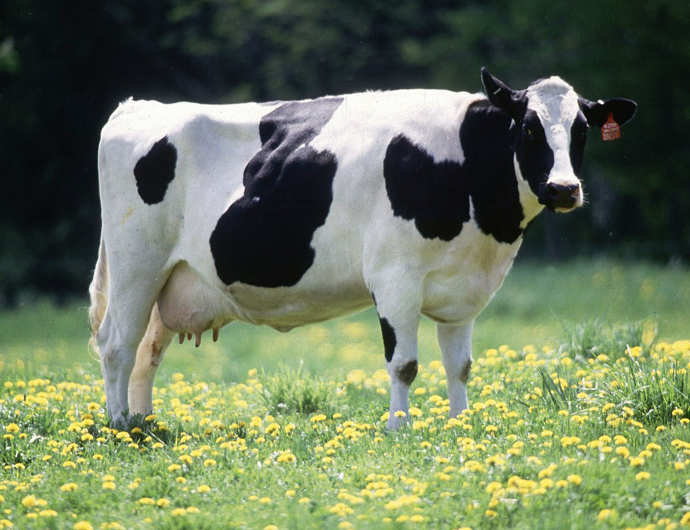
A cow – How many cows did we find?
1

Slide 4

We’re going on a scavenger hunt
What will we find?

Slide 5
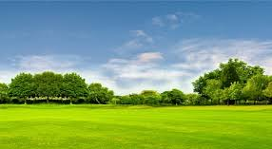
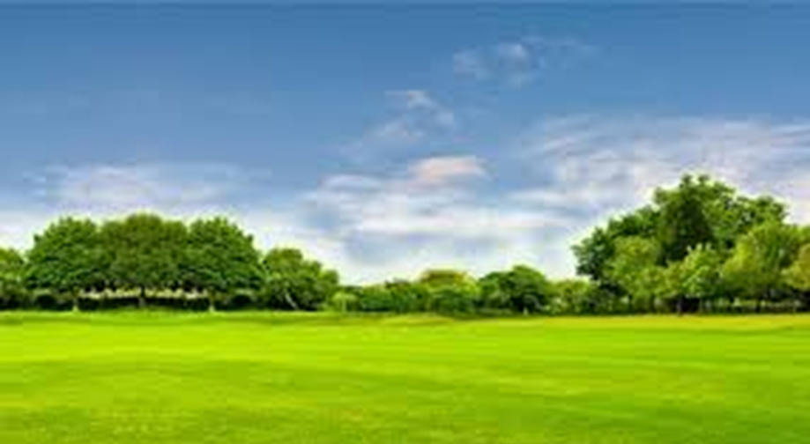
Field’s – How many fields did we find?
2

Slide 6
We’re going on a scavenger hunt
What will we find?

Slide 7


Flowers – How many flowers did we find?
3

Slide 8
We’re going on a scavenger hunt
What will we find?

Slide 9
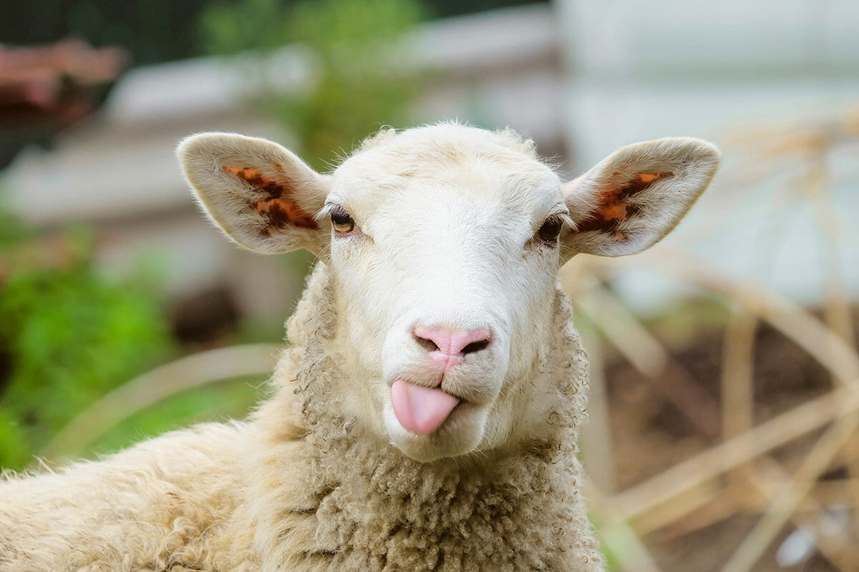


Sheep – How many sheep did we find?
4

Slide 10
We’re going on a scavenger hunt
What will we find?

Slide 11
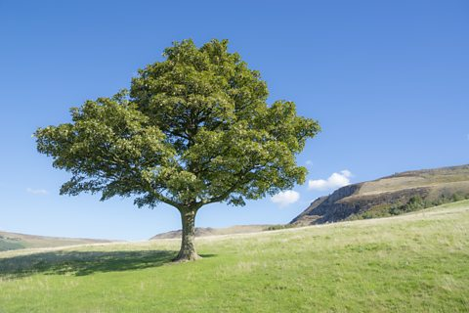

Tree’s – How many tree’s did we find?
5

