Slide 1
Owlyness
July 2020

Slide 2
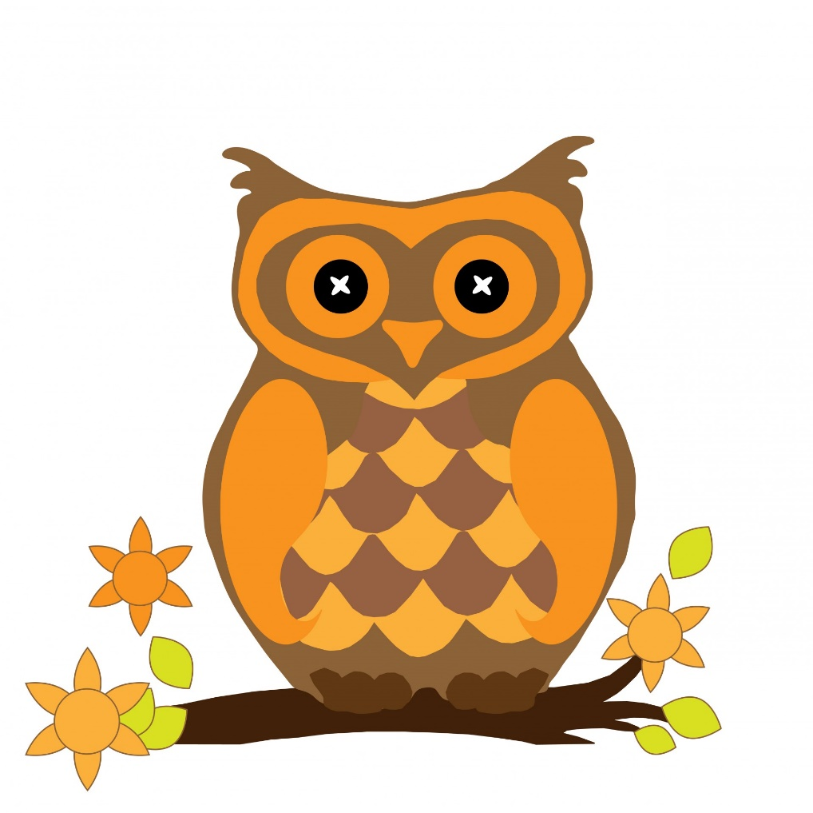
Owl liked doing Owly things.

Slide 3
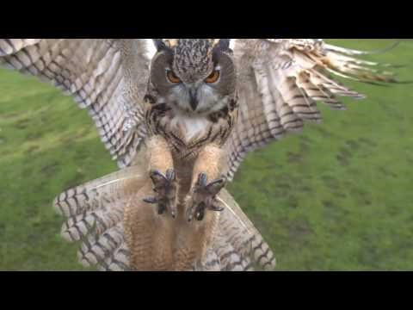
Owl liked flying.
https://www.youtube.com/watch?v=3wdsE1UgP6k

Slide 4
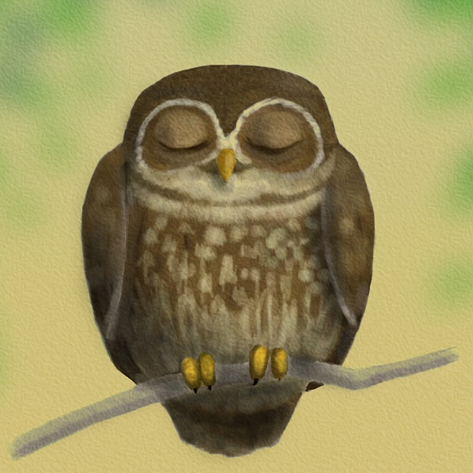
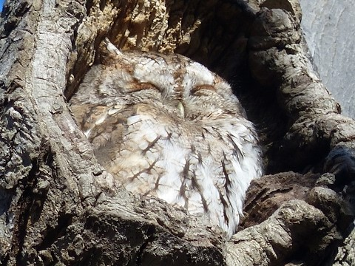
Owl liked sleeping.

Slide 5
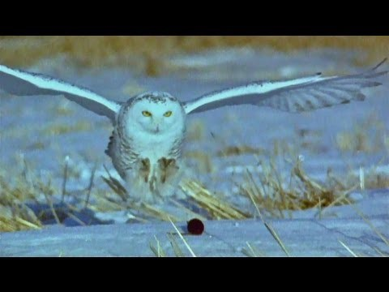
Owl liked hunting.
https://www.youtube.com/watch?v=pjTfqOrVJRI

Slide 6
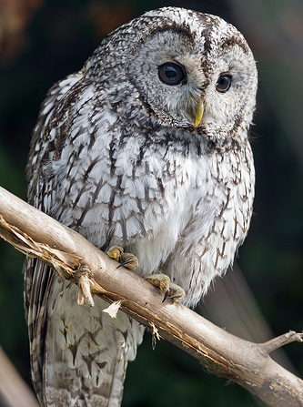
Owl liked to say ‘Twit two’.
https://www.youtube.com/watch?v=ezaBqCf0hv0

Slide 7
Owl liked sitting in his tree.

Slide 8
Owl also liked doing unowly things…

Slide 9
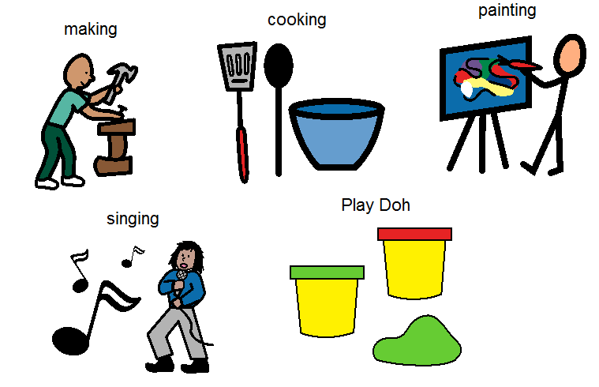
Like being creative

Slide 10
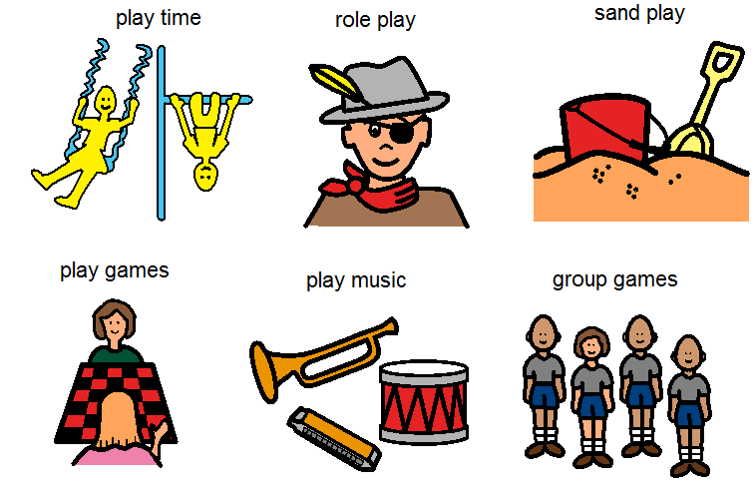
And playing

Slide 11
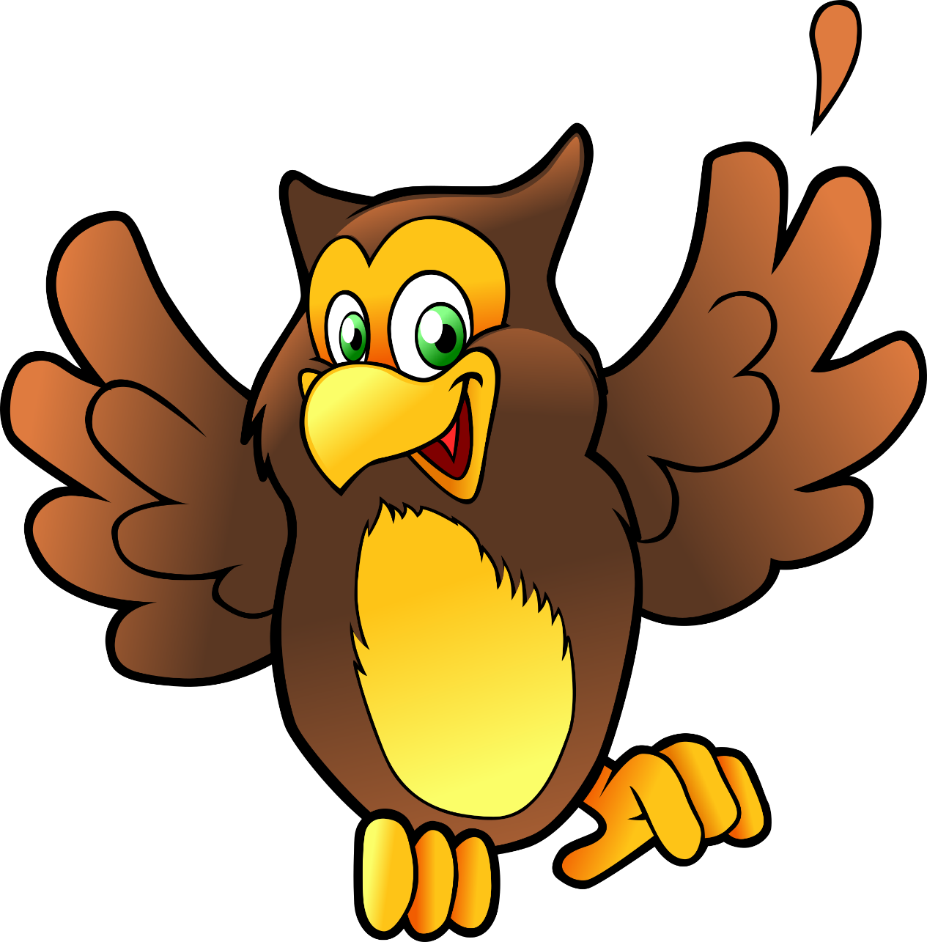
This made Owl VERY happy!

Slide 12
It made him so happy, all the other owls caught his happiness.
He filled the woods with play and creativity.

Slide 13
What do you like doing that makes you feel happy?

Slide 14
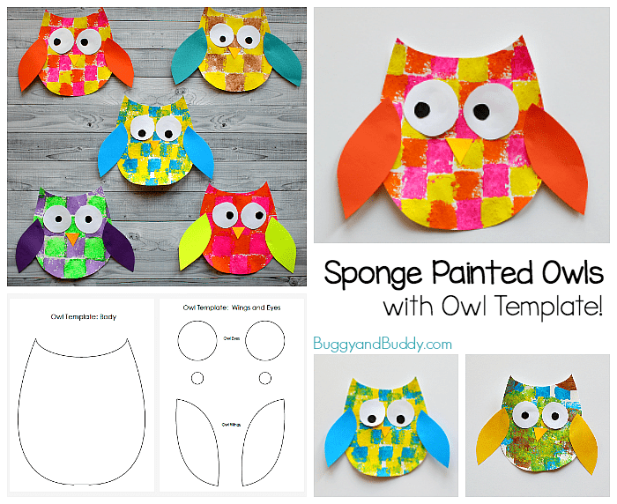
Using this template print images of things your child likes and then collage to make your own Owl.

Slide 15
I am good at…. I would like to get better at….
I am good at making friends. I would like to get better at making decisions. Donna
I am good at gardening. I would like to get better at knitting. Liz
I am good at horse riding. I would like to get better at photography. Megan R
I am good at doing make-up. I would like to get better at floristry. Megan W
I am good at cooking. I would like to get better at driving long distances. Libby
I am good at making people laugh. I would like to get better at cooking. Lorna
Please complete your own sentence and share them with lorna.banfield@woodlands.surrey.sch.uk

