Slide 1
ONE And lots

Slide 2

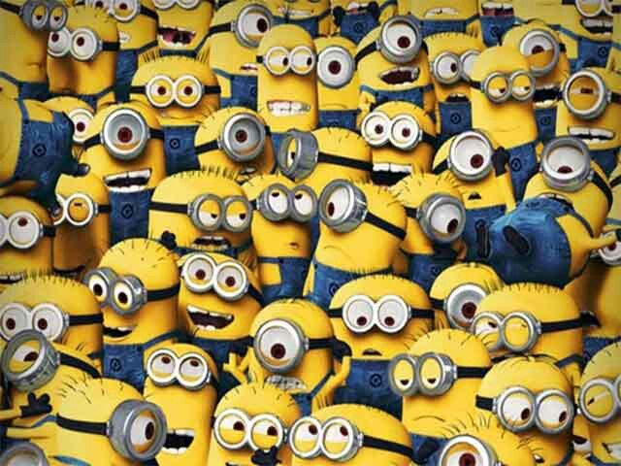
which picture has 1 minion?

Slide 3
The answer is….

Slide 4
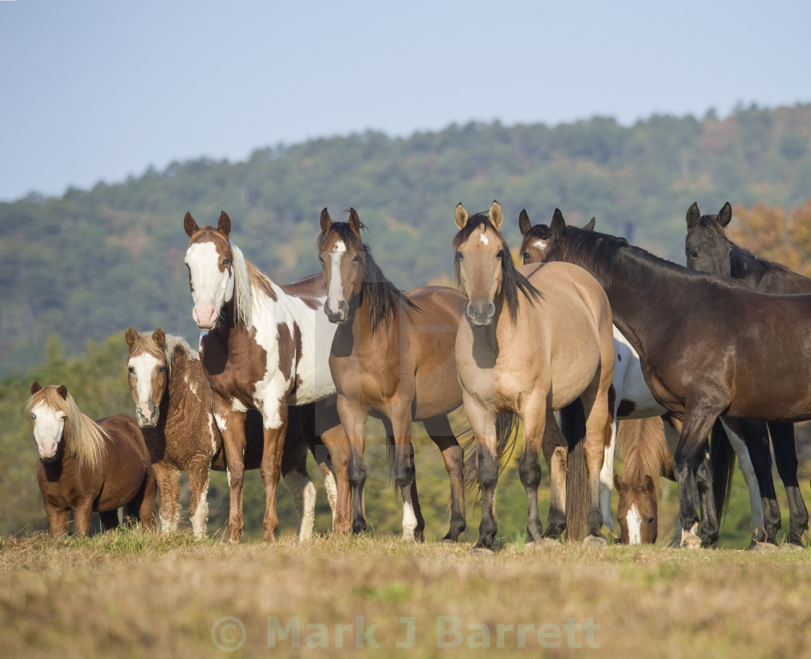
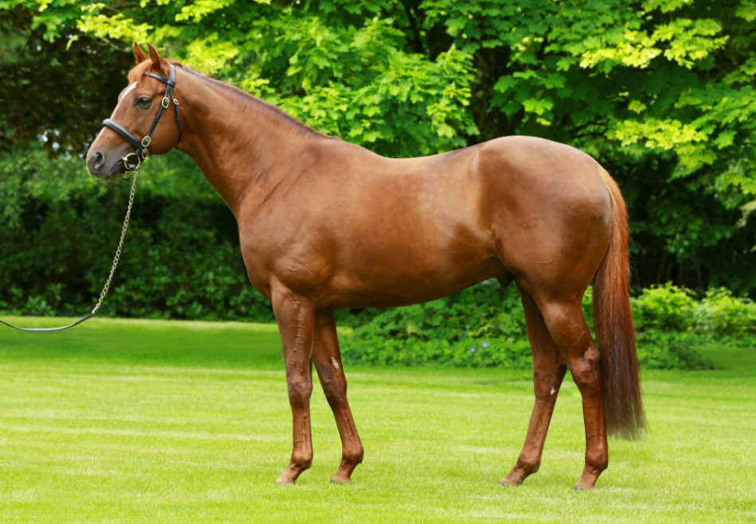
Which picture has lots of horses?

Slide 5
The answer is…

Slide 6
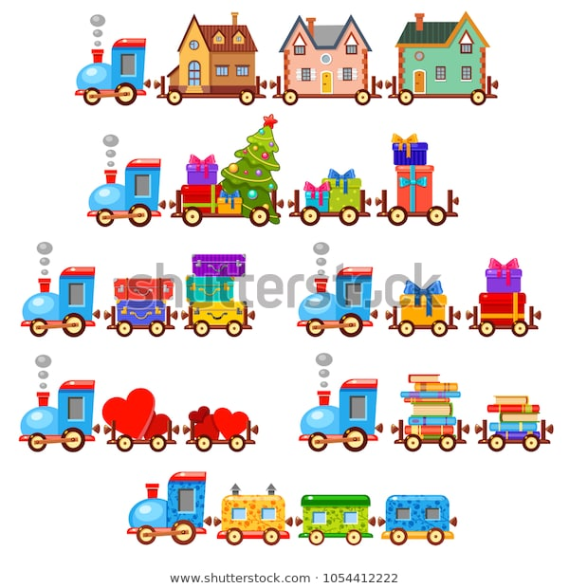
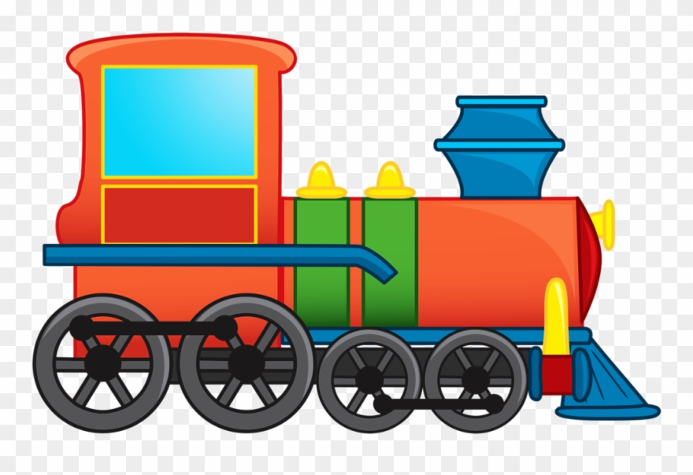
Which picture has 1 train?

Slide 7
The answer is…

Slide 8
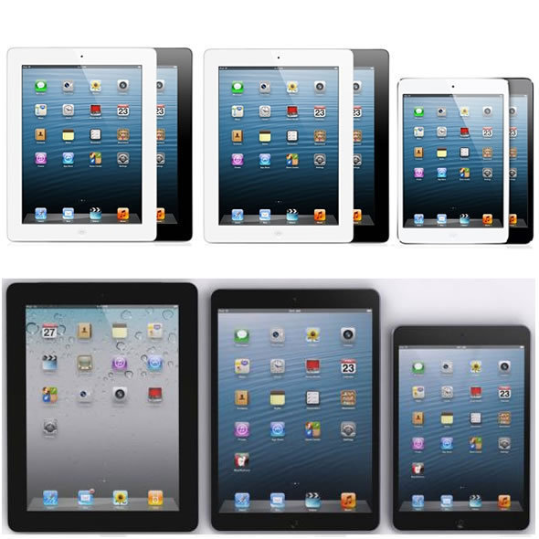
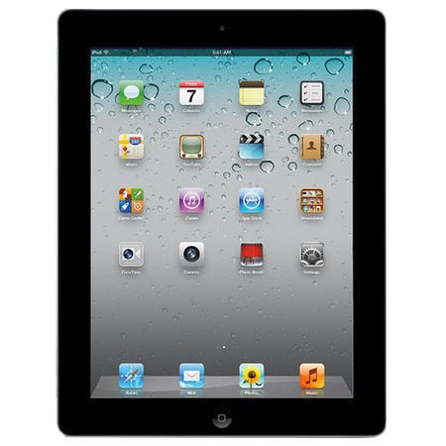
Which picture has lots of Ipad’s?

Slide 9
The answer is…

