Slide 1
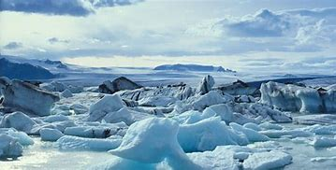
Artic Animals
The artic is very cold and very snowy, a few animals live there.
Shall we take a look at them?

Slide 2
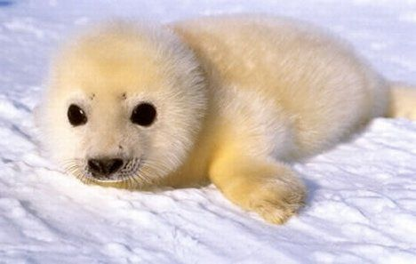
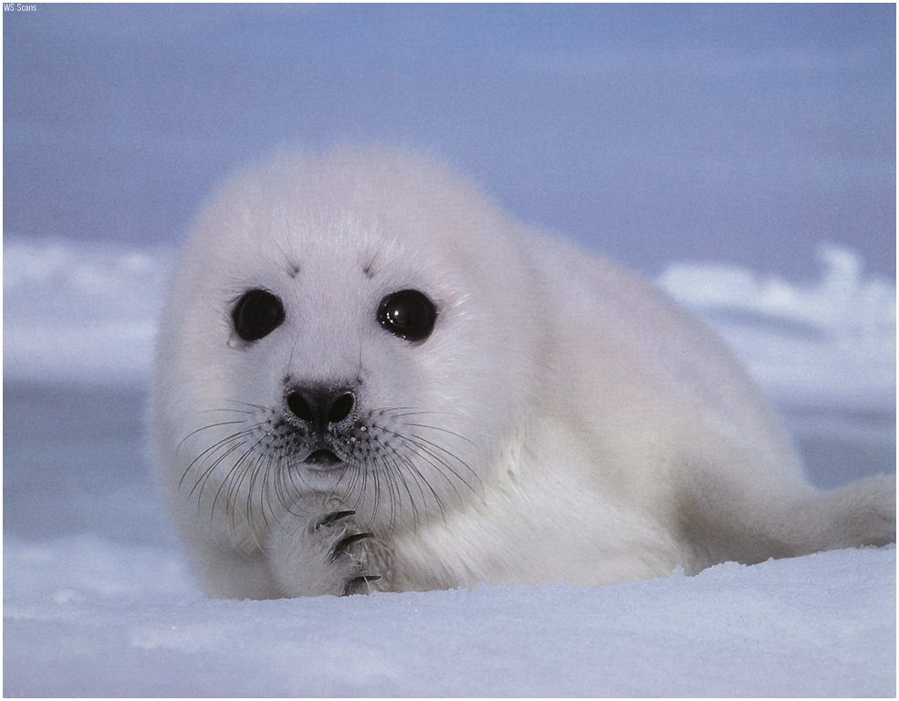

What can you see?
I have big black eyes.
I have white fur.
I am small.
What am I?

Slide 3
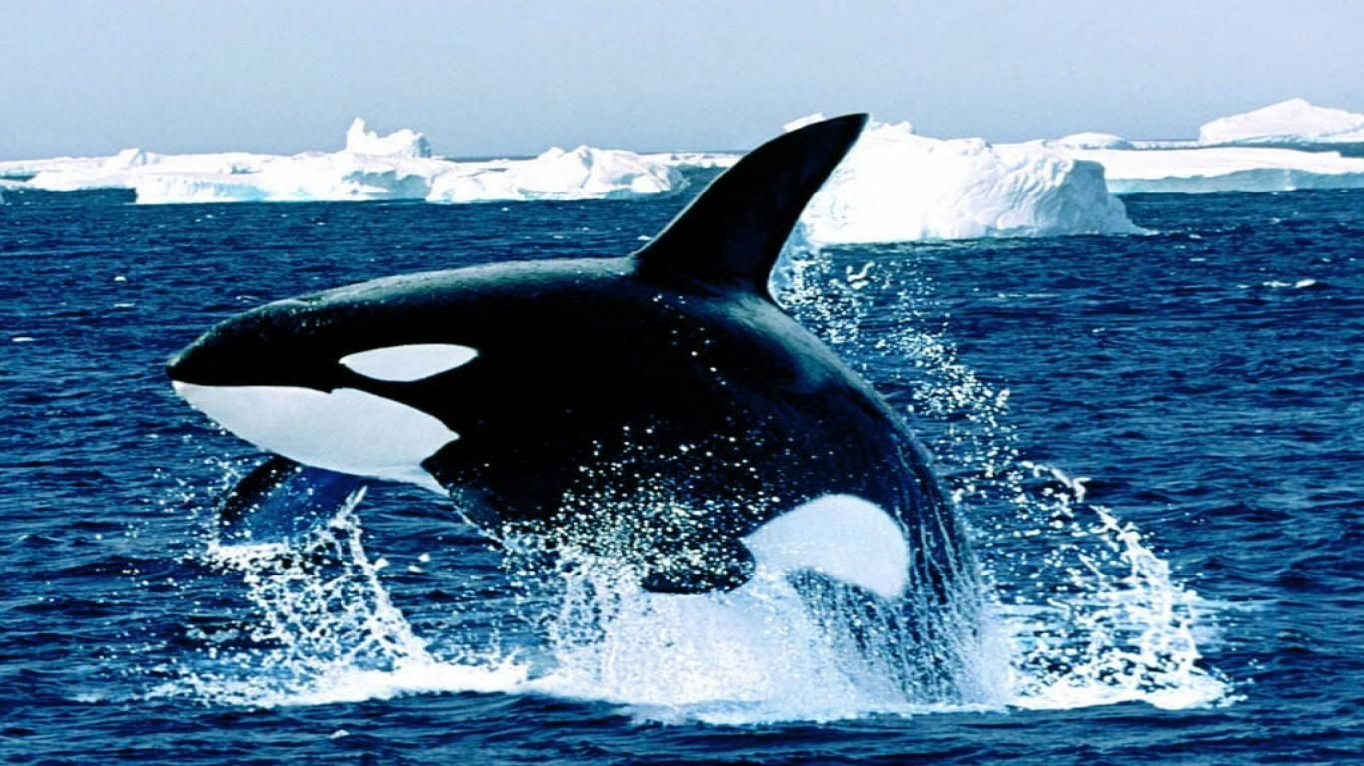
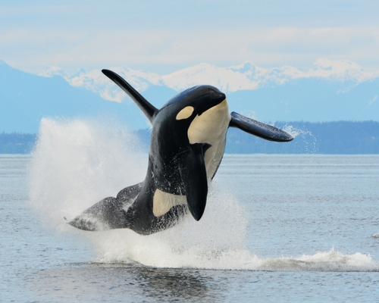
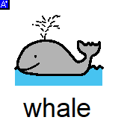
What can you see?
I live in the sea.
I am black and white.
I eat fish.
What am I?

Slide 4
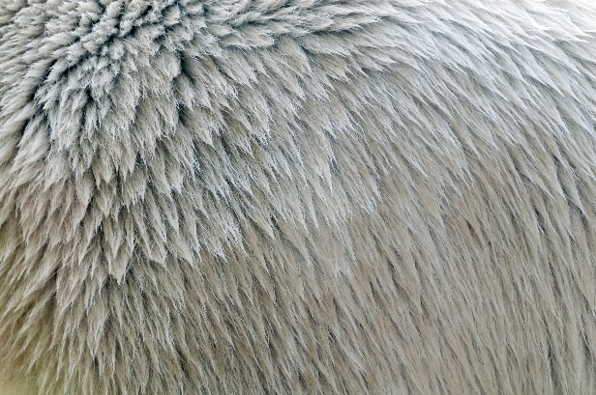
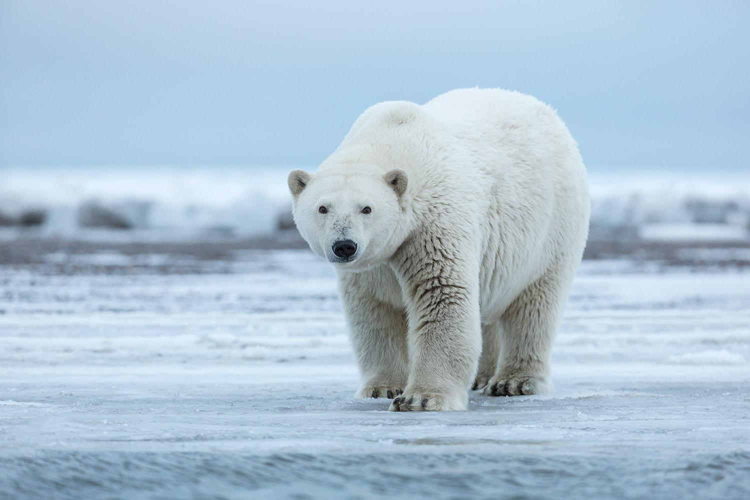
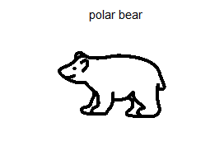
What can you see?
I have white fur.
I live on ice.
I hide in the white snow.
What am I?

Slide 5
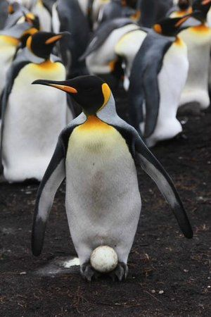
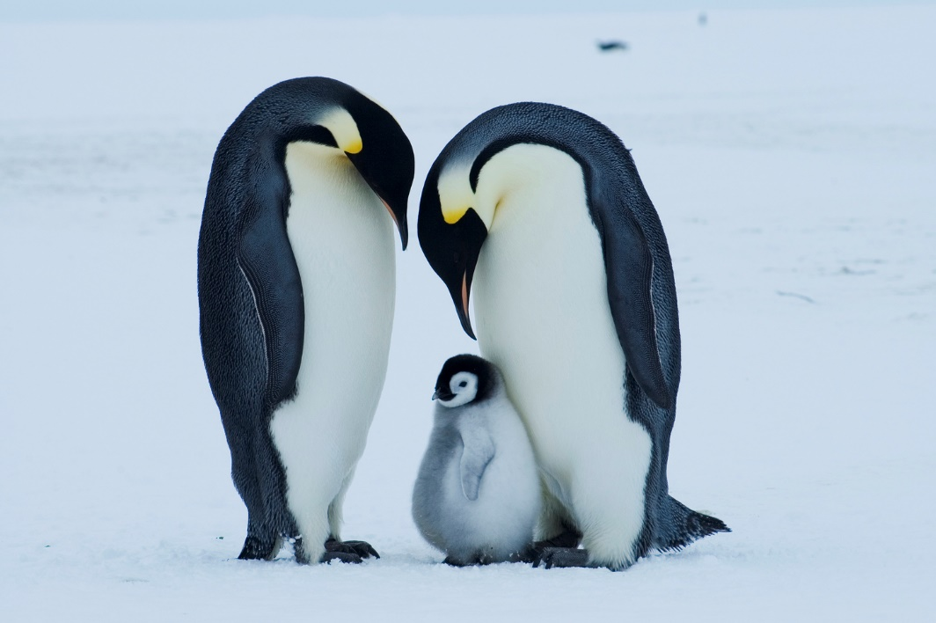
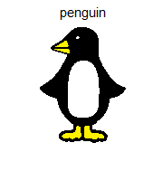
What can we see?
I have flippers.
I have a beak.
I carry my egg on my feet.
I can swim very fast.
What am I?

