Slide 1
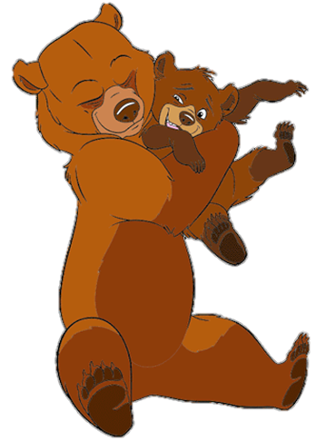
Wake up Mummy bear!

Slide 2
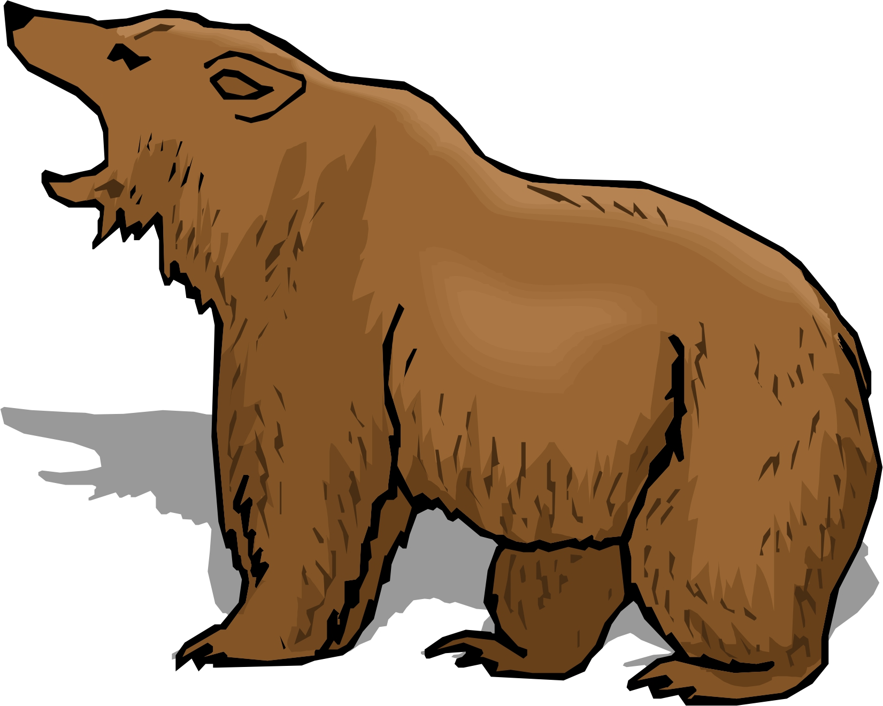
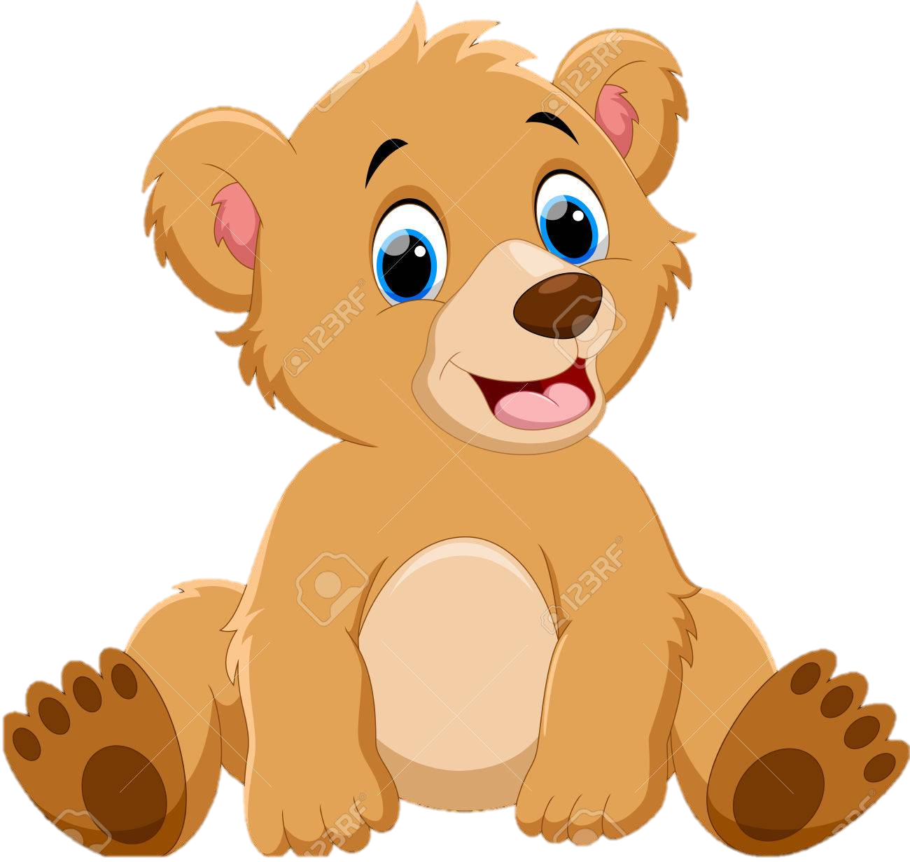
Mummy bear yawned. It was time for a sleep.
But baby bear wasn’t tired.

Slide 3
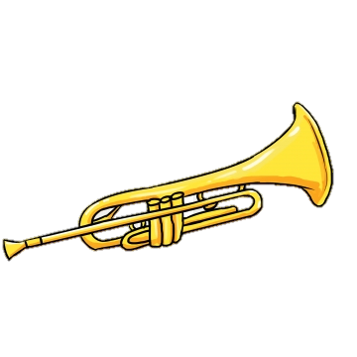
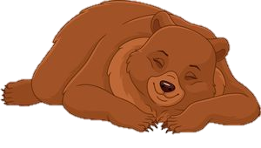
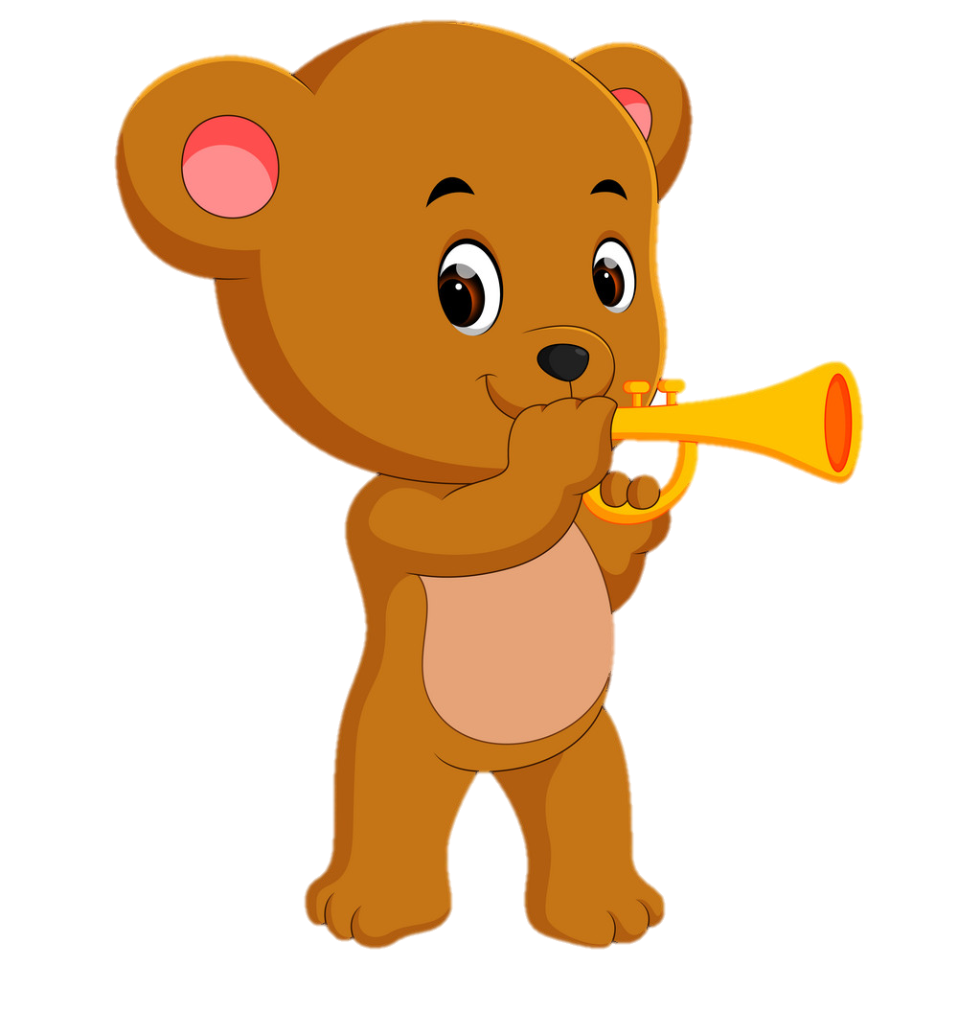
LOUD!!
Quiet….
‘Wake up Mummy bear!’ said baby bear.
‘Shh!’ said Mummy bear.

Slide 4
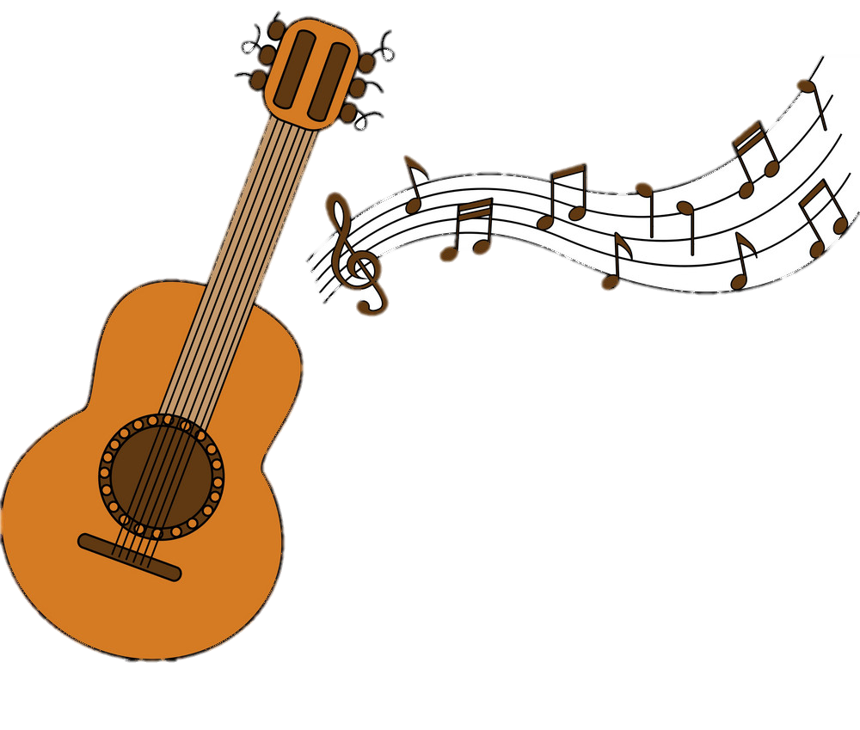
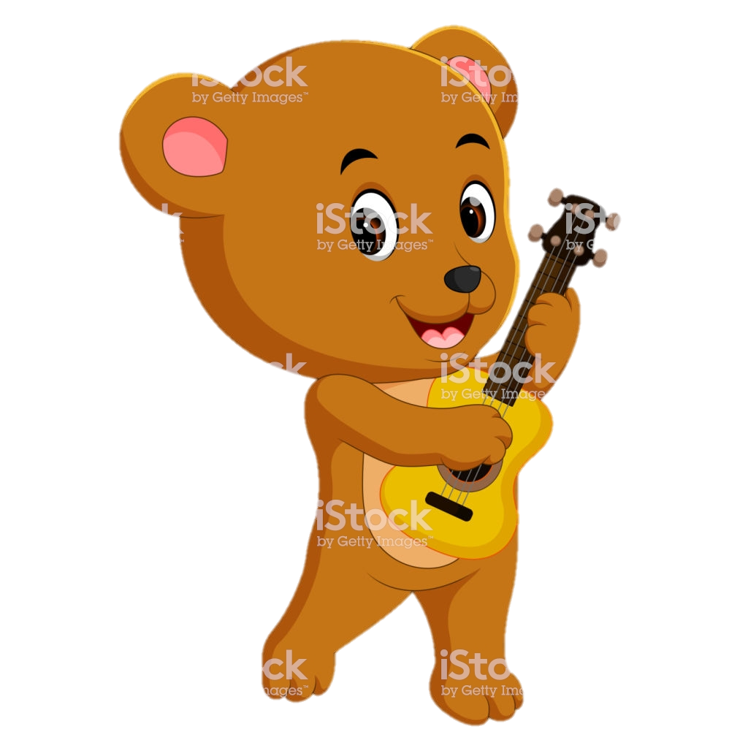
LOUD!!
Quiet….
‘Wake up Mummy bear!’ said baby bear.
‘Shh!’ said Mummy bear.

Slide 5
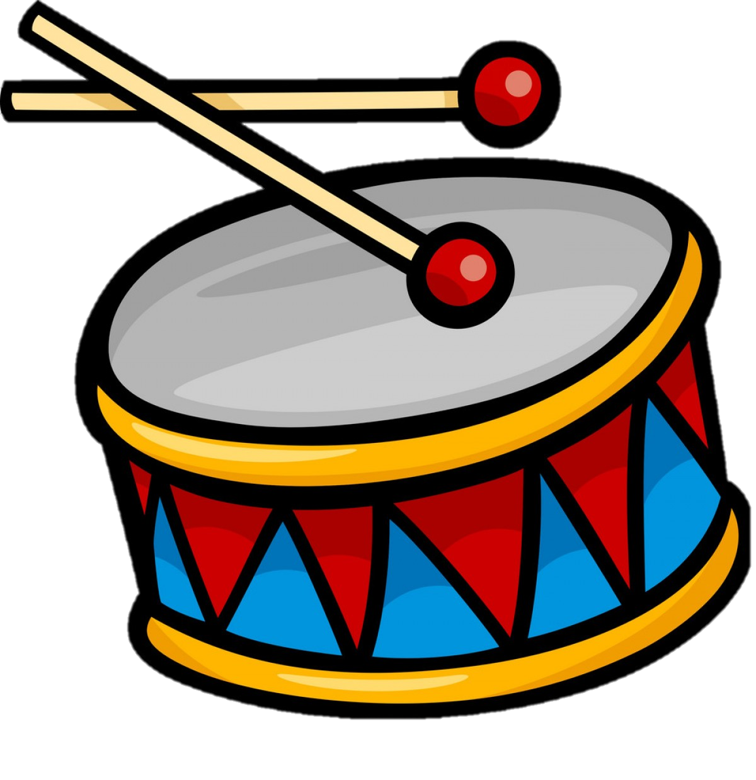
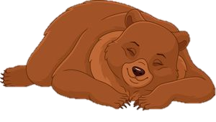
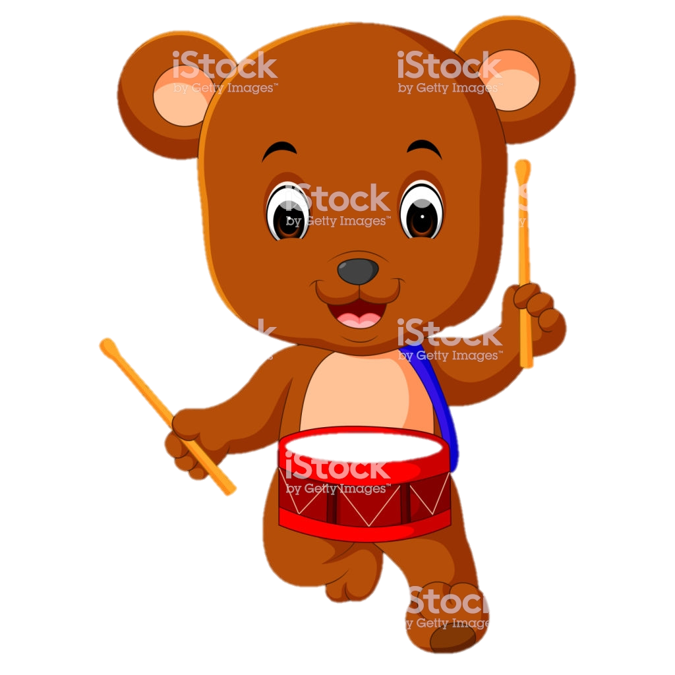
LOUD!!
Quiet….
‘Wake up Mummy bear!’ said baby bear.
‘Shh!’ said Mummy bear.

Slide 6
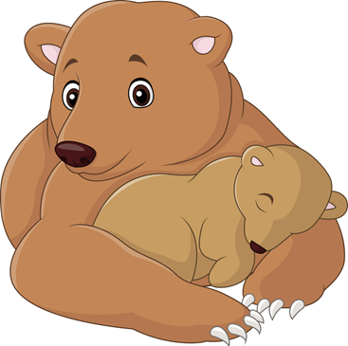
Quiet….
‘Shh!’ said Mummy bear. Time for sleep baby bear.

