Slide 1
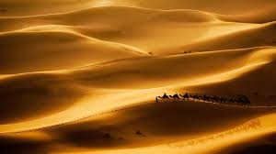
Desert Animals
The desert is very hot and very dry, a few animals live there.
Shall we take a look at them?

Slide 2
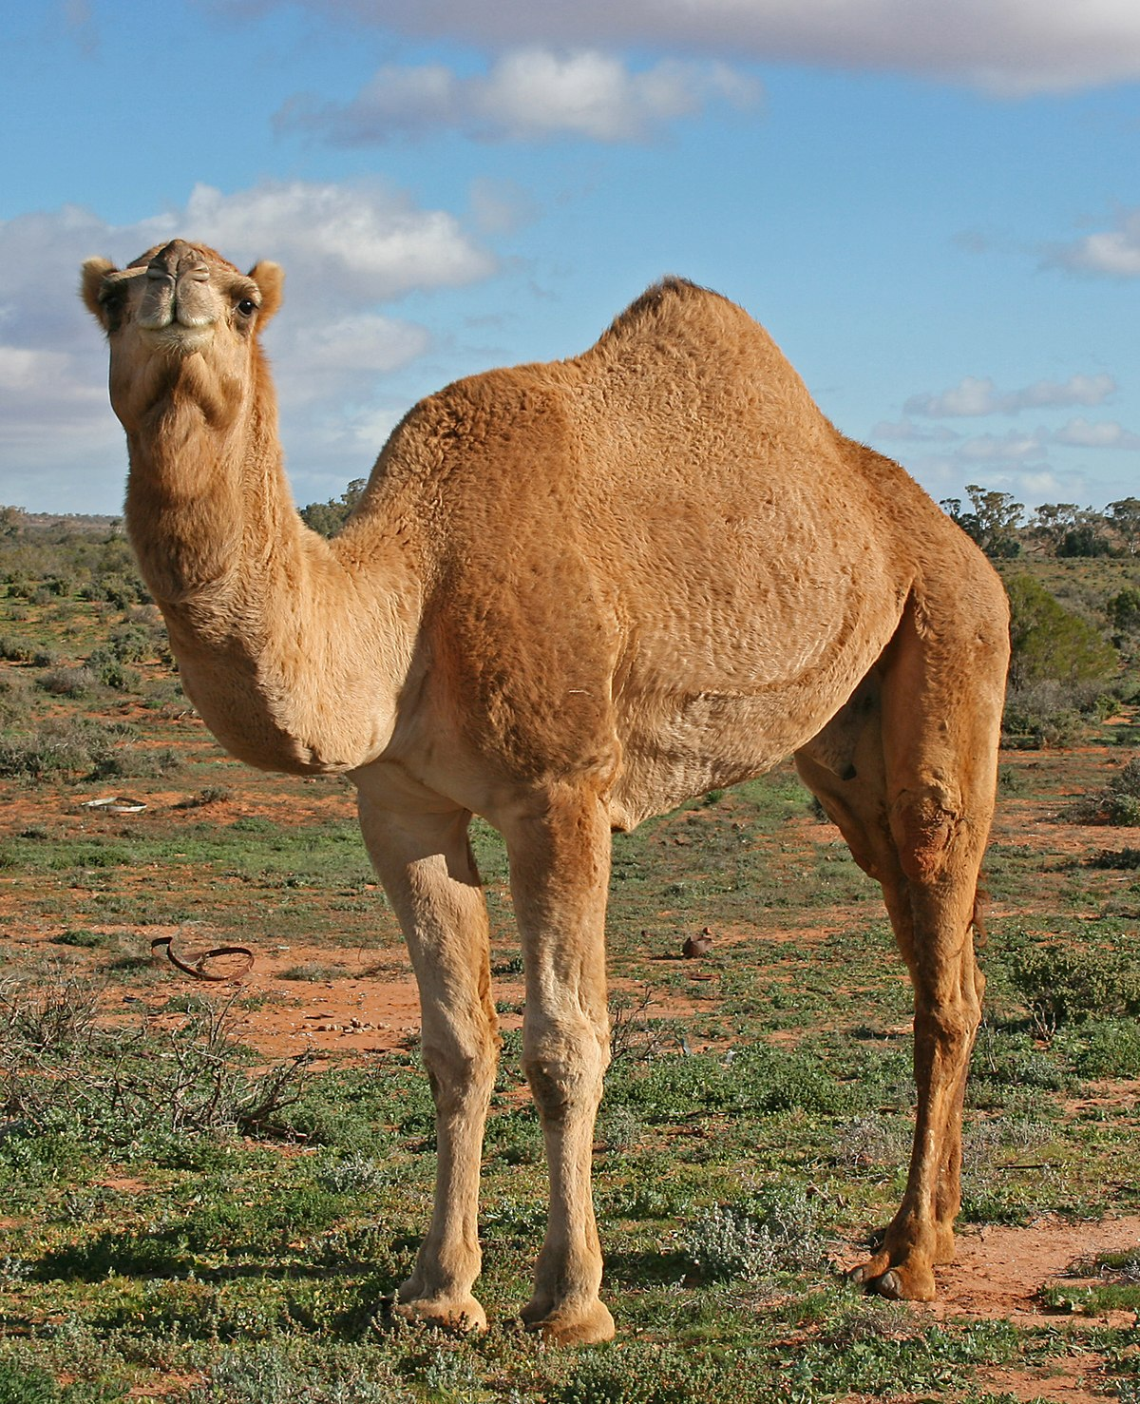
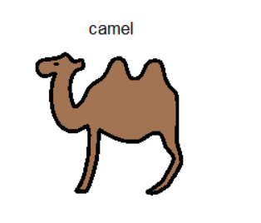
What can you see?
I eat grass and plants.
I carry people.
I have humps.
What am I?

Slide 3
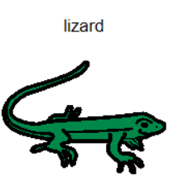
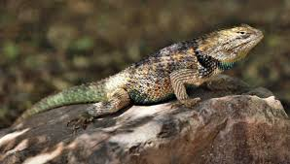
What can you see?
I have tough skin.
I hide under rocks.
I am a reptile.
What am I?

Slide 4
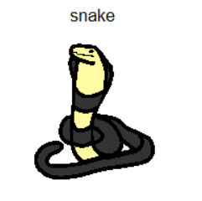
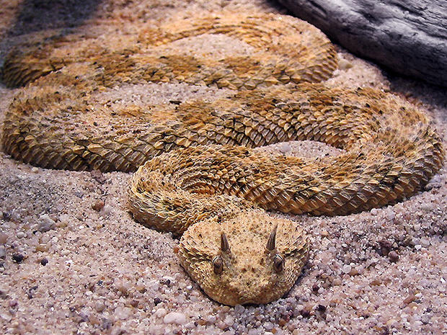
What can you see?
I am scaly.
I eat things that are bigger than me.
I am long.
What am I?

Slide 5
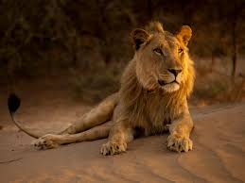
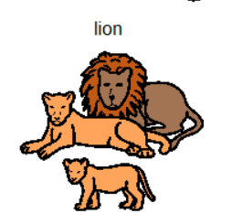
What can we see?
I have paws.
I like to sleep.
I have a thick coat.
What am I?

Slide 6
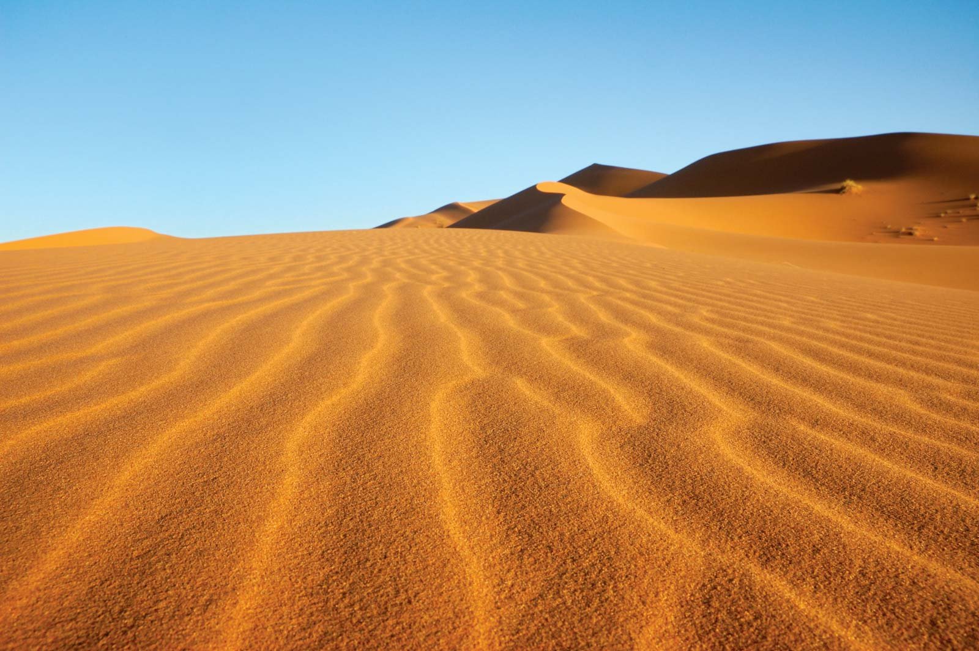
Live in the desert Do not live in the desert

Slide 7


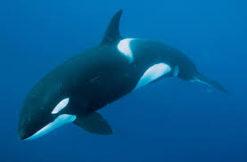
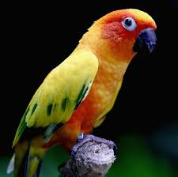

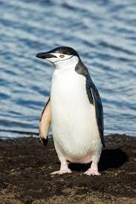

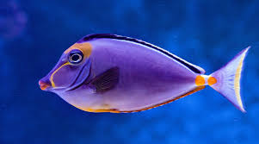

Slide 8
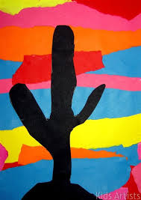
Desert sunset art

