Slide 1
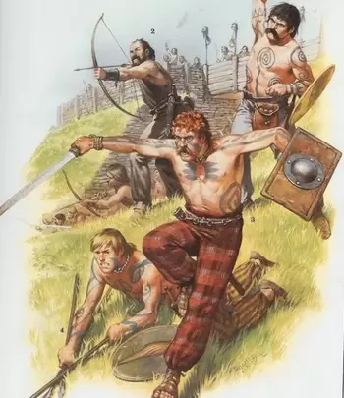
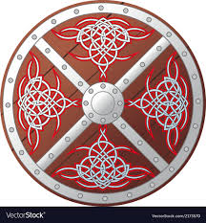
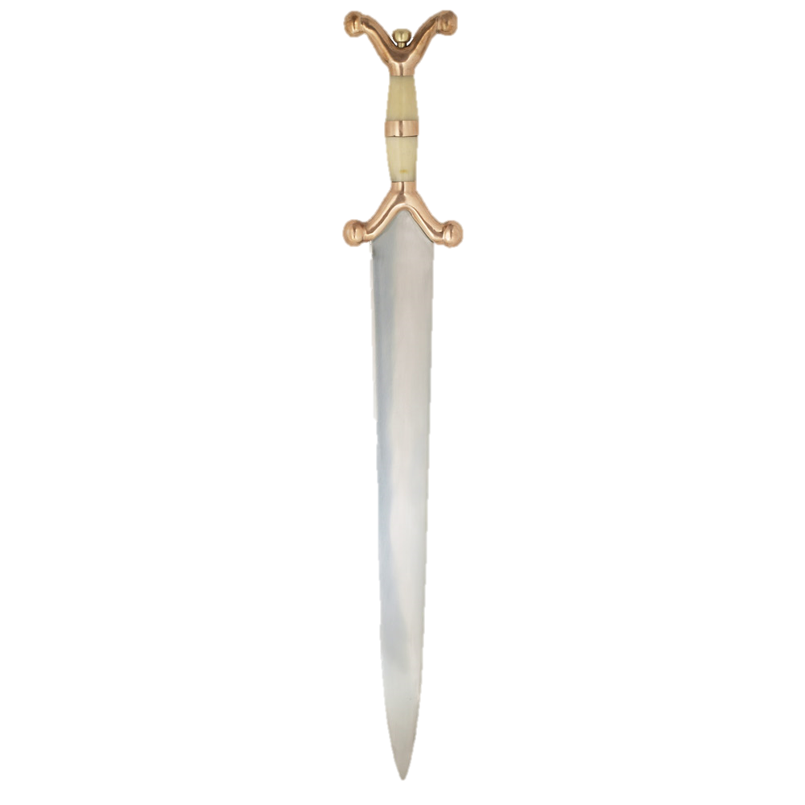
Make a Celtic shield and sword

Slide 2
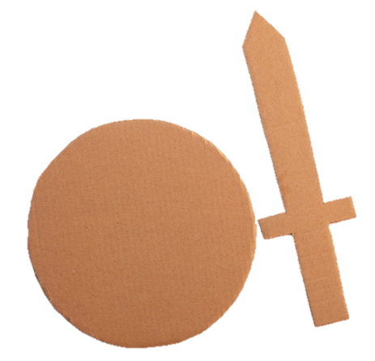
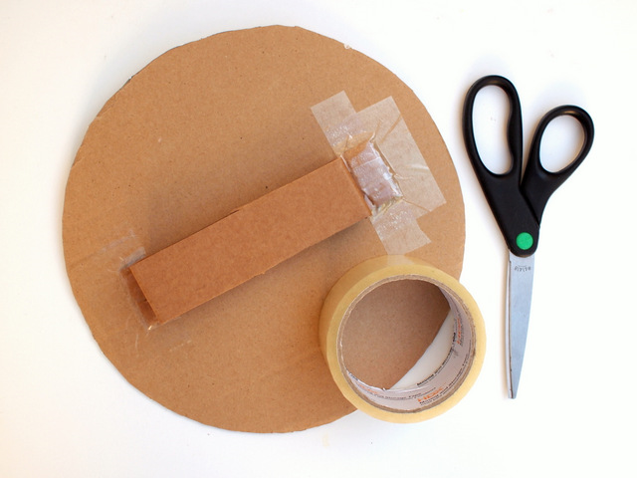
Make a Celtic shield
Celtic shields were made of oak, probably covered in hide or felt, and had a central strip of iron.
Cut out a cardboard circle. Attach a handle to the back of your shield.
Decorate the front of your shield.
Make a Celtic sword
Celtic swords were made of unhardened iron and could be bent out of shape in battle!
Cut out a cardboard sword shape.
Decorate with pens or paints.

