Slide 1


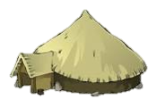
Celtic Houses

Slide 2
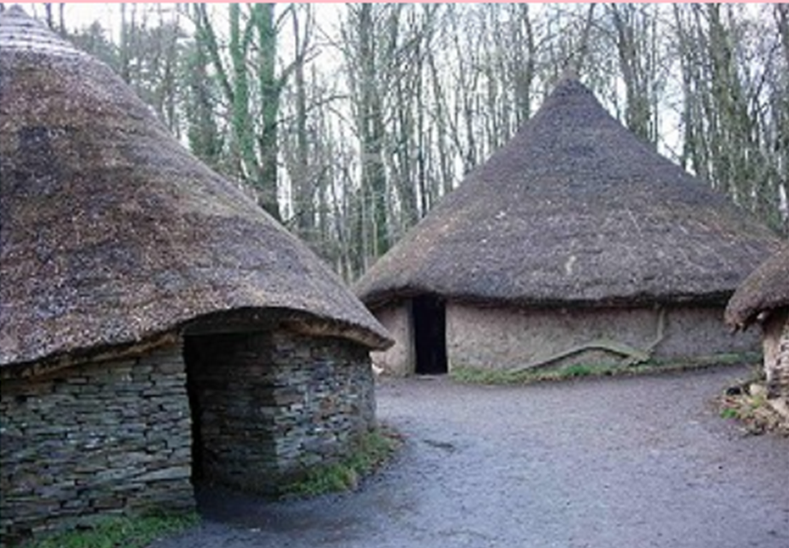
Celts lived in homes called Roundhouses. They had no windows. Several houses made a village.

Slide 3
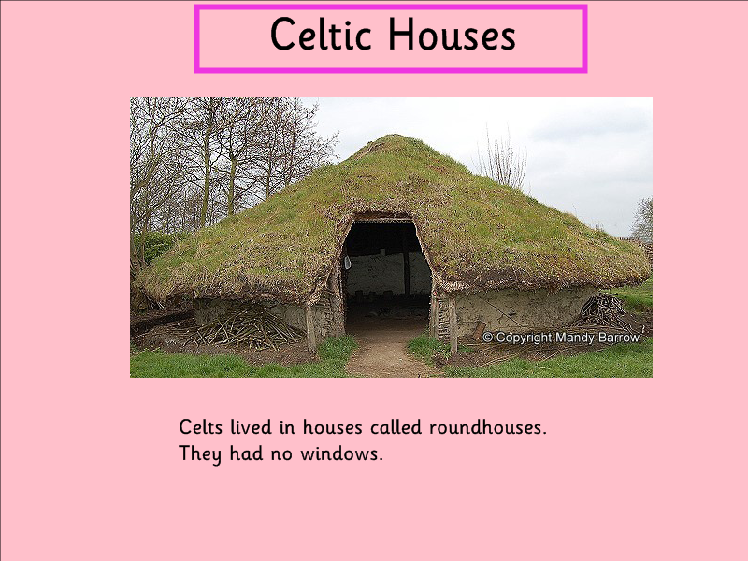
Lots of people lived in one roundhouse. It had just one room.

Slide 4
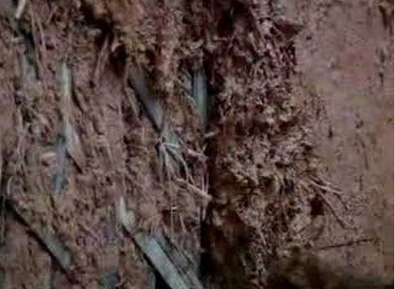
Celts used wood from the forest. The roof was made of wooden poles. It was then covered in straw.
The walls were made of sticks and mud. This mixture was called wattle and daub.

Slide 5
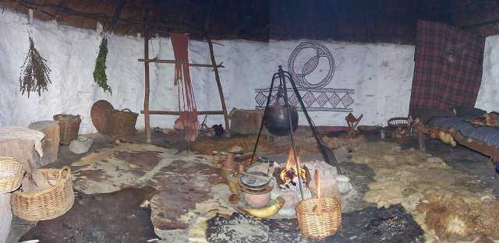
A fire was always burning in the middle of the room. It was used for heat, light and cooking. The room would have been very smoky.

Slide 6
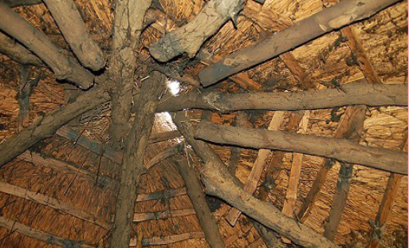

Can you see the hole in the roof?
This was to let the smoke out.

Slide 7
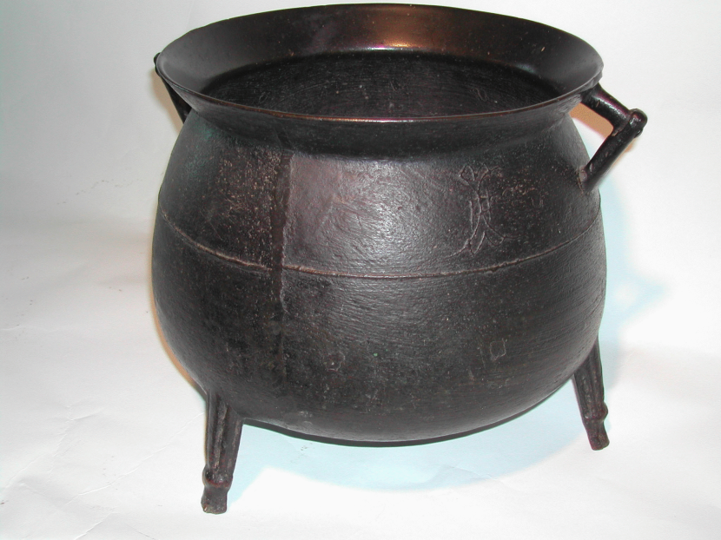
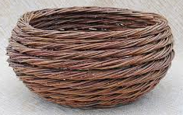
Food was cooked over the fire in a big pot called a cauldron.
Food was gathered in baskets made of woven willow branches.
Cow horns were used as cups.

Slide 8
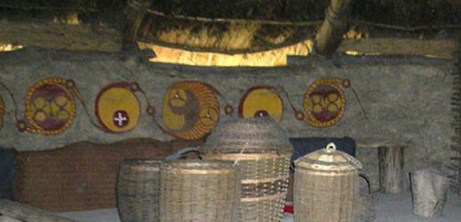
Celts liked to decorate the inside walls with colourful paintings.

Slide 9
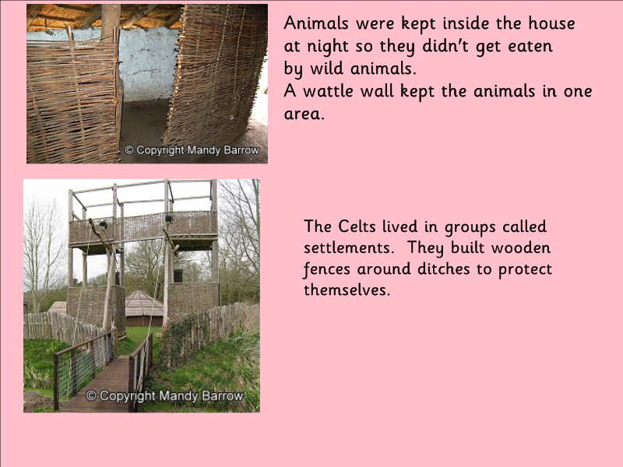
Animals were also kept inside the house at night, so they didn’t get eaten by wild animals such as wolves and bears.

Slide 10
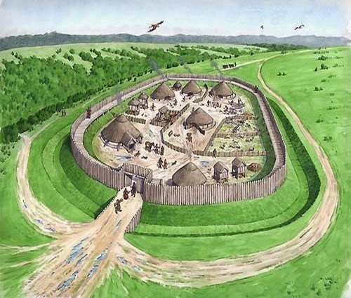
Celtic Safety Facts…..
Life for Celts was very dangerous. Different tribes often fought over land or goods. They built wooden fences and ditches around their villages.
To keep really safe, they built their settlements on top of hills. These are called hill-forts.

