Slide 1
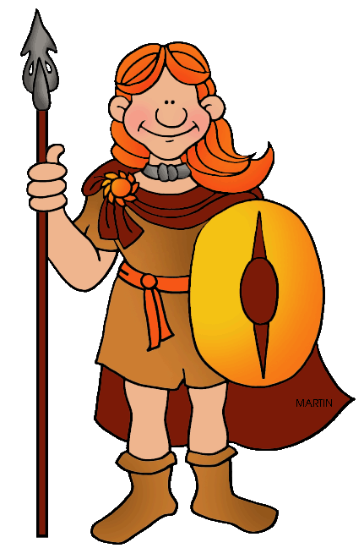
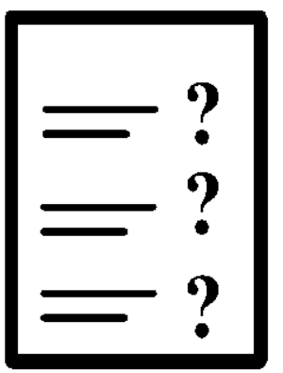
Celtic Quiz

Slide 2
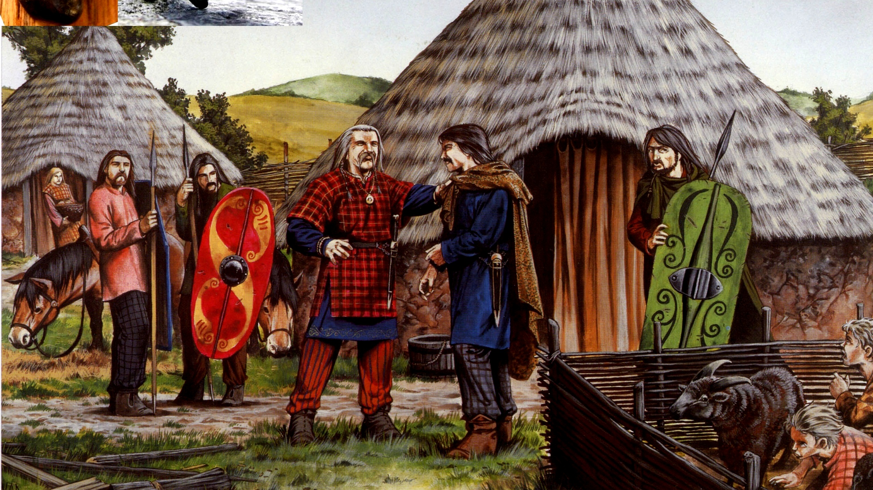

































How well do you know the Celts? Before you start take a look at this picture, have a think or talk about what you can see. There may be some clues!! Good luck!!

Slide 3
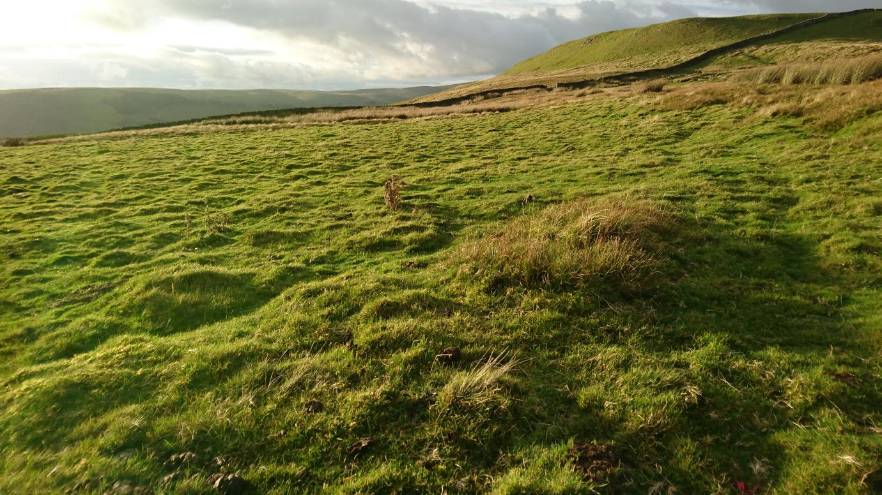

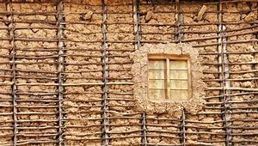
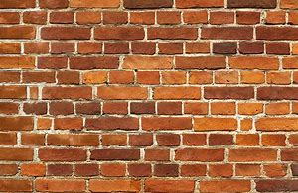
What did the Celts use to build their houses?
Mud and sticks
Bricks and cement

Slide 4
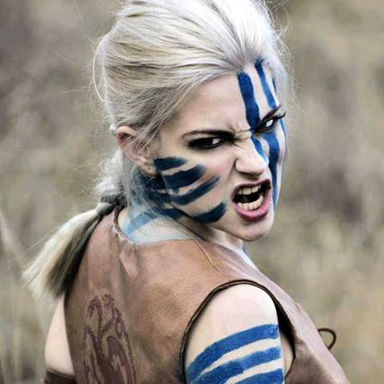
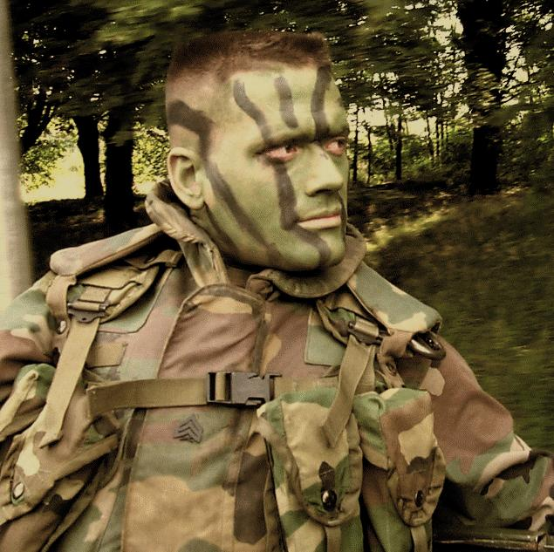
How would the Celts get ready for battle?
Camouflaged and quietly
Bright paints and shouting

Slide 5
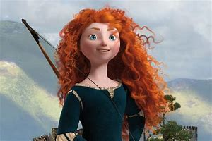
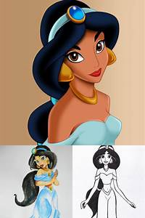
What are the Celts best known for?
Red hair
Black hair

Slide 6


What shape are Celtic houses?
Round
Square

Slide 7
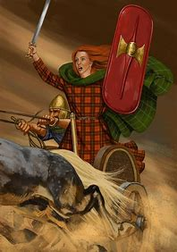
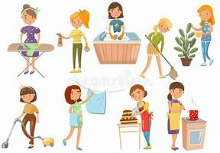
What was the role of Celtic women?
To stay at home cooking and cleaning
To go to war and fight with the men

Slide 8
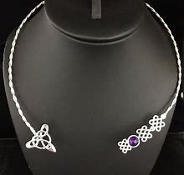
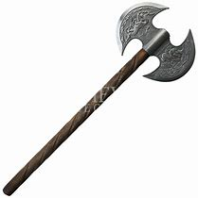
What is a Torc?
Necklace
Axe

Slide 9
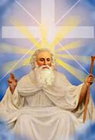
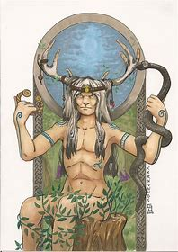
Who did the Celts worship?
God of skill and goddess of nature
One God

Slide 10

Congratulations!
You finished the quiz.
You could pass for a real Celt!!

