Slide 1

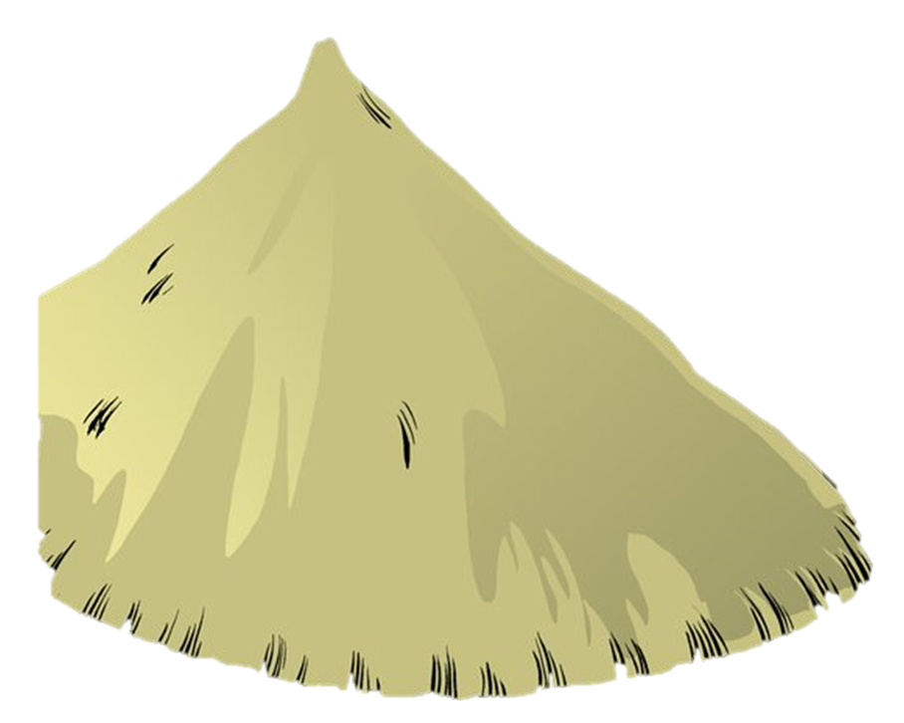
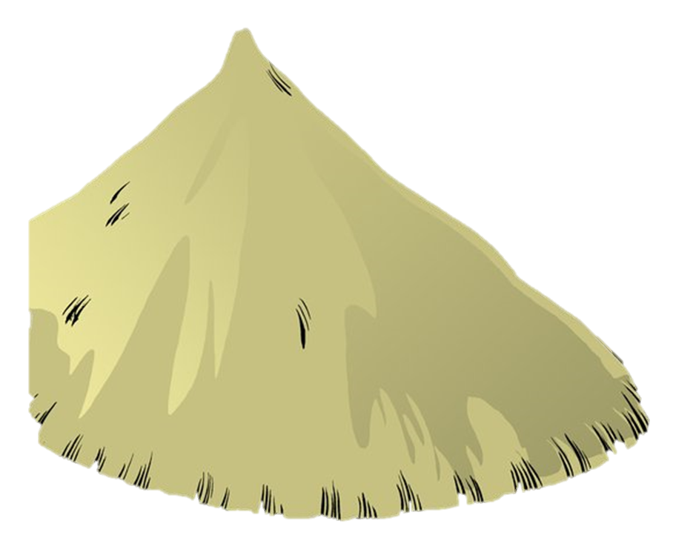
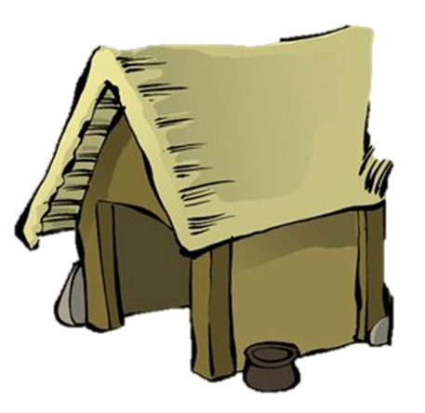
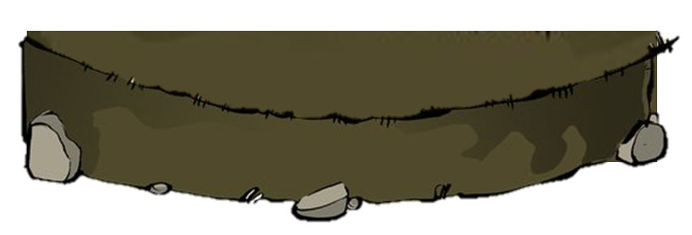

How to build a Celtic roundhouse
Add a chimney for the fire smoke
Add a thatched roof
Make a doorway
Build a mud wall

Slide 2

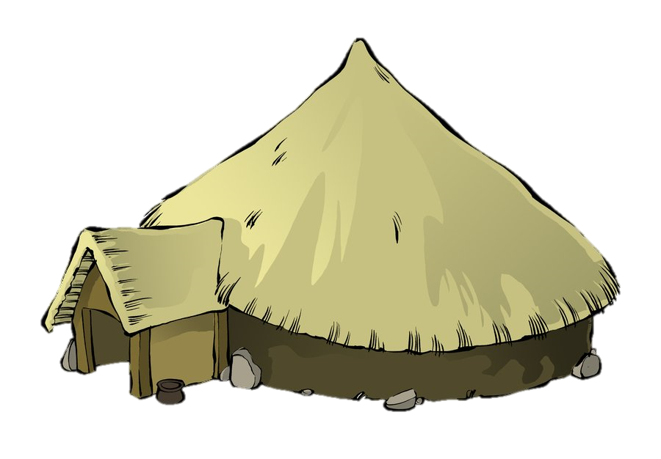

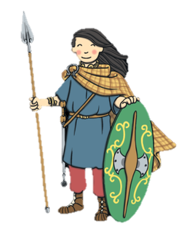
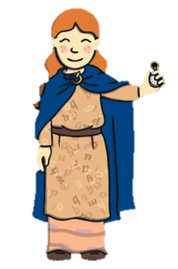
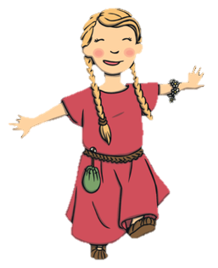

Slide 3
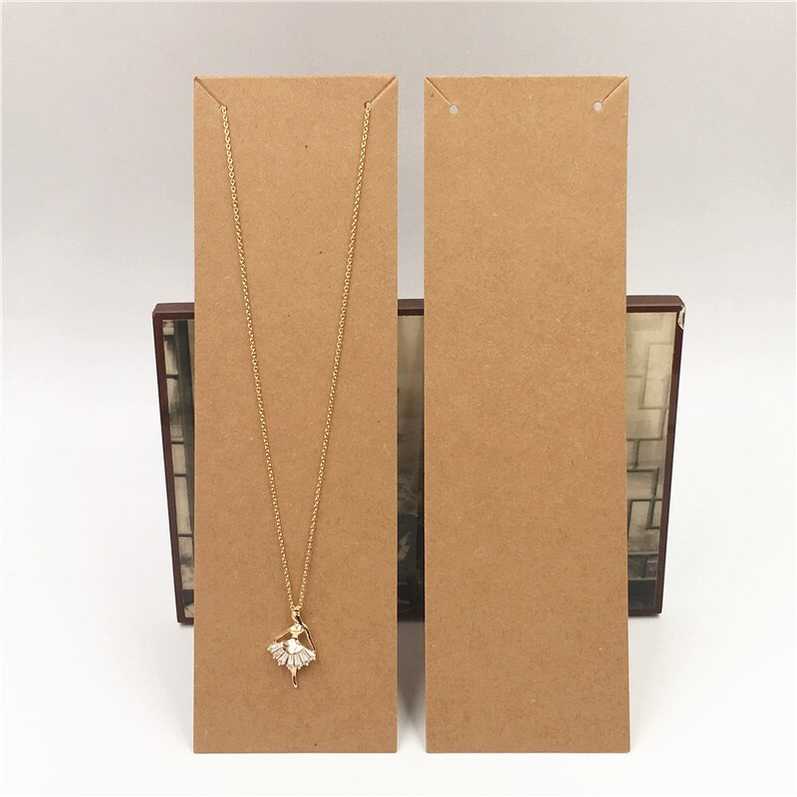
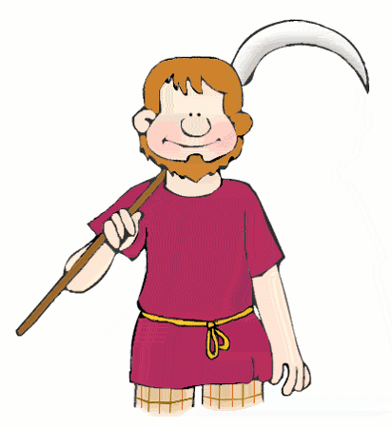
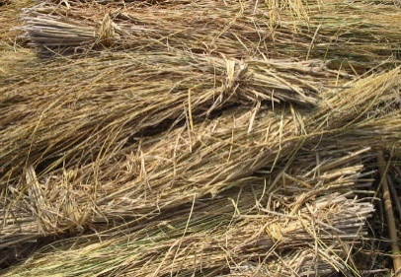
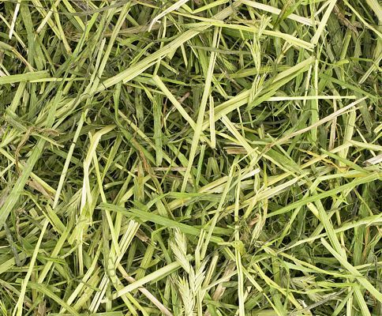
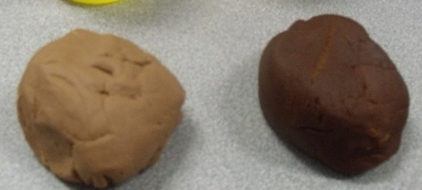
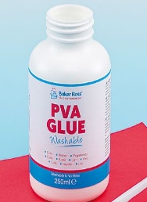
Have a go at making your own Celtic house.
You will need…
A long strip of card for the wall.
Some straw (if you have a pet) or you could use some dried grass. Remember the Celts used anything they could find.
Plasticine for the mud walls or you could you play doh.
Another large piece of card for the roof
Glue

Slide 4
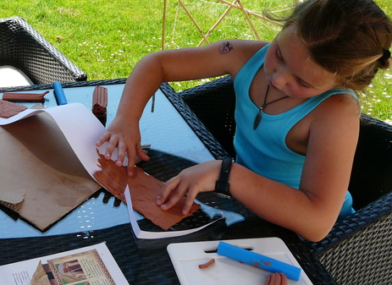
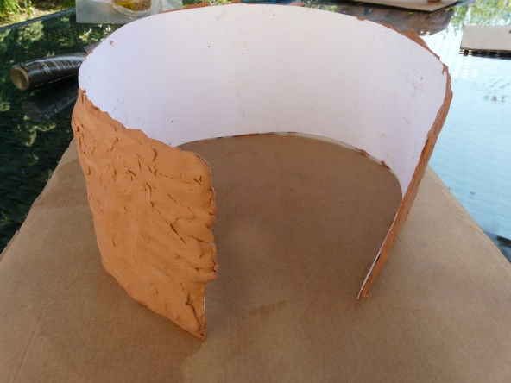
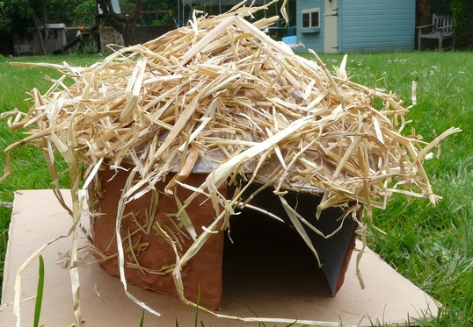
Instructions
1. Cover the long strip of cardboard (wall) with a thin layer of plasticine or play doh.
2. Press scraps of straw into the walls
3. Stand the wall up in a circle shape, leaving a gap for the doorway. You might want to use tape or glue to attach it to a base to help it stand up.
4. Cut out a cardboard circle for the roof. Make it into a cone shape that overhangs the walls.
5. Now for the messy bit! Cover the roof with straw or grass using glue to stick it on.

Slide 5



