Slide 1
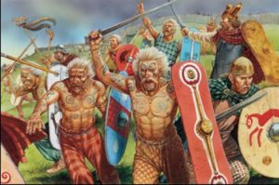
The Celtic People

Slide 2
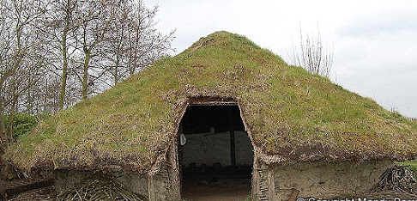
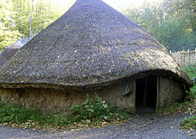
The Celtic people live in round houses. They had thatched roofs made from straw or heather. The walls were made from wood, straw and mud which could all be collected from the forests. There is a small opening for a door but how many windows can you see?

Slide 3
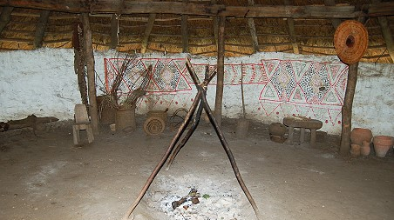
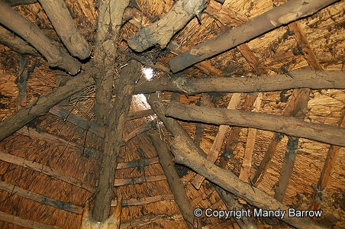
The Celts didn’t have any windows but they had a small hole in the roof to let the smoke out. They would light a fire in the middle of their round house for cooking and eating.

Slide 4
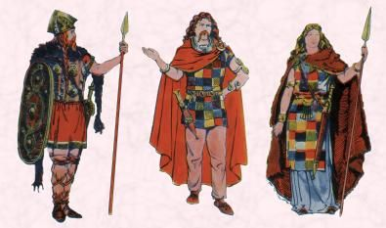
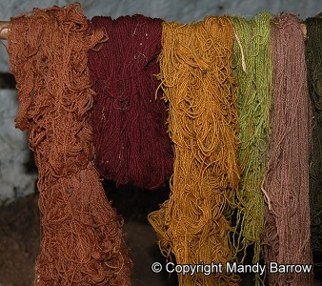
The celts loved bright colours so they would dye their trousers and tops lots of different colours. Their clothes were made from wool and they used vegetables and berries to dye their tunics and trousers.

Slide 5
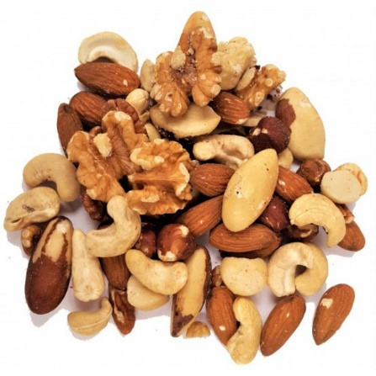
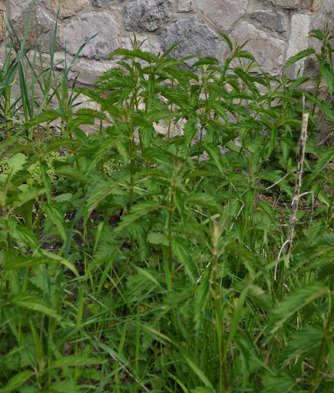
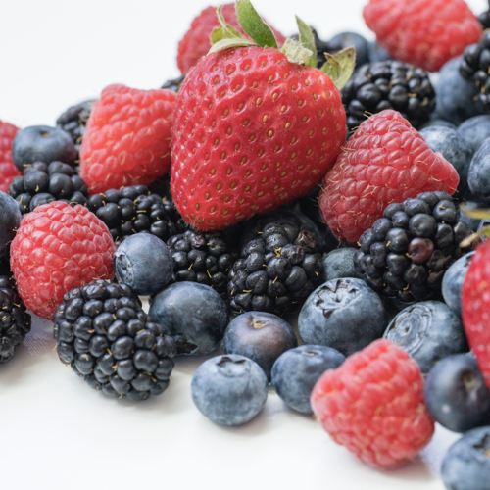
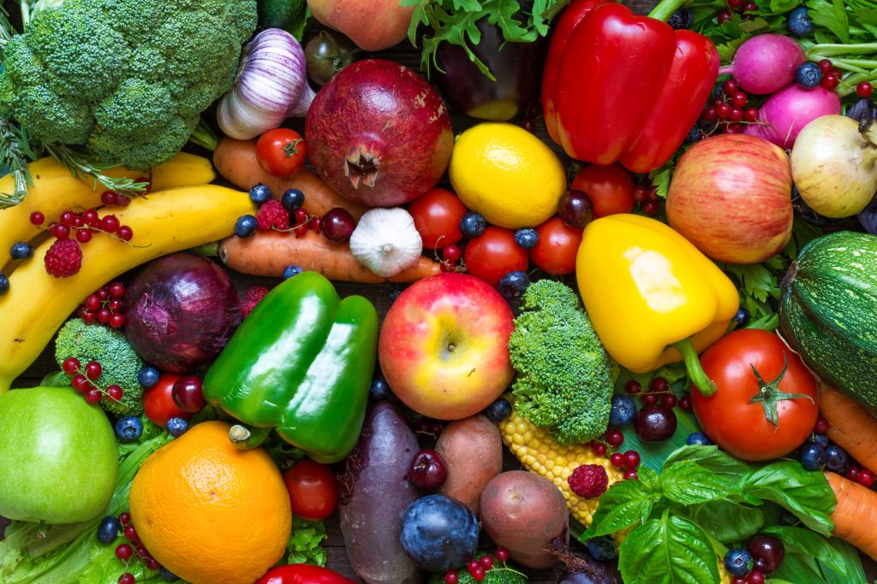
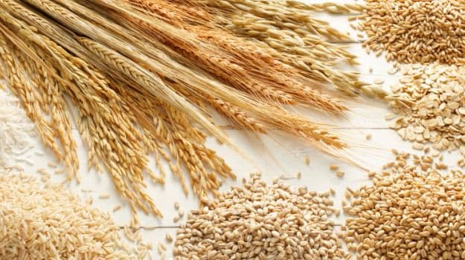
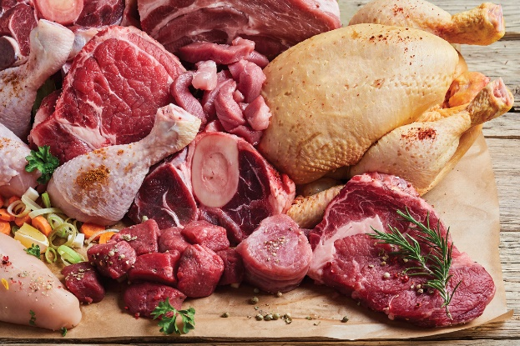
The were no shops or super markets when the Celts were alive so they had to eat what they could grow or hunt. What foods do you think they ate?
Berries
Nuts
Nettles
Meat from animals
Fruit and Vegetables
Grains to make bread and porridge

Slide 6
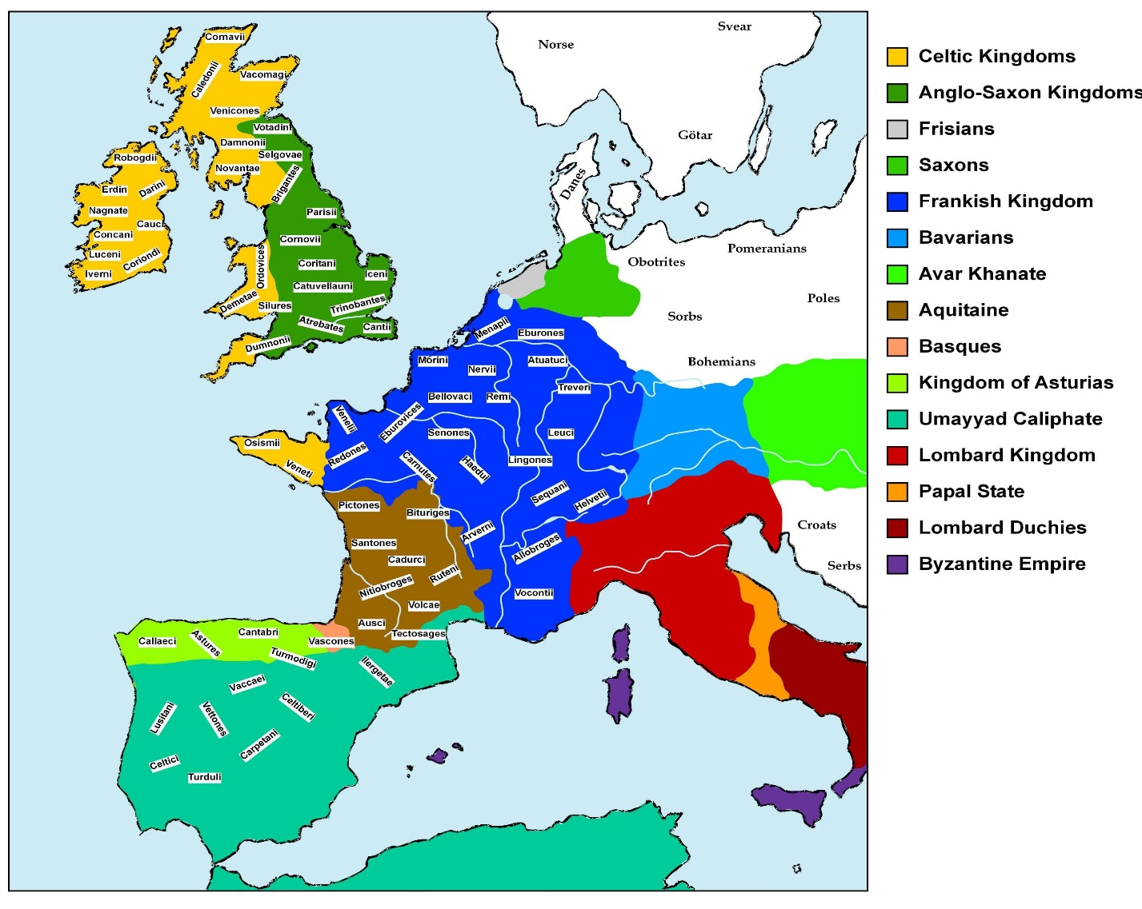
Below you can see the Celts lived all over Europe. There were many different tribes which they belonged to this would depend on where they lived.

Slide 7
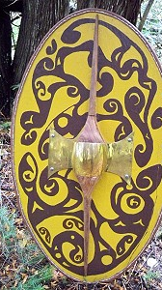
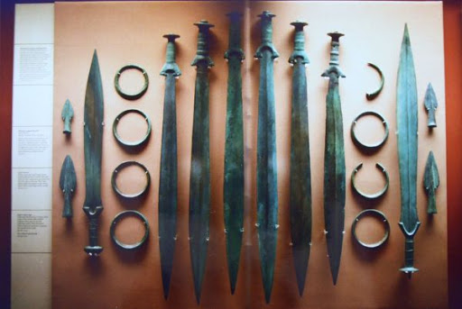
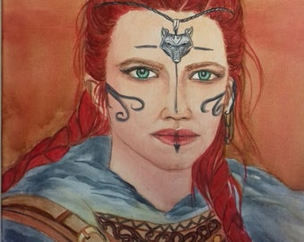
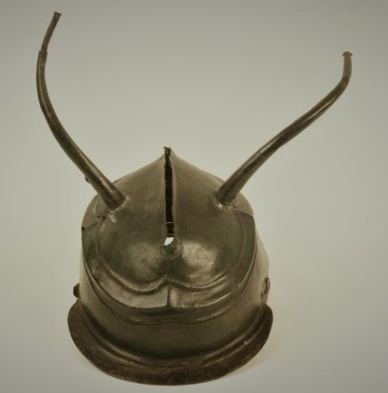
Weapons and Warriors
The Celts would battle the many different tribes. They were fierce, clever and brave.
They used daggers and long swords made of iron.
Some warriors liked to wear blue body paint.
Celtic warriors carried long or oval shape shields. They were made of oak.
This horn helmets made the Celts look taller!
Woman would also fight in battle along with the men.

Slide 8
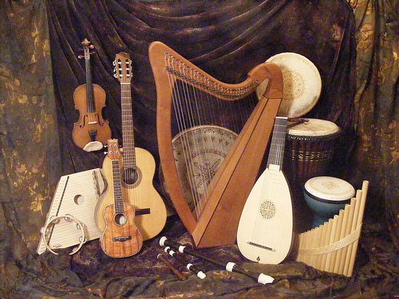
The Celts would make their own instruments, these were mostly made from wood. Celtic music is still very popular all over the world today especially in Scotland and Ireland! Here’s some Celtic music what instruments can you hear?

