Slide 1
Going skiing

Slide 2
Things we need:
trousers
jacket

Slide 3
gloves

Slide 4
goggles

Slide 5
safety helmet

Slide 6
ski boots

Slide 7
skis and poles

Slide 8
The weather
snowy

Slide 9
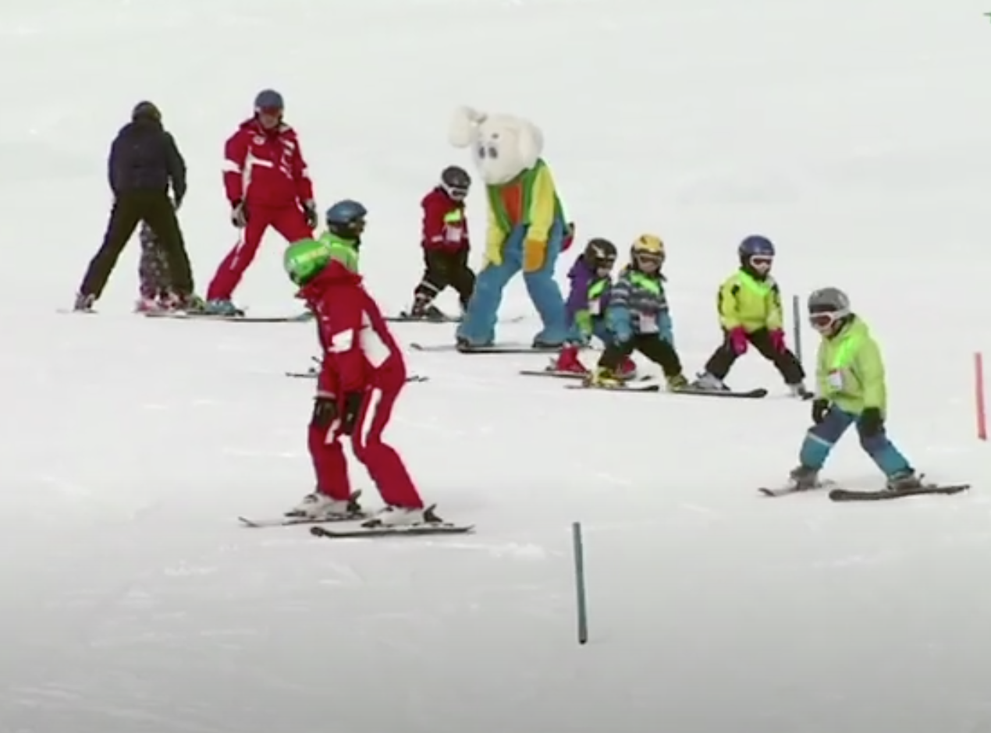
https://youtu.be/deVfk2Nwo-E
Click on the picture to watch these children skiing!

