Slide 1
Maths story
Numbers 1-5
Town

Slide 2

We’re going on a scavenger hunt
What will we find?

Slide 3

A cinema – how many cinemas did we find?
1

Slide 4
We’re going on a scavenger hunt
What will we find?

Slide 5


Cafés – how many cafés did we find?
2

Slide 6
We’re going on a scavenger hunt
What will we find?

Slide 7



Shops – how many shops did we find?
3

Slide 8
We’re going on a scavenger hunt
What will we find?

Slide 9
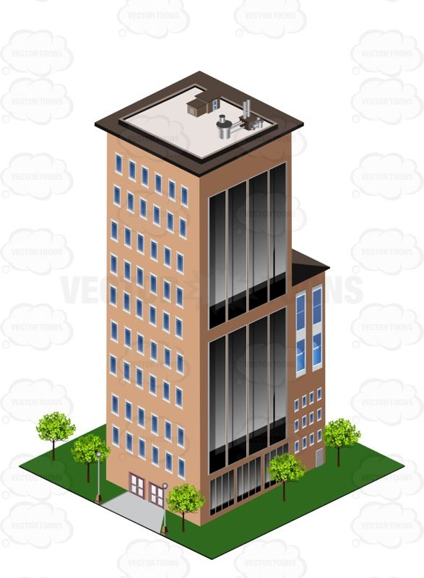



Tall buildings– how many tall buildings did we find?
4

Slide 10

We’re going on a scavenger hunt
What will we find?

Slide 11


Traffic lights– how many traffic lights did we find?
5

