Slide 1
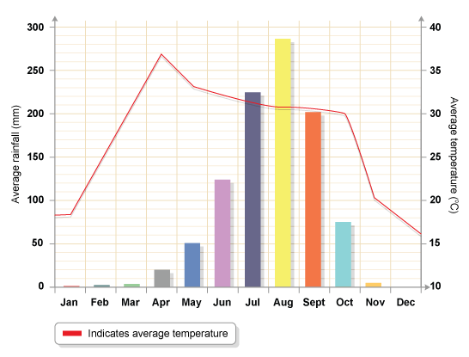
Climate Graphs
Below is a climate graph. A climate graph shows the amount of rainfall and the temperature of an area. The area we looking at is the African savanna.

Slide 2
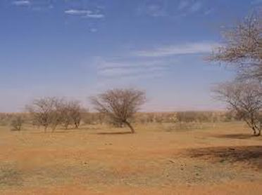
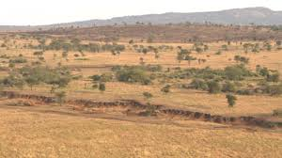
The dry season in the savanna is very long. There is very little rain during this time, only around 10cms and the temperature is actually a little cooler during this time.

Slide 3
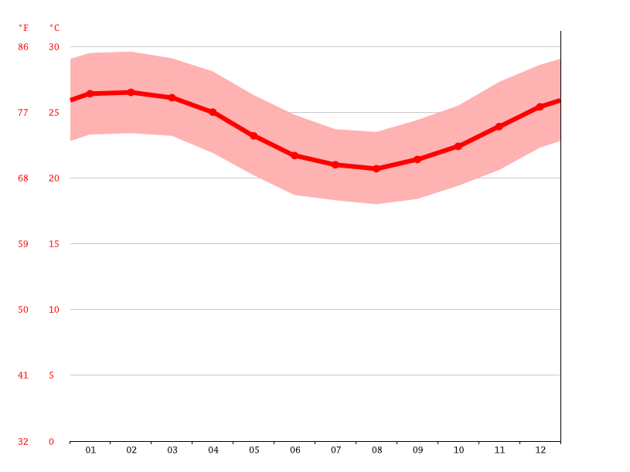
This graph shows us the temperature over a year.
Temperature
Month

Slide 4
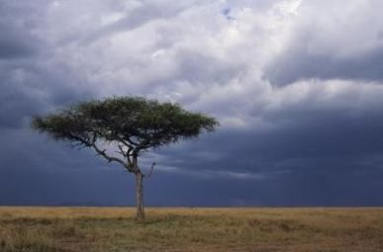
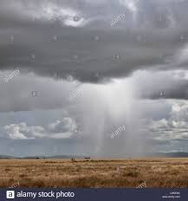
The wet season in the savannah is between May and November.

Slide 5
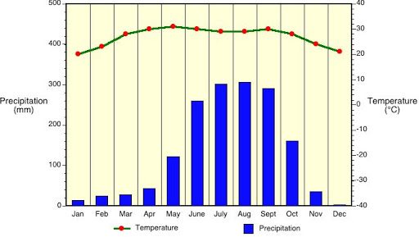
The graph below shows which months of the year have the most rainfall.

Slide 6
This climate graph shows the temperature and the rainfall together. We can then compare the months to see how the weather changed over the year.

