Slide 1
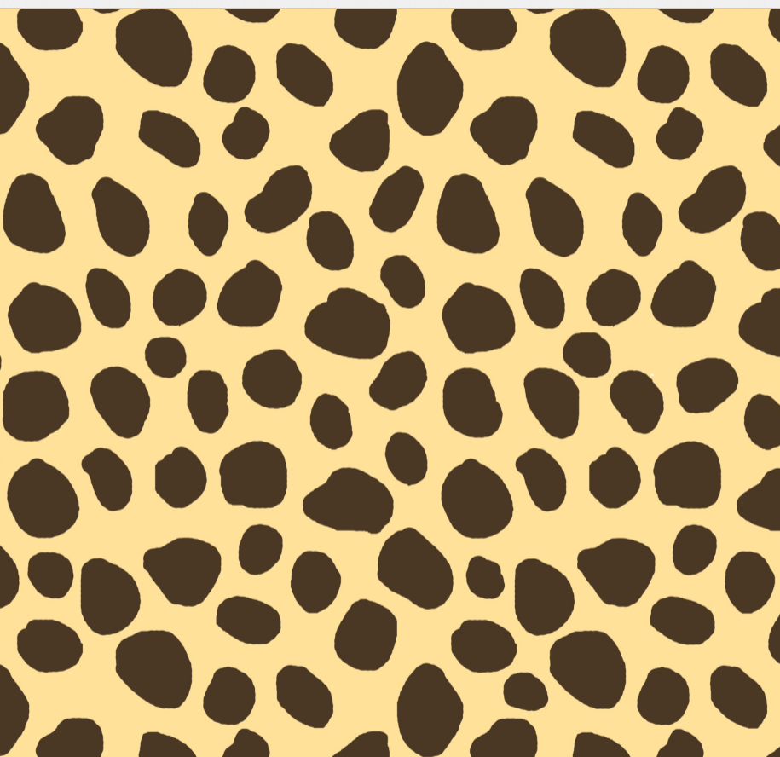
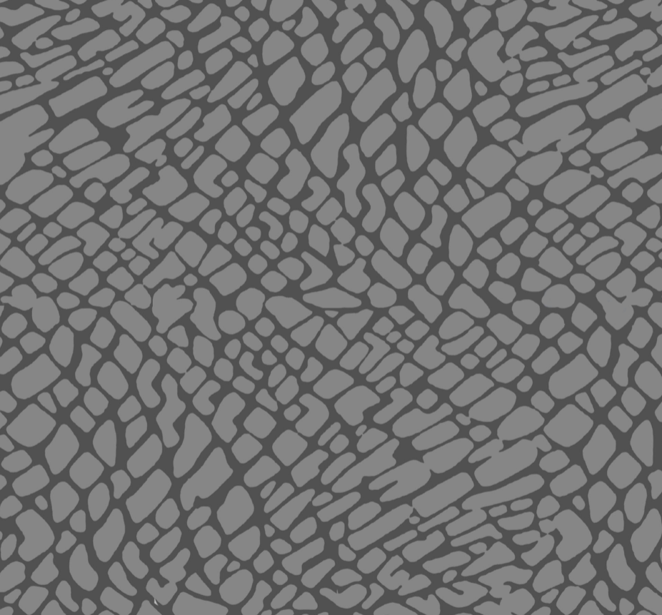
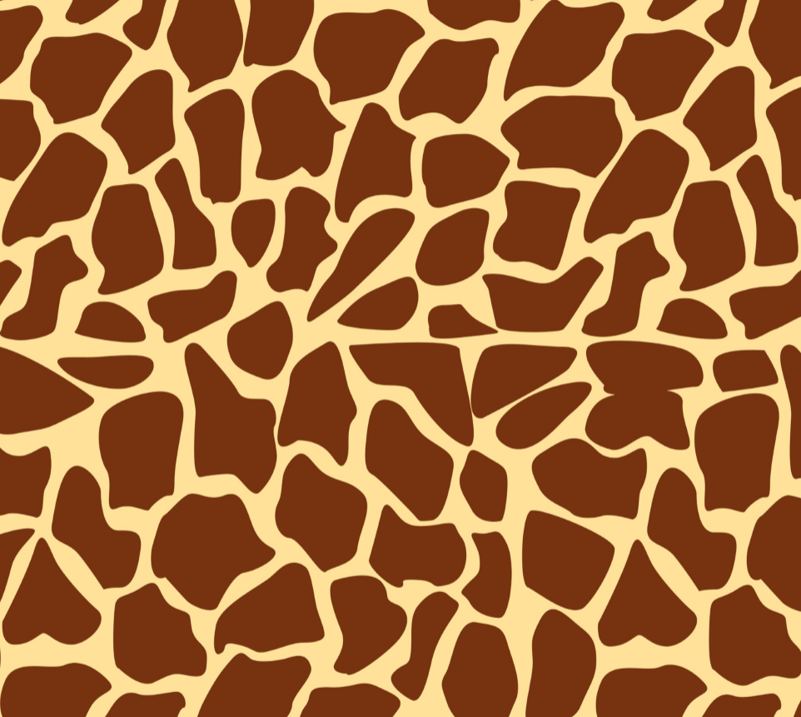

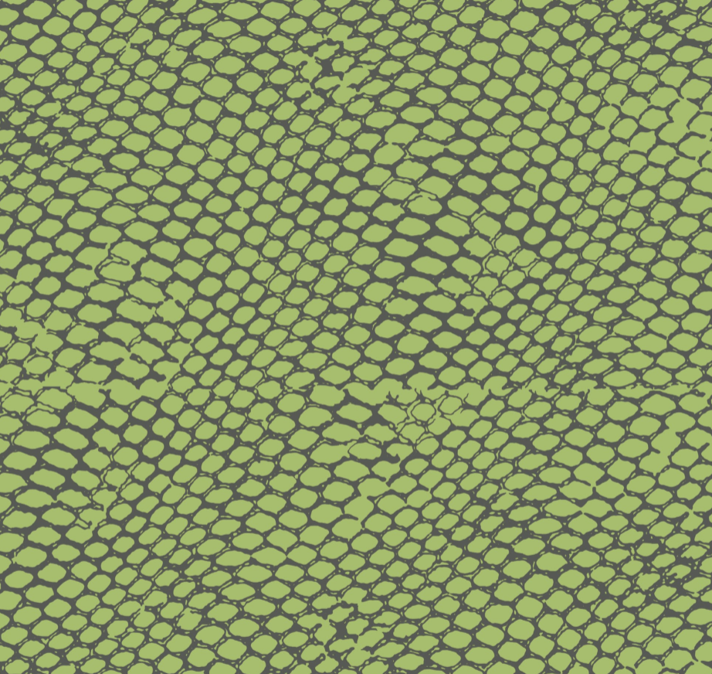
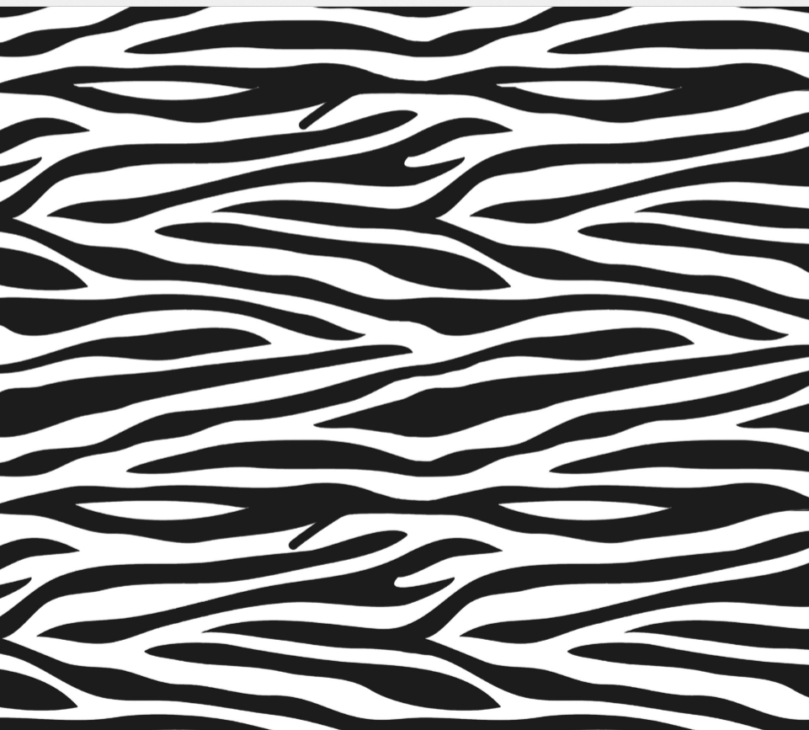
Savanna – Who’s skin?

Slide 2
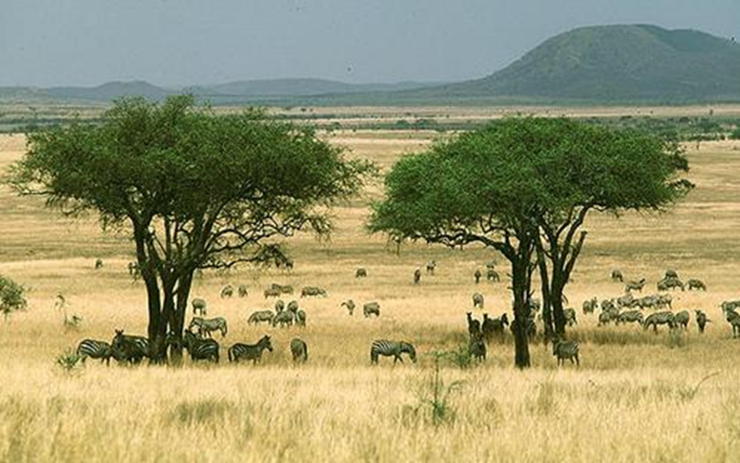
Savanna – Who’s skin?
Savanna animals are adapted to their environment. Look at their skin!

Slide 3
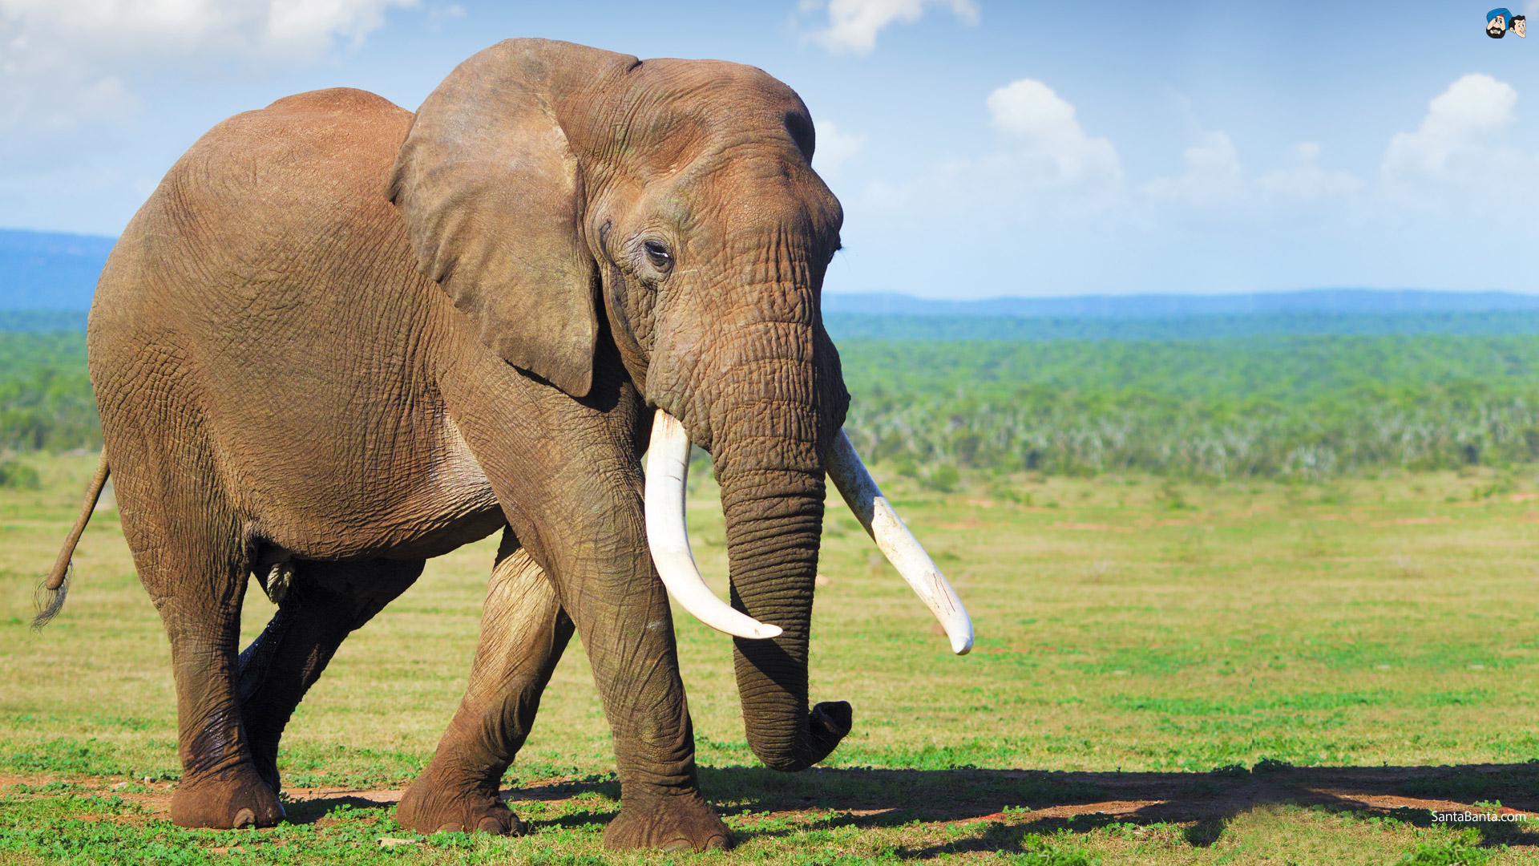
Elephant
Tough skin to protect them.

Slide 4
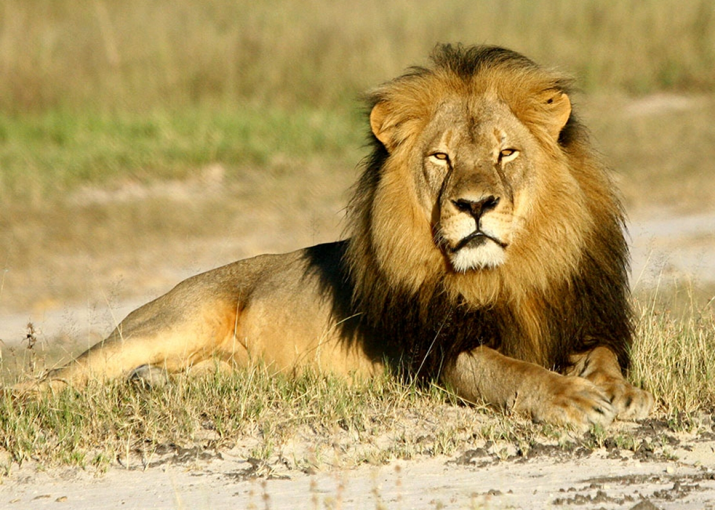
Lion
Yellow fur so they can hide in the grass and catch animals to eat.

Slide 5
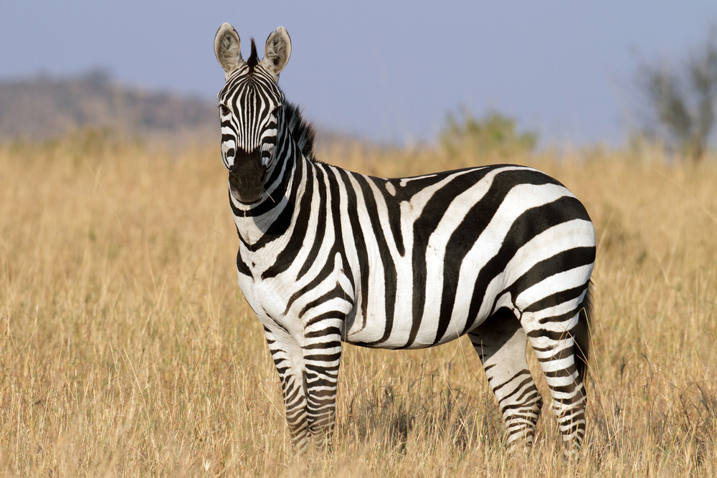
Zebra
Stripy skin so they can hide from predators.

Slide 6
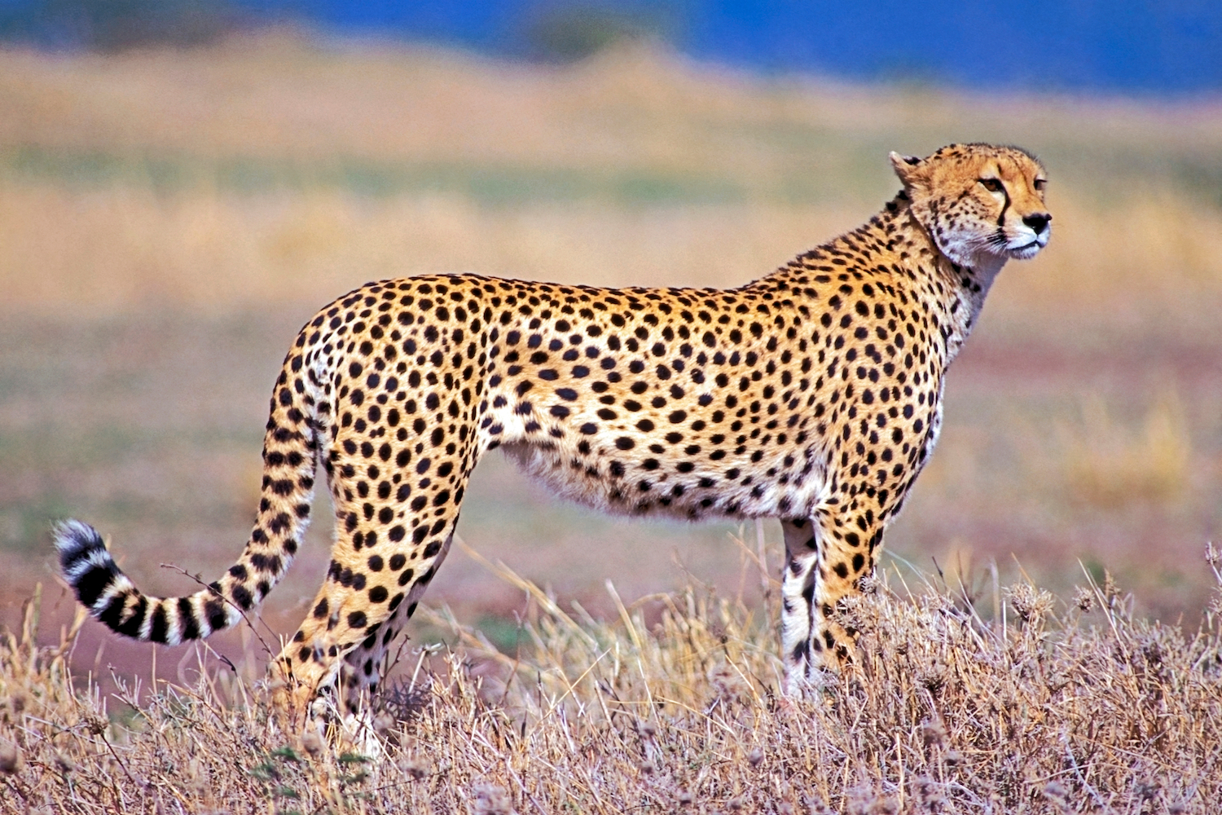
Cheetah
Spotty skin so they can hide in the grass and catch animals to eat.

Slide 7
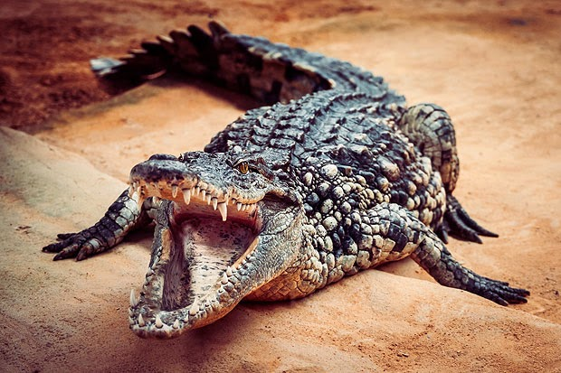
Crocodile
Tough skin to protect them.

Slide 8
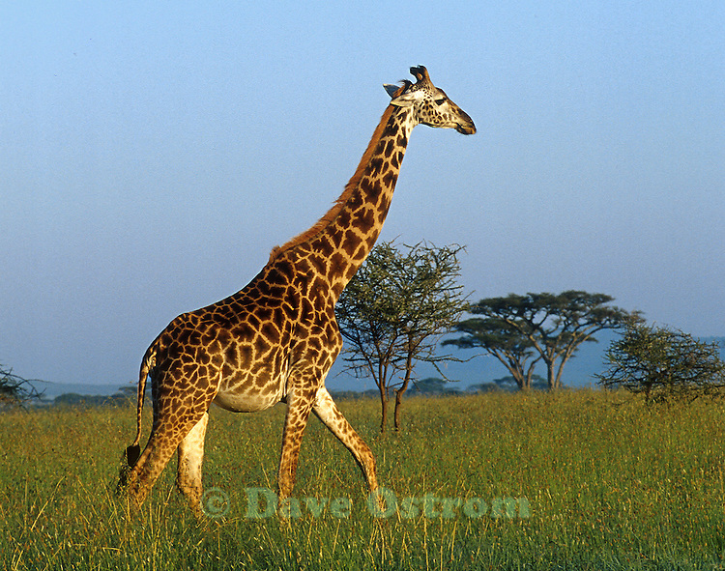
Giraffe
Patterned skin so they can hide from predators.

