Slide 1
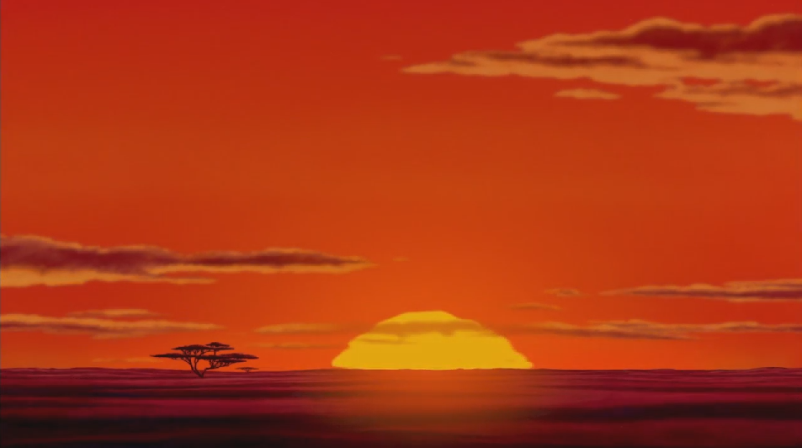

Slide 2


With help if needed to cut out the animals. Can make stick on background to make a picture.

Slide 3



Slide 4
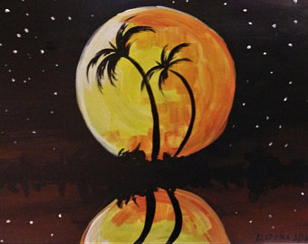
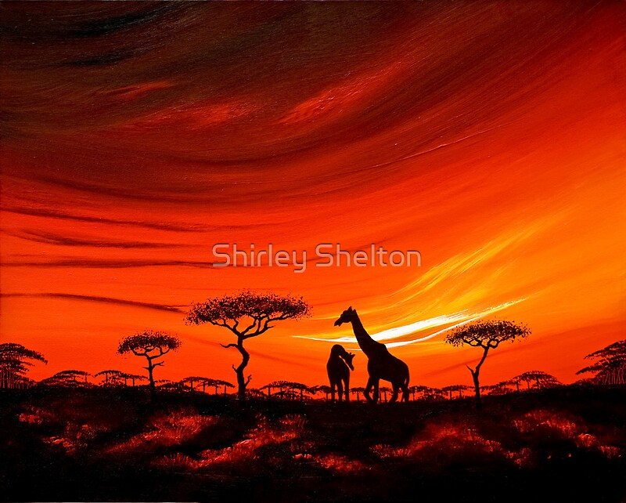

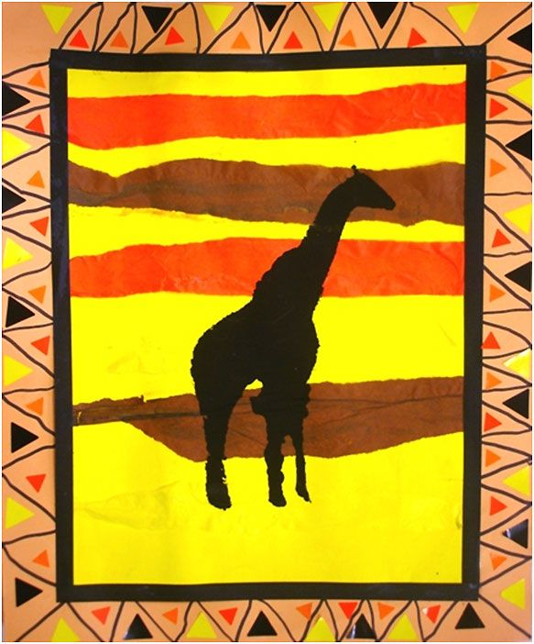
You can use the background on the first slide and stick on the animal silhouettes.
Or, if you have paints and want to get messy, you could pour strips of different colours on the paper or card and use brushes or hands to blend together. Or you could even tear different strips of coloured tissue paper to layer up and stick on.

