Slide 1
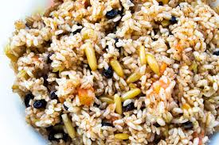
Savanna spiced rice
Ingredients
1 onion
1 clove or garlic
5 cardamom pods
1 whole cinnamon sticks
½ teaspoon ground cumin
1 teaspoon of black pepper
½ teaspoon ground cloves
2 cups of rice
1 cup of coconut milk
2 cups of vegetable stock
Method
Finely dice the onion and garlic and fry until golden.
Add the rice and spices to the pot, stir and cook for 1 minute.
Add the coconut milk and vegetable stock and bring to a boil.
After 5 minutes, reduce the heat to low, cover firmly with a lid and allow the rice to cook for 15 minutes.

