Slide 1
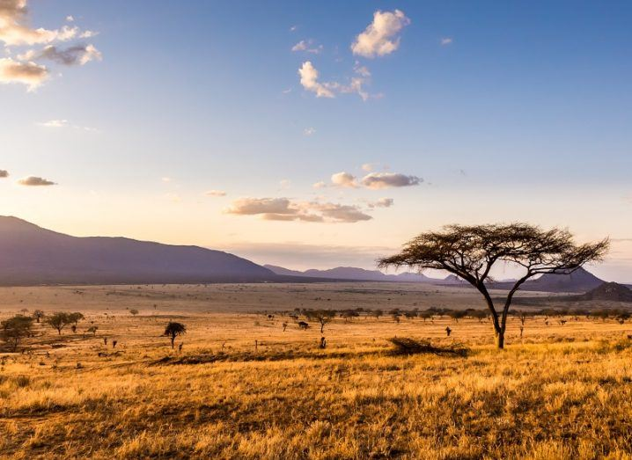
The African Savanna
A savanna is a large stretch of grassland with few trees. It is home to many animals who have adapted to live here. Lets take a look…

Slide 2
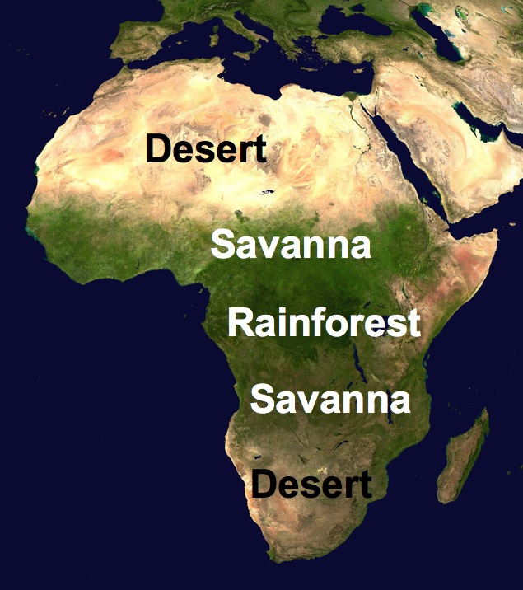
A savanna is found between the desert and the rainforest. The largest savanna is located in Africa. Nearly half of Africa is covered with savanna grasslands.

Slide 3
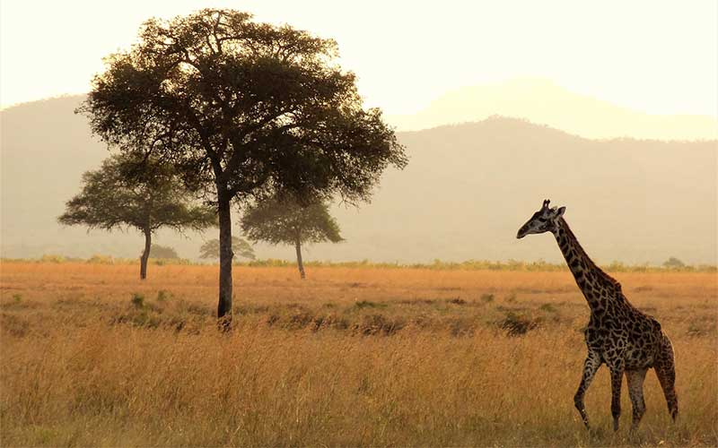
Lots of animals live in the savanna. Can you guess what is hiding here? This animal can reach high into the trees for their food…

Slide 4
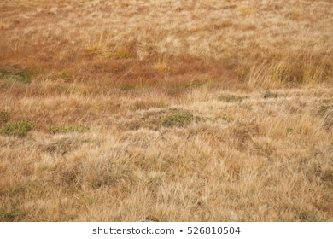
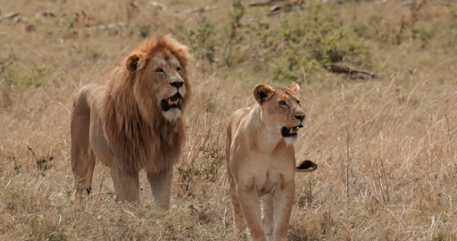
These animals hide low in the grass looking to catch prey, their tan colour helps them to blend in with the grassland. They are carnivores which means they eat meat. Can you guess?

Slide 5
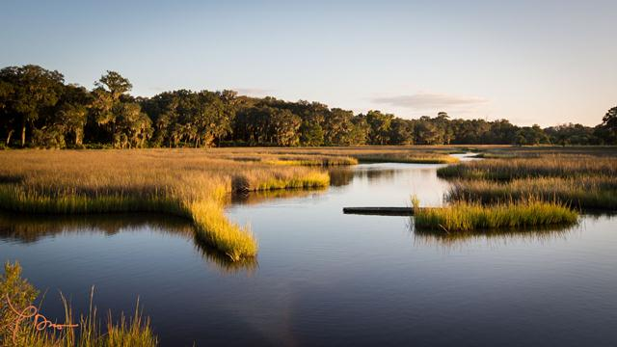
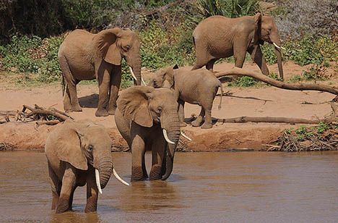
The animal hiding here is very big, they are herbivores which means they eat plants, grass, tree bark, twigs, roots and fruit. Can you guess? Here is a clue - their large ears help them to keep cool in the hot sun…

Slide 6
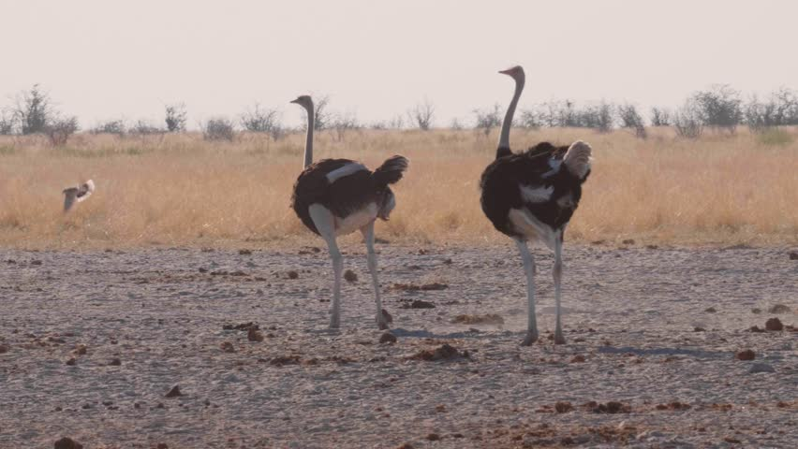
The Afican savanna has two main seasons. During the dry season it gets very hot and there will be no rain for many months. Look at the ostriches long legs! This helps them to keep cool as they are further away from the grounds heat.
Do you know the other season?

Slide 7
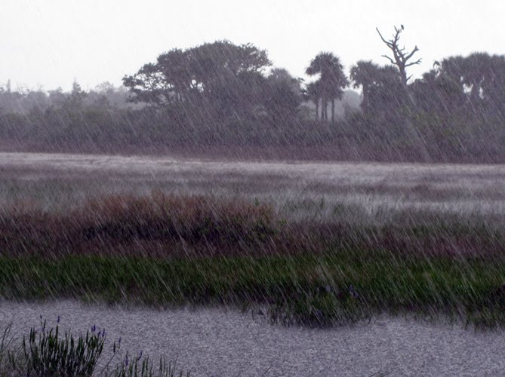
It is the wet season. The rain allows the rivers and lakes to fill up again so there will be plenty of water for the animals to drink. The animals will return to graze on the plants and grass that has grown again from the rain fall.

Slide 8
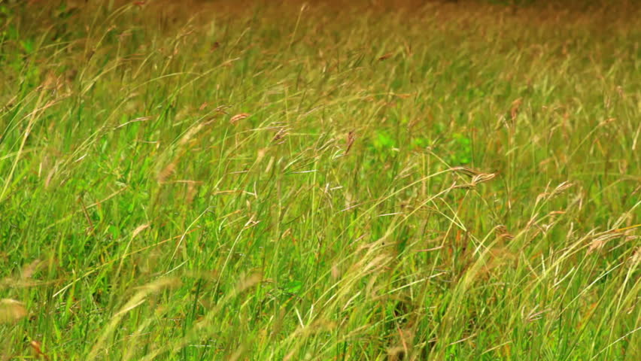
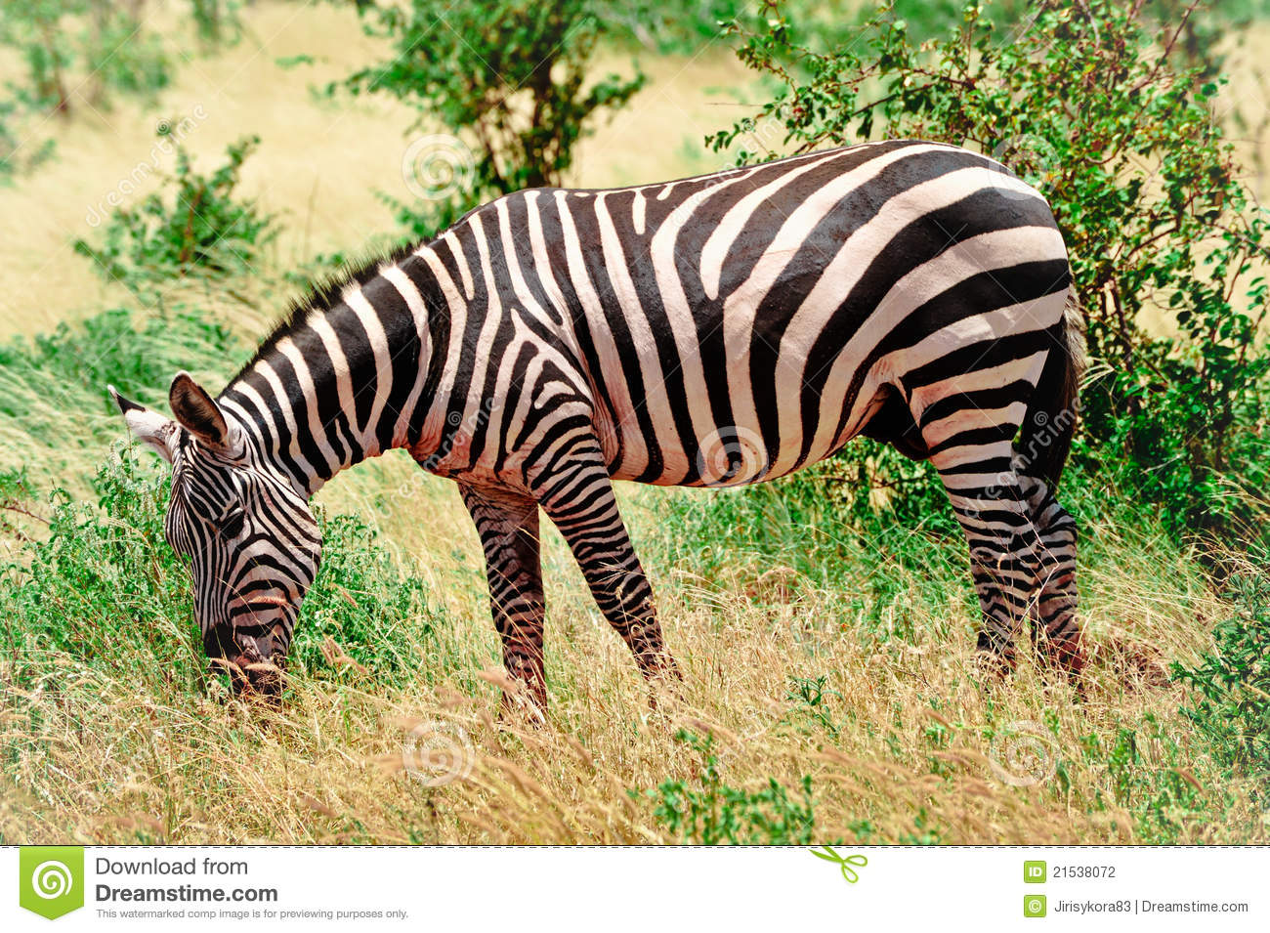
With powerful legs for running away from predators and stripes to camouflage, this animal has strong teeth adapted for a grassy diet. Do you know which animal is behind the grass?

Slide 9
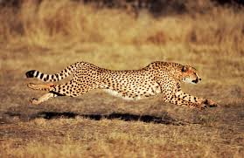
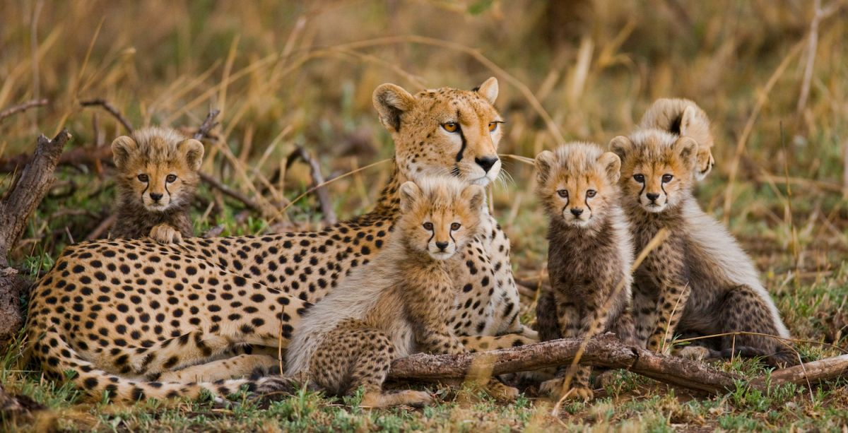
Look at the colours of this cheetah, its fur is golden yellow and pale orange. Its looks the same colour as the grassland behind it. This helps the cheetah to hide and sneak up on their prey. Its body is long and slim and can run up to 70 miles per hour! With muscular legs as well the cheetah is the fastest animal on earth!
Take a look at these baby cheetah cubs, they have a mane on their backs helping them to blend in with the tall grass in the savanna.

Slide 10
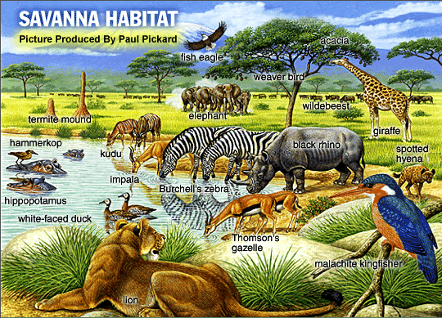
We have seen some of the animals that live in the African Savanna but there are many more. Why don’t you research some others, see what type of food they eat, what noise they make and how they have adapted to live in their habitat.

