Slide 1
MATHS
In and on

Slide 2
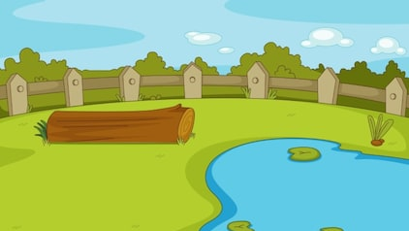
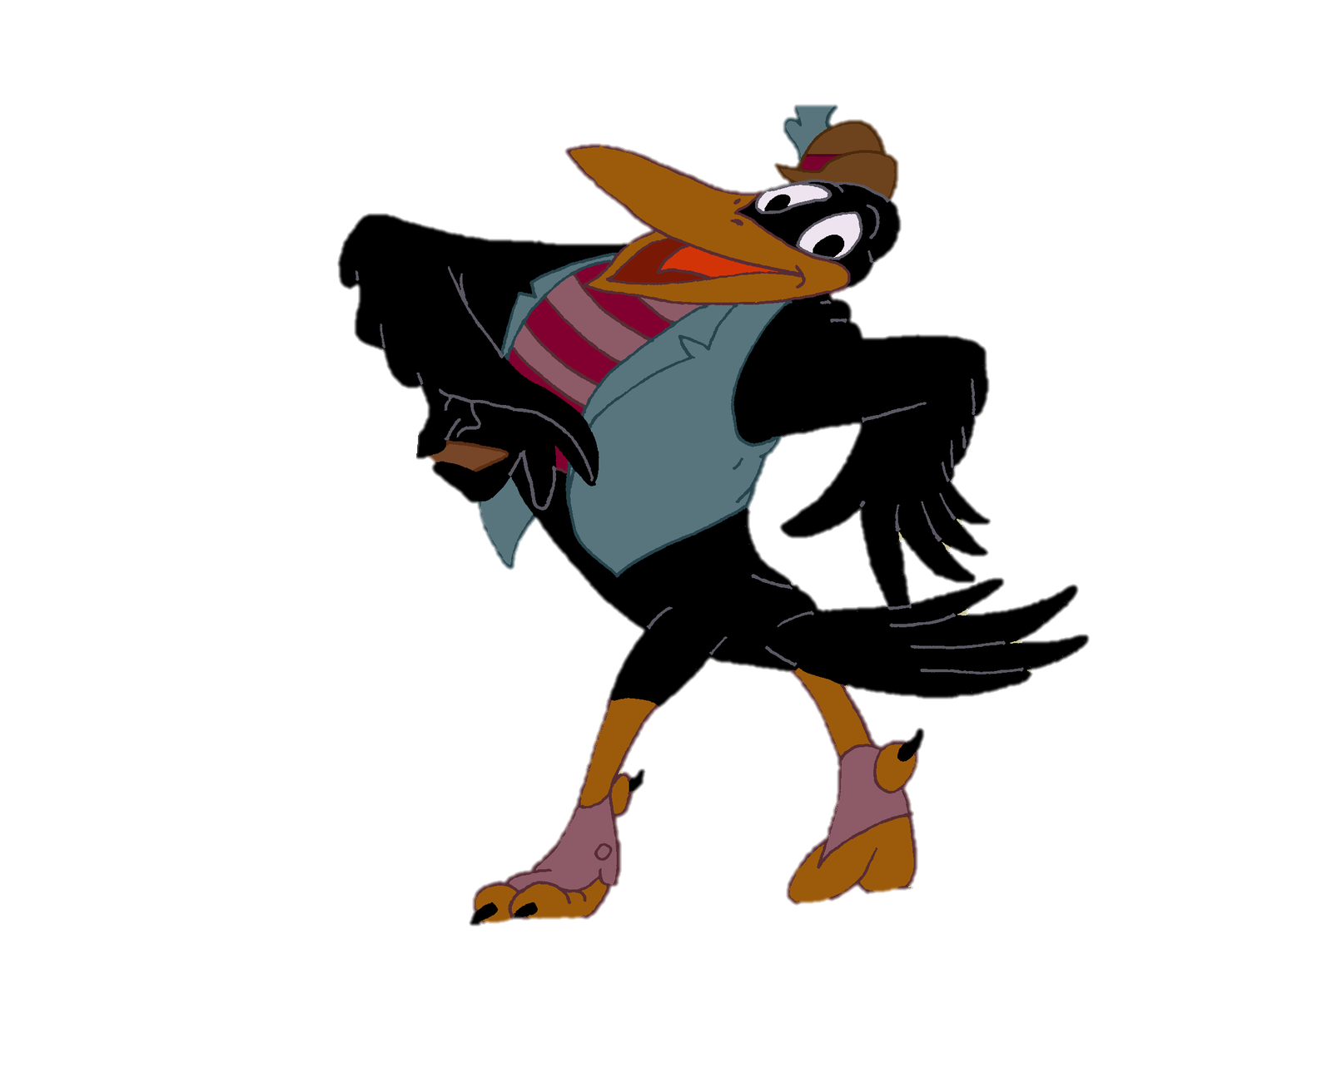
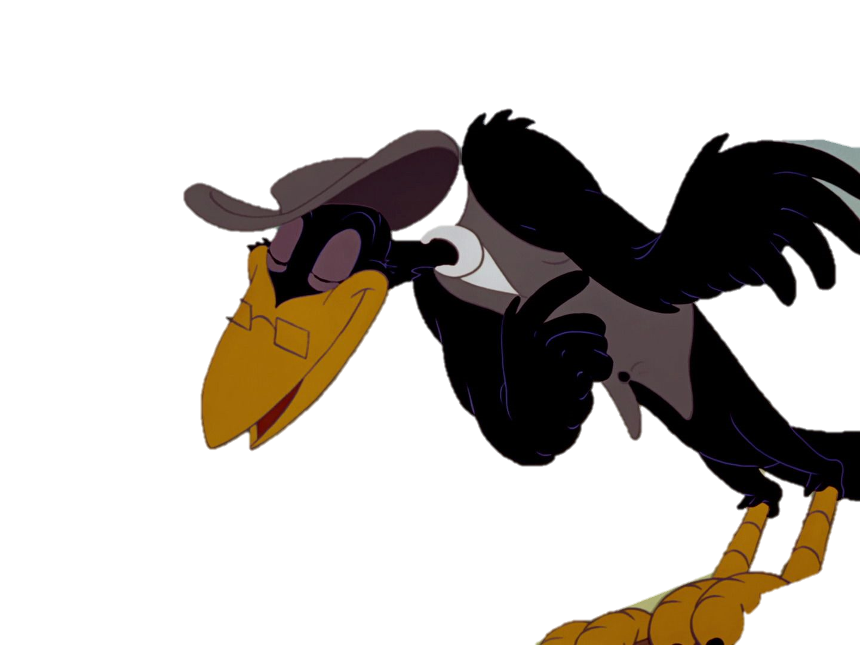
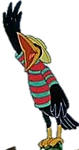
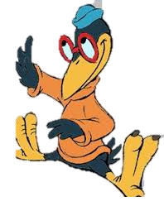
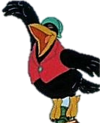
Counting together can you see how many birds are sitting on the fence?

Slide 3

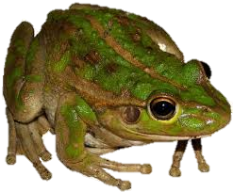
Can you count how many are on the log?
Can you count how many are in the pond?
How many more frogs are in the pond than on the log?
How many frogs altogether?

Slide 4
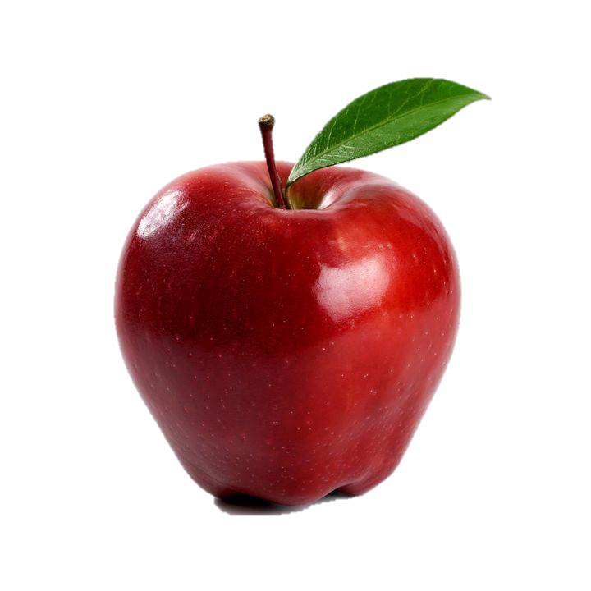
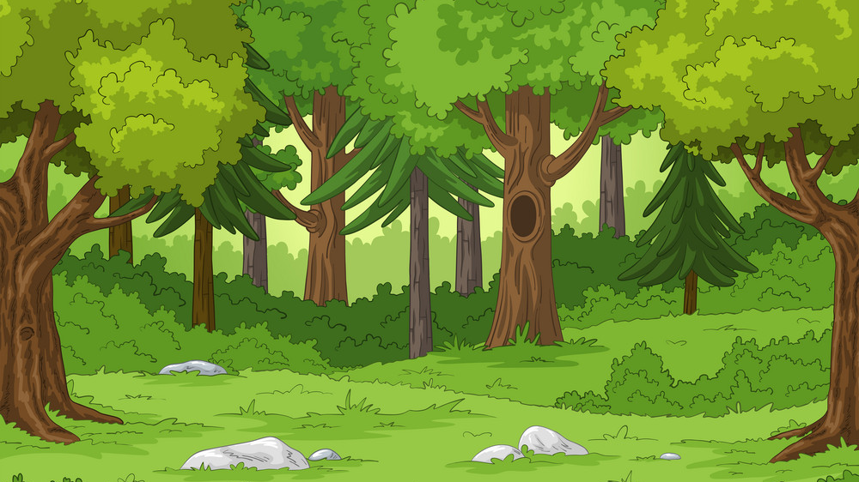
Can you count how many apples are in the tree?
Can you count how many apples are on the ground?
How many altogether?

