Slide 1

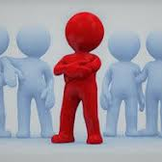
Differences

Slide 2
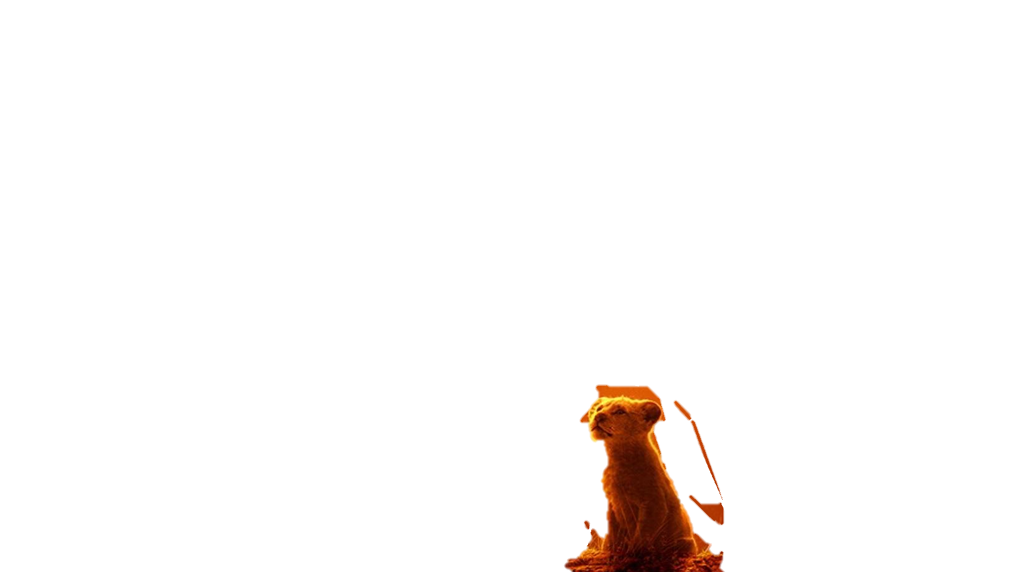
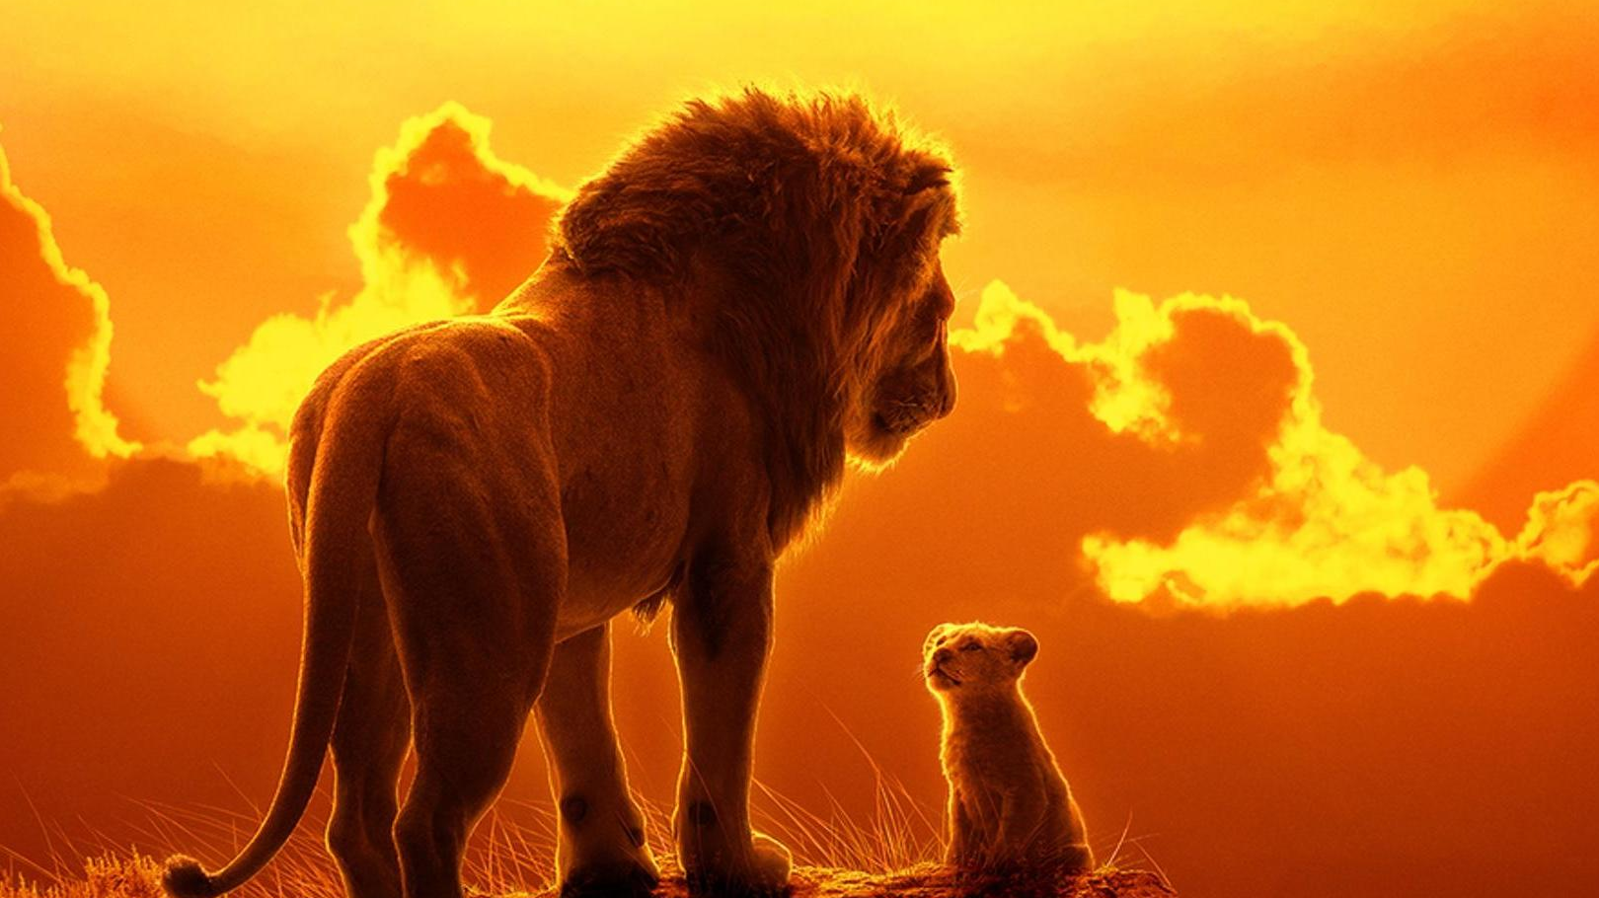
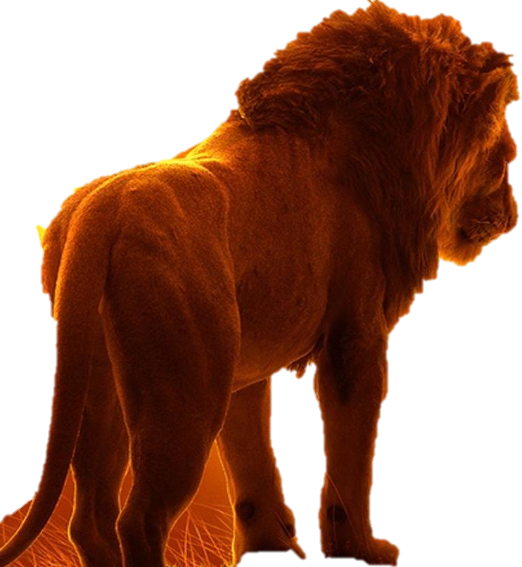
A lion is big.
A lion cub is small.

Slide 3
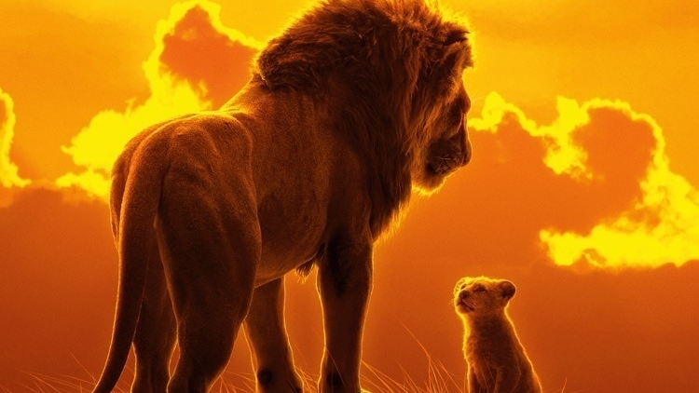
Look at your family are some bigger or smaller than you?

Slide 4
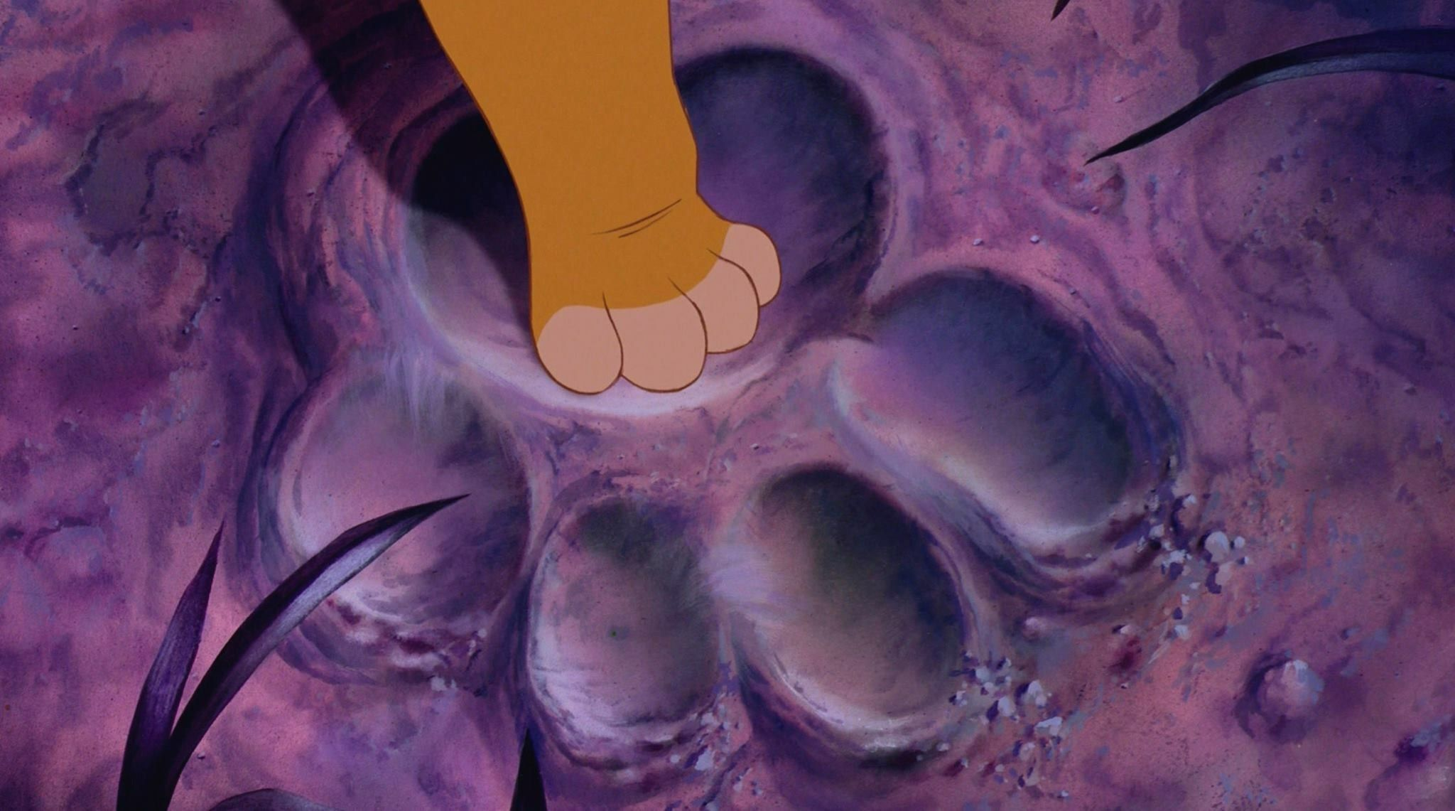
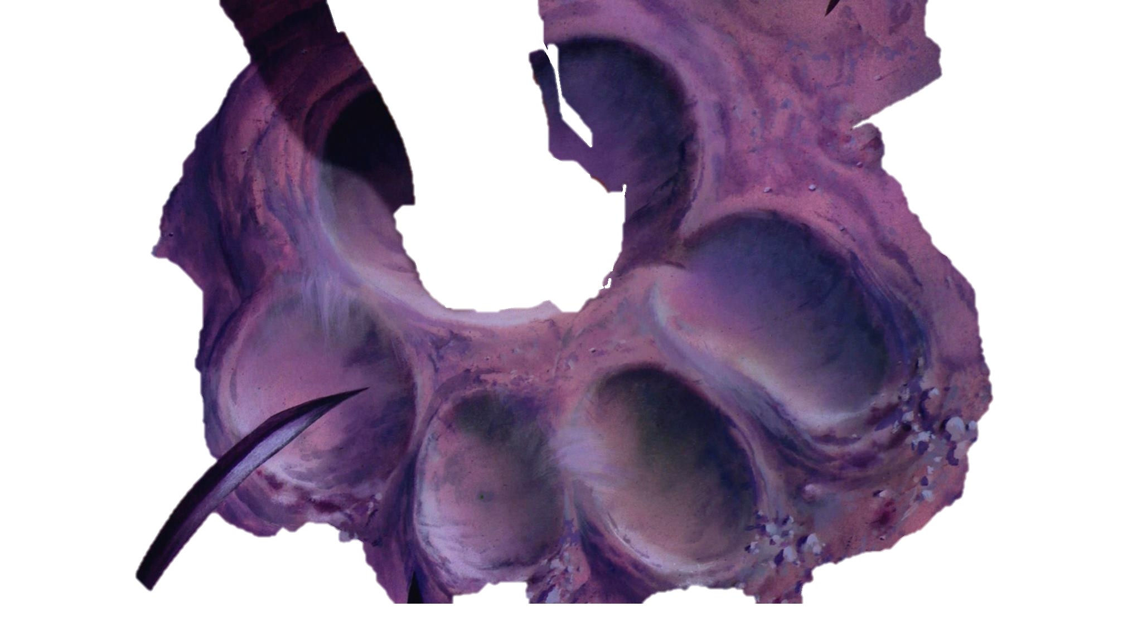
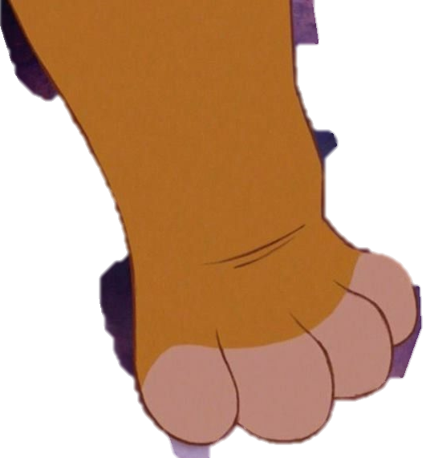
A lion cubs footprint is small.
A lions footprint is big.

Slide 5
Can you and your family draw around your hands or feet and see the size difference?

Slide 6
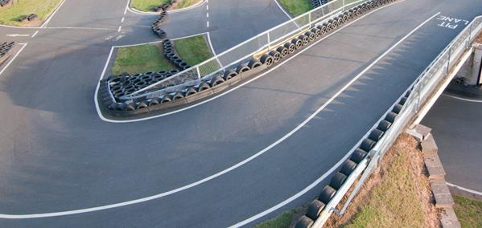
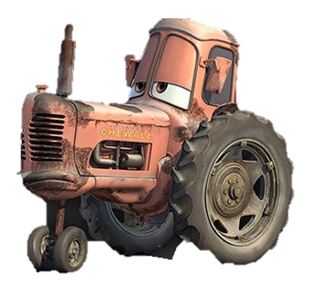
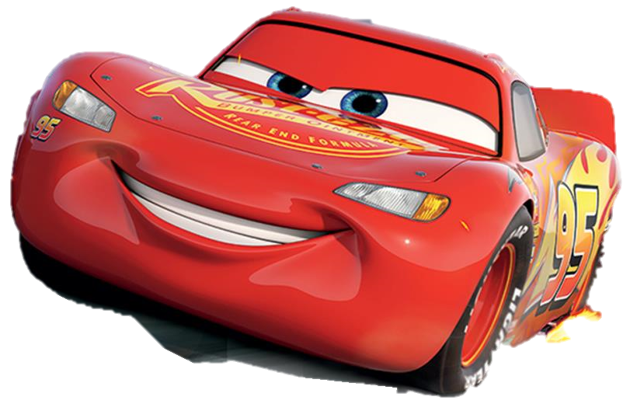
A tractor is slow.
A race car is fast.

Slide 7
Could you race against someone?

Slide 8
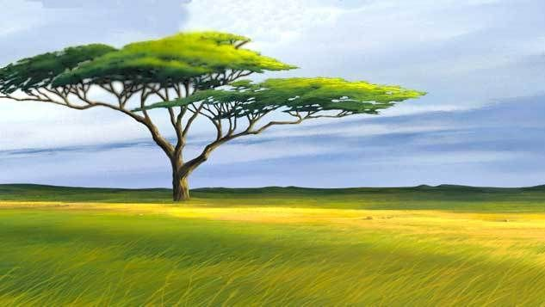
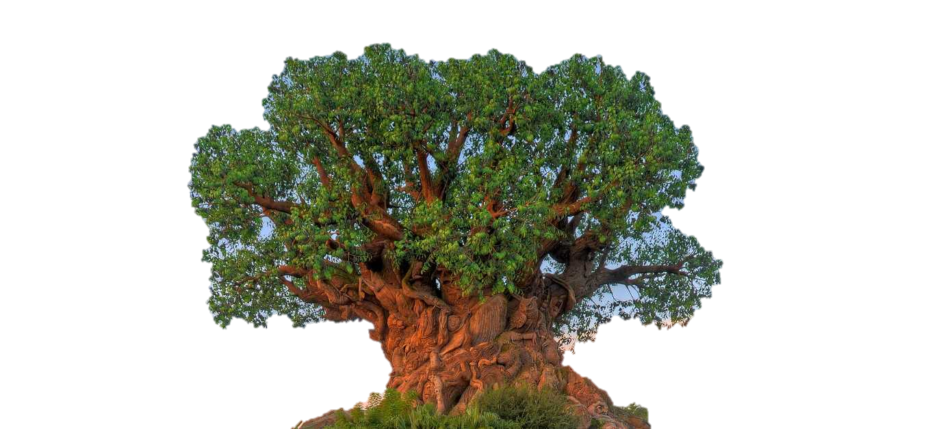
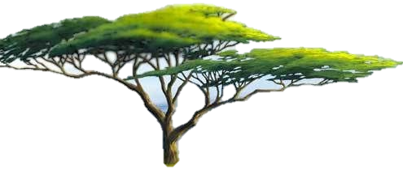
Tree trunks are thin.
Tree trunks are wide.

Slide 9
When out walking or in your garden look at the different sizes of the tree trunks.

Slide 10
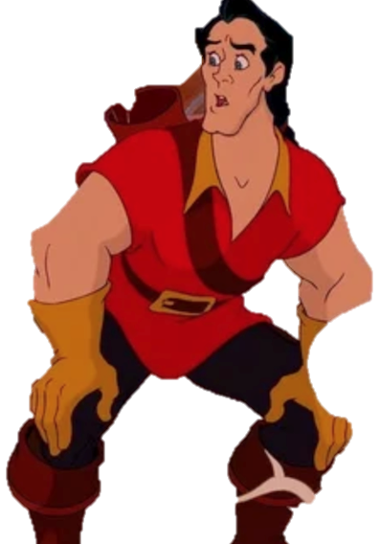
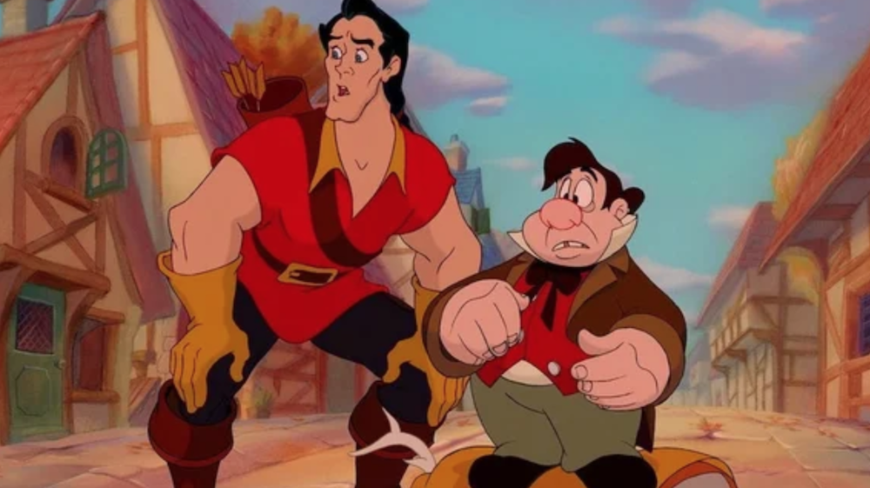
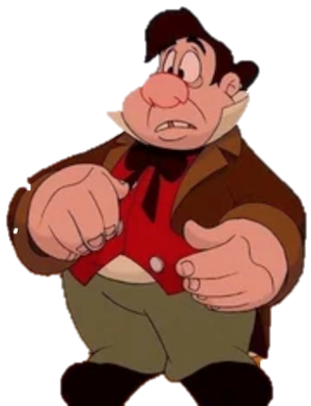
Some people are tall.
Some people are short.

Slide 11
You could measure your height and compare with your family.

Slide 12
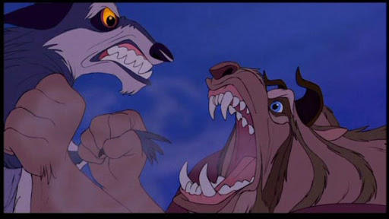
Some animals make loud noises.

Slide 13
Can you make a loud noise?

Slide 14
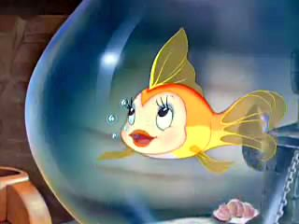

Some animals are quiet.

Slide 15
Can you play the quiet game with your family?
Who can stay the quietest the longest?

