Slide 1






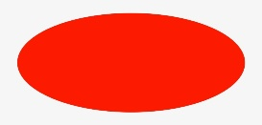
Shapes big and small

Slide 2





Circle
Have a look at these circles, are they BIG or small?
How many circles can you see?
How many sides can you count on each circle?

Slide 3
What shape is this? Look in your PODD book see if you can find it.
Look at the triangles below how many are big and how many are small?
Can you count the number of sides?

Slide 4
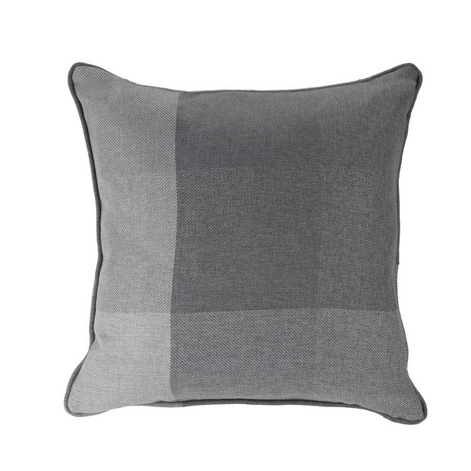
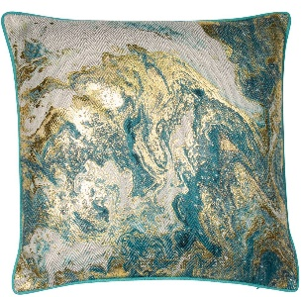
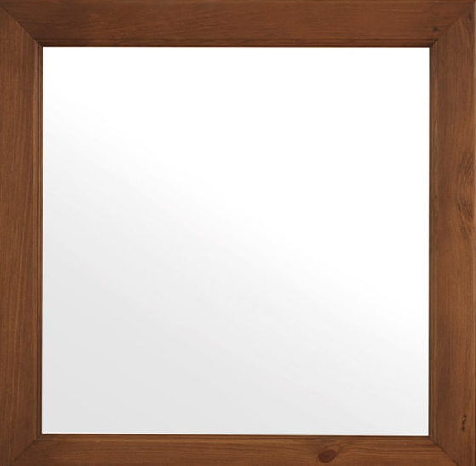
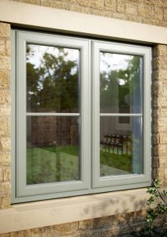
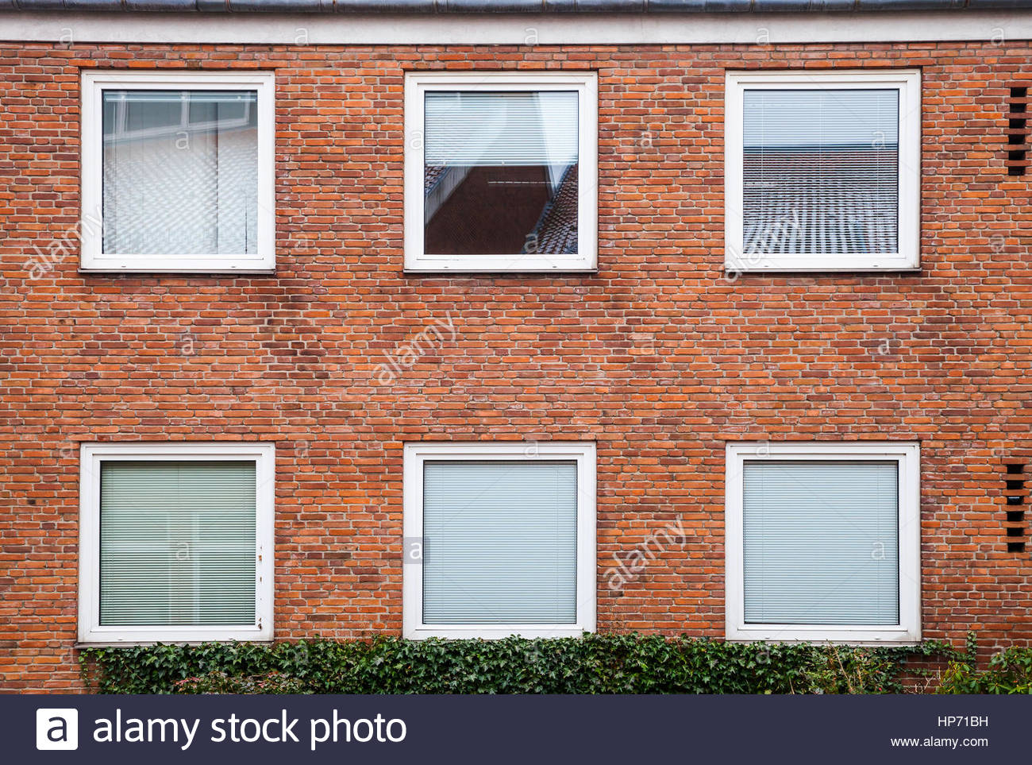
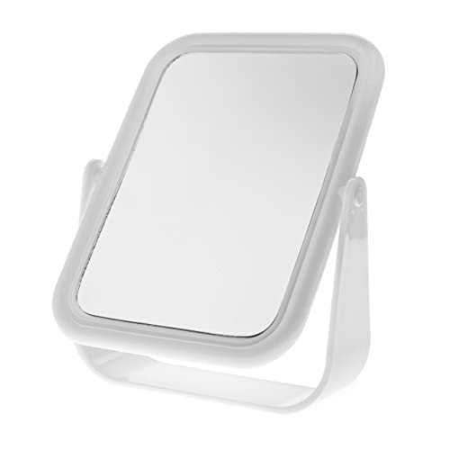
This is a square, how many sides does this shape have?
Take a look around your home can you find things that are a square shape?
Small cushion
Big cushion
Big square windows
Small square window
Small mirror
Big mirror

Slide 5
Rectangles
Can you match these rectangles up?

Slide 6



Ovals
Can you put these ovals in order starting with the smallest first?

Slide 7



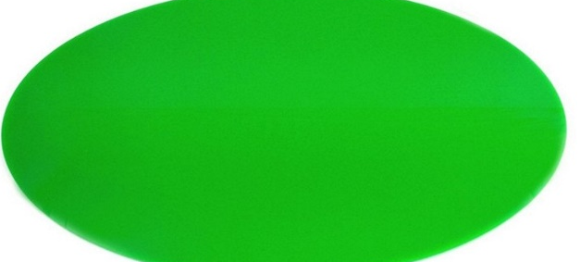




What can we do with shapes?
Shapes are all different colours and sizes and they are all around us. You could try making a picture using different shapes.
Can you guess what this will be? Look at the different shapes.

