Slide 1
Big and small

Slide 2
big
small

Slide 3
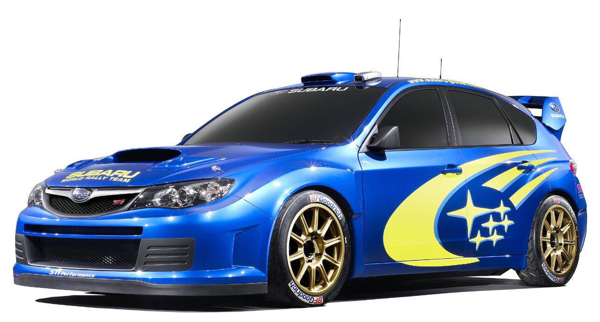

Big
car
Small car

Slide 4
I see a big car.

Slide 5
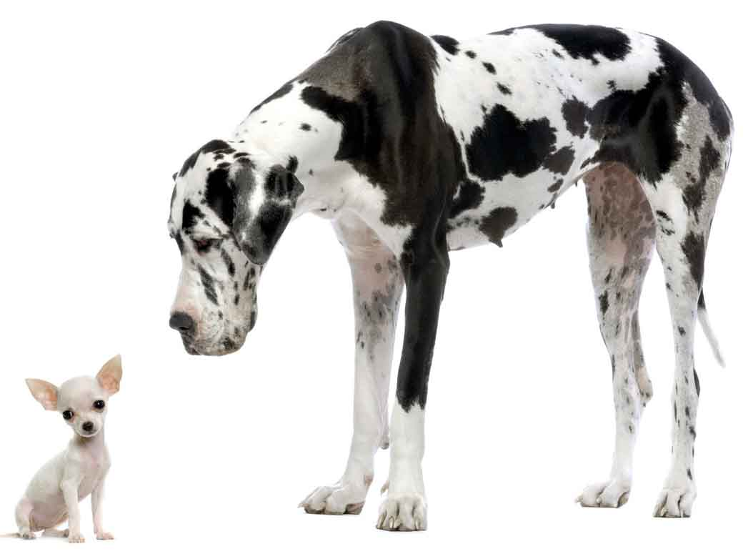
Little dog
Big dog

Slide 6
I see a big dog.

Slide 7
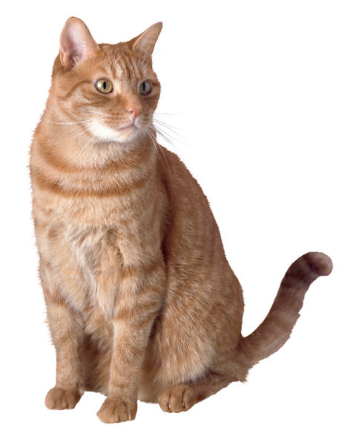
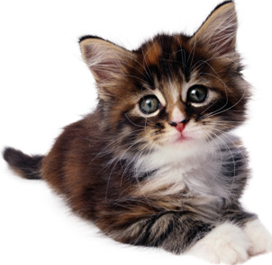
Big cat
Small cat

Slide 8
I see a big cat.

Slide 9
How many big things can you see?

