Slide 1
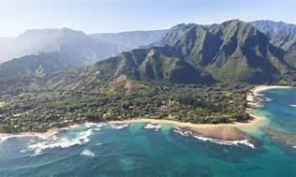
Land and sea plants

Slide 2
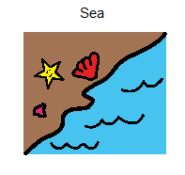
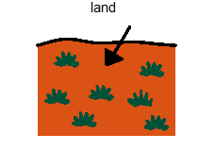
Where do you find this plant?

Slide 3
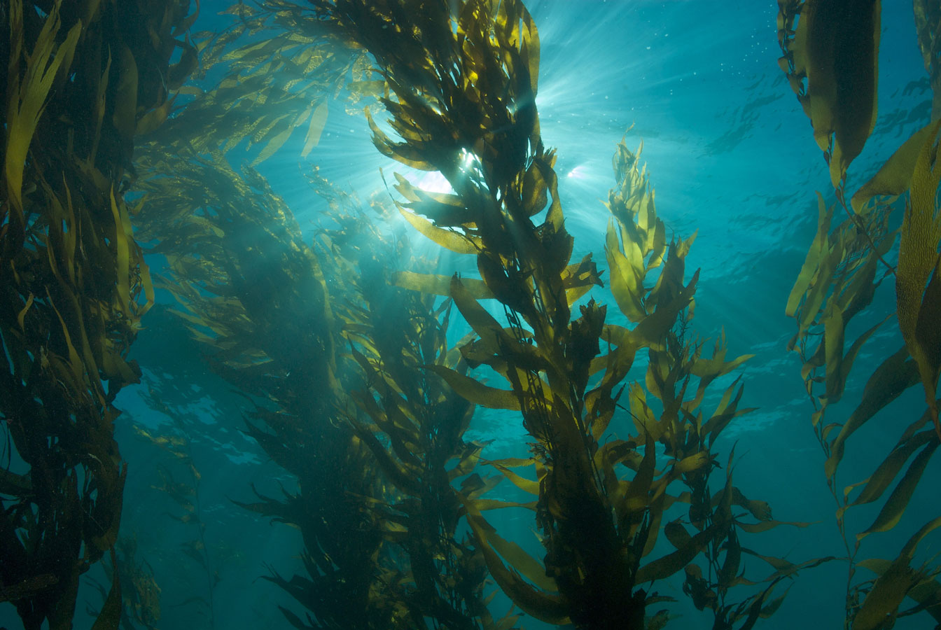

Seaweed

Slide 4
Where do you find this plant?

Slide 5
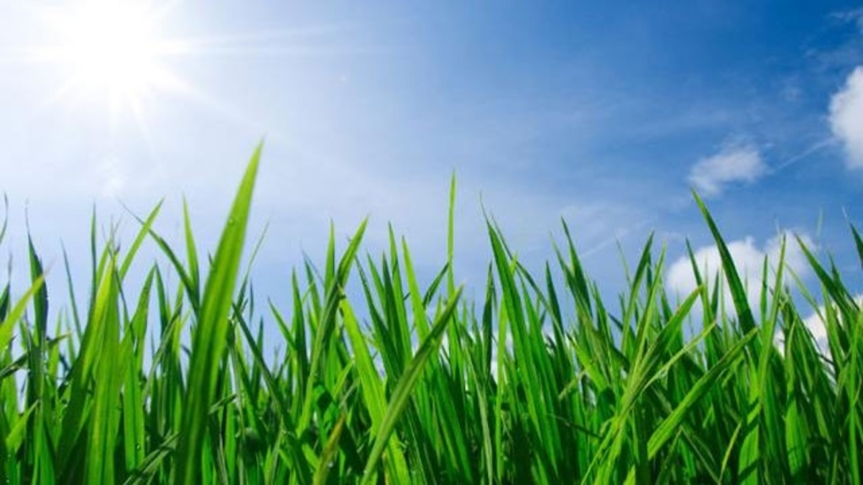

Grass

Slide 6
Where do you find this plant?

Slide 7
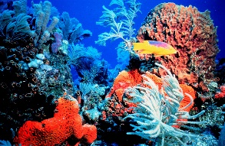

Coral

Slide 8
Where do you find this plant?

Slide 9
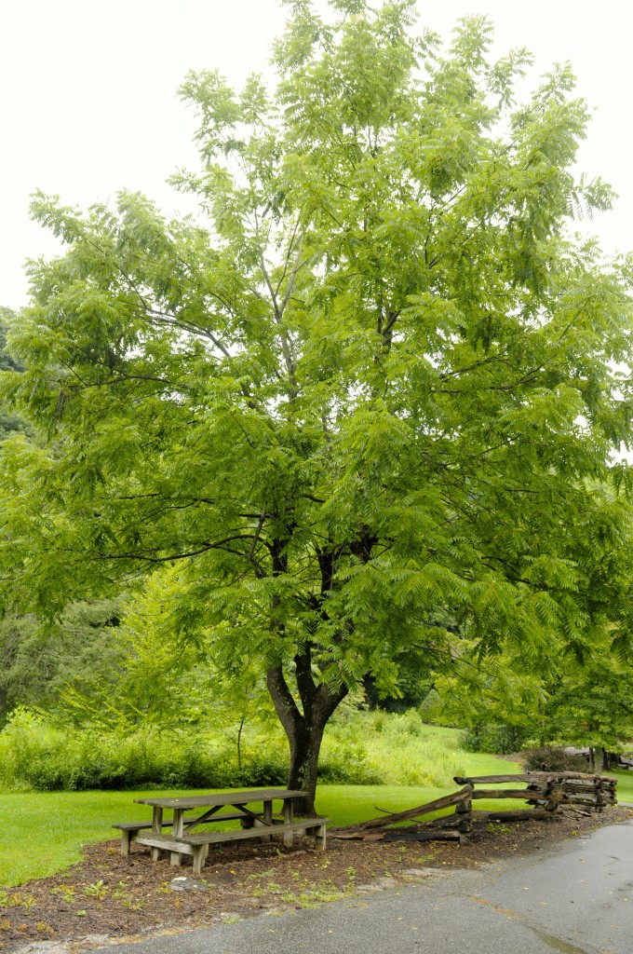

Tree

Slide 10
Where do you find this plant?

Slide 11
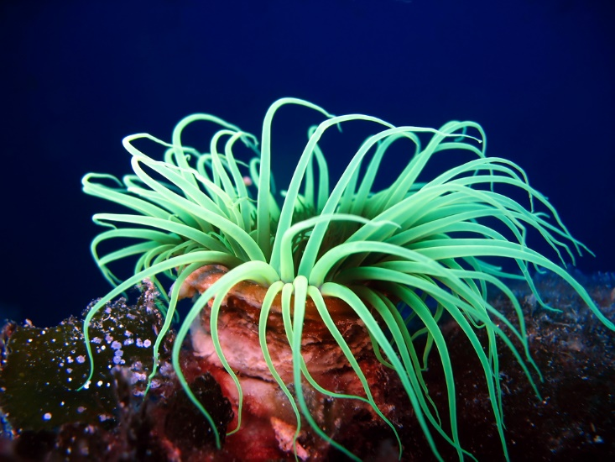
Sea anemone

Slide 12
Where do you find this plant?

Slide 13
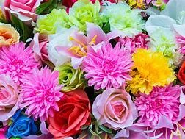
Flowers

