Slide 1
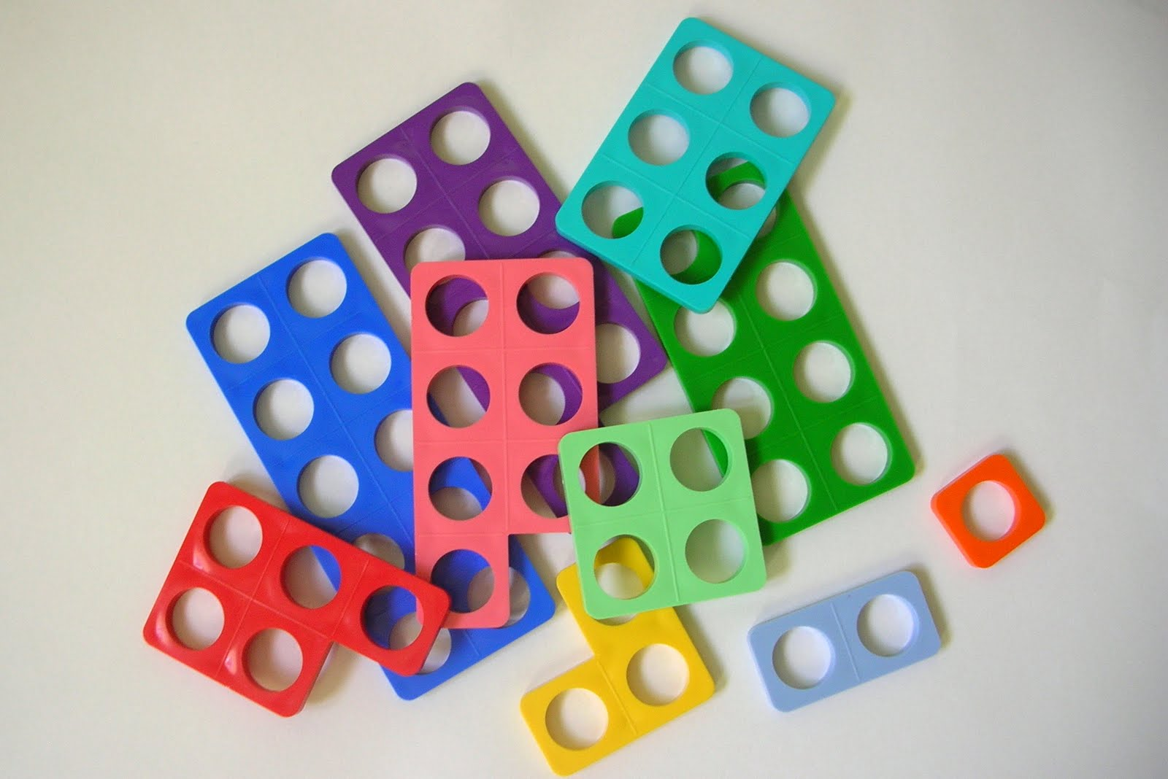
Counting using the numicon

Slide 2

How many?

Slide 3

How many?

Slide 4

How many?

Slide 5

How many?

Slide 6

How many?

Slide 7

How many?

Slide 8

How many?

Slide 9

How many?

Slide 10

How many?

Slide 11

How many?

Slide 12

How many?

Slide 13
How many?

Slide 14

How many?

Slide 15
How many?

Slide 16

How many?

Slide 17
How many?

Slide 18

How many?

Slide 19
How many?

Slide 20

How many?

Slide 21
How many?

