Slide 1
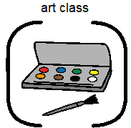

Slide 2
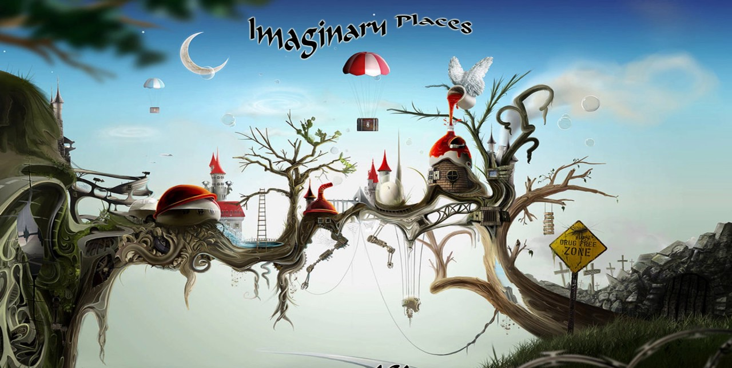
Imaginary Places

Slide 3
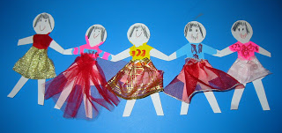
Use your paper dolls. You are going to take them to an imaginary place!

Slide 4
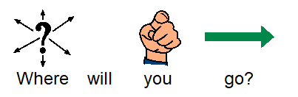
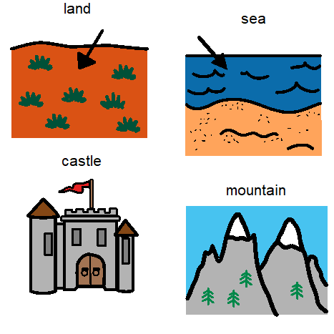
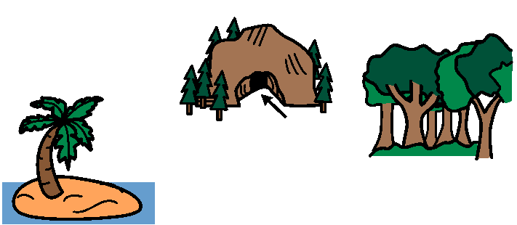
Choose from these or one of your own.

Slide 5
My imaginary place
My imaginary place is called (use alphabet page to create)
What does it look like? Describe the place
Colours?
What will I find there? What features?

Slide 6
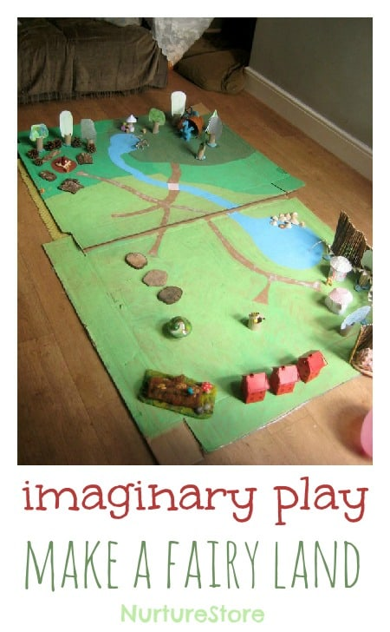
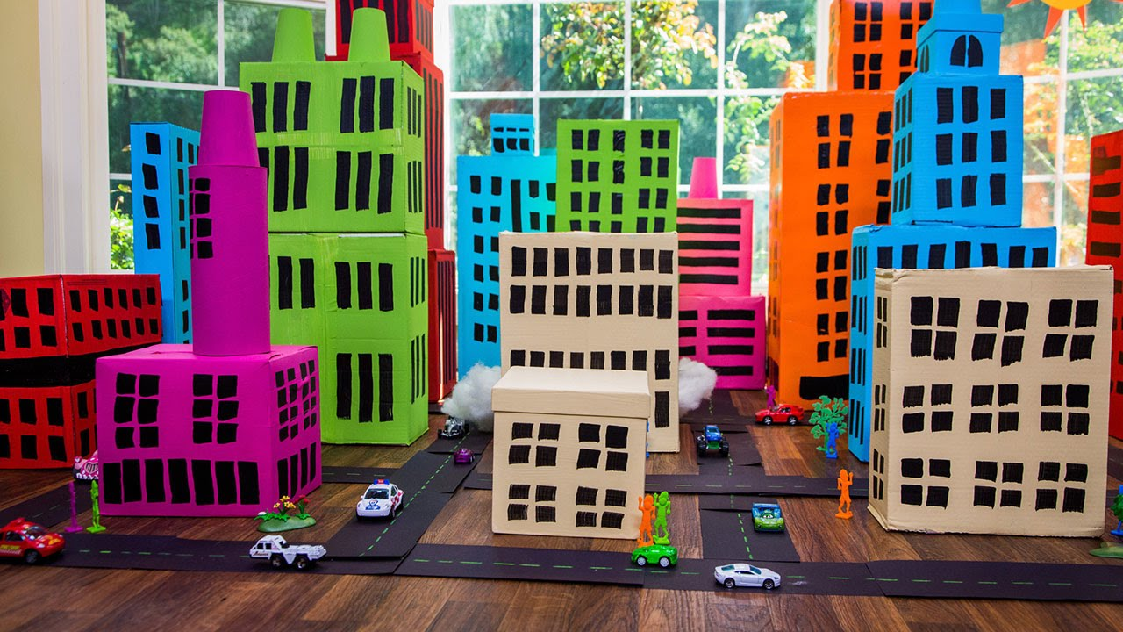
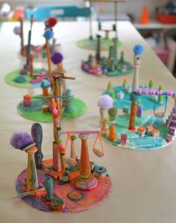
Please use some junk modeling to create a 3D version of your imaginary place.

