Slide 1

PSHE

Slide 2

George Saves the World Story
https://www.youtube.com/watch?v=i6xdwpgFWd0

Slide 3
PCW-
Our World is….

Slide 4
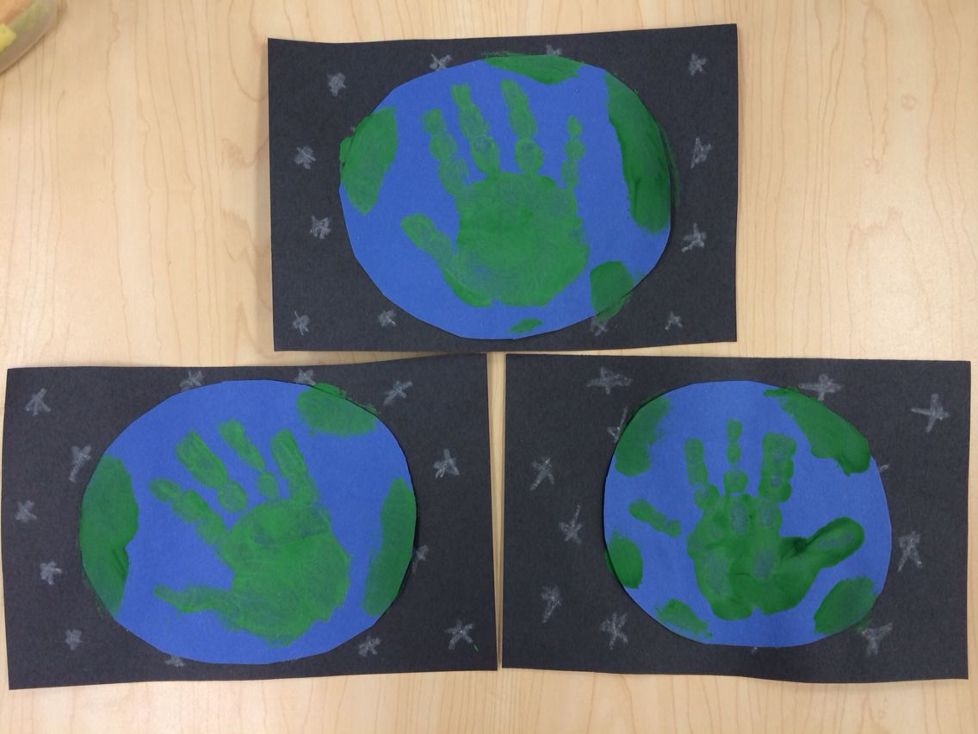
Make a Save the World poster
Paint your hand with green and blue colours
Make handprints on a world
Make a poster

