Slide 1
It’s time for Science

Slide 2
We are thinking about the topic
‘Habitats’

Slide 3
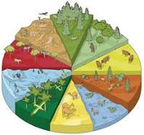
Today we are thinking about habitats

Slide 4
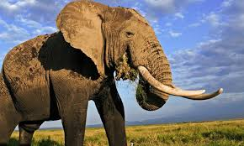

Slide 5
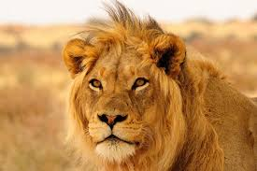

Slide 6
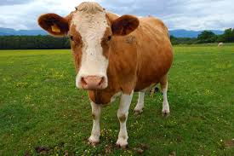

Slide 7
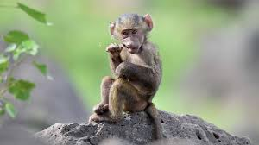

Slide 8


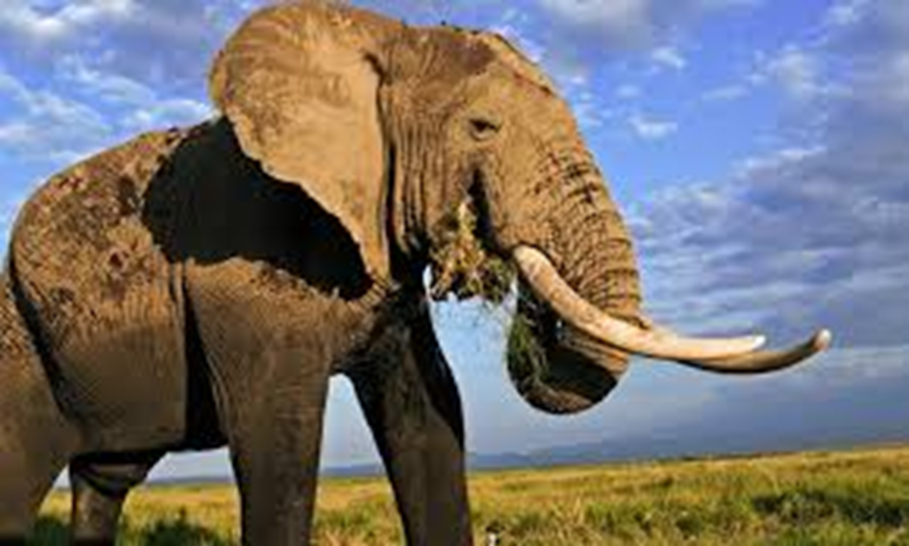


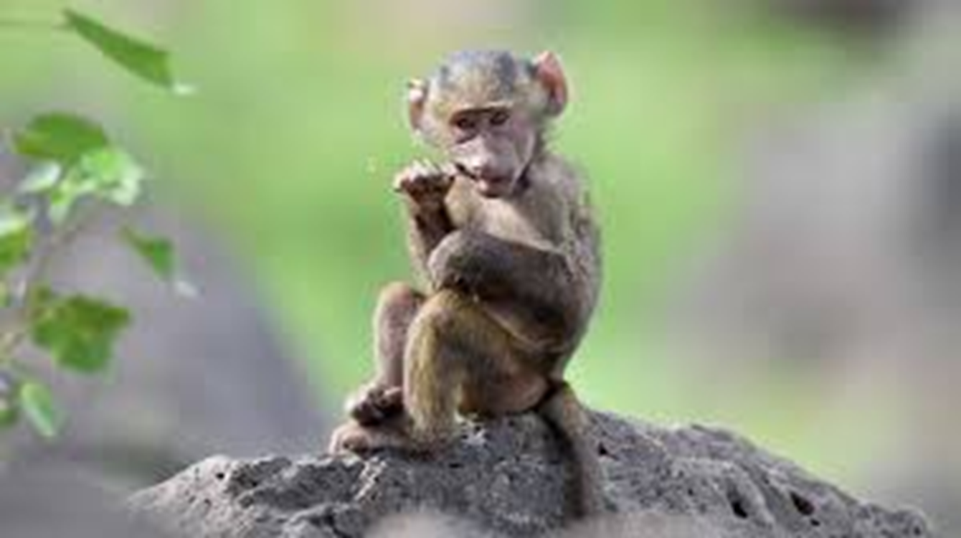

Slide 9
Science Activities
Choose an animal Research sounds and videos for that animal Talk about where they live using PODD Play animal Snap-using animal toys or pictures Match animal sounds to their pictures

