Slide 1
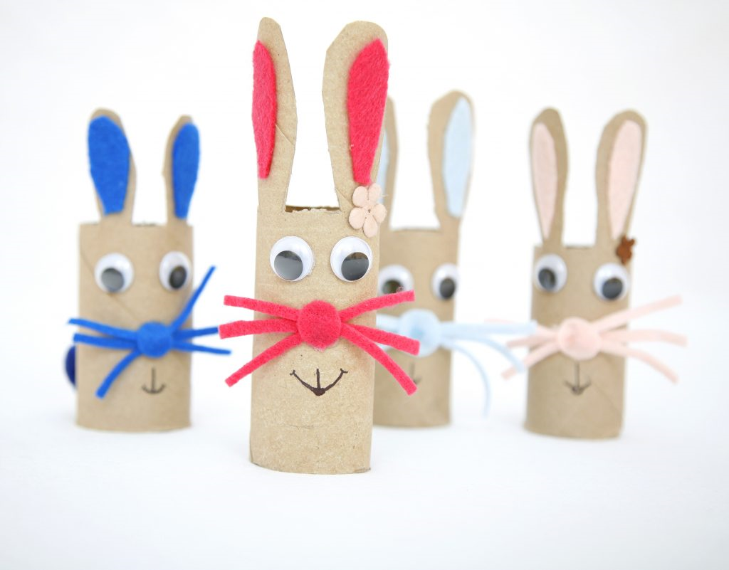
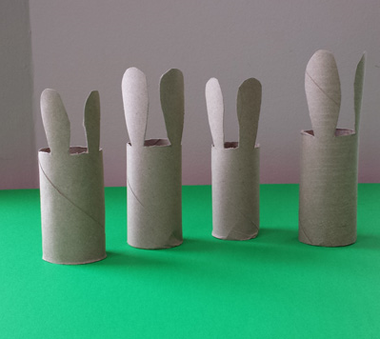
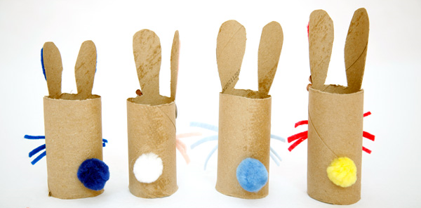
Make a family of rabbits out of cardboard tubes
Cut the cardboard rolls into bunny shapes – cut out the ears
Add some eyes – either googly eyes if you have them or draw them on.
Add a nose and whiskers
Add a mouth
Add a pompom for a tail!

