Slide 1
The Arctic
Let’s identify and group animals that live in the artic
Watch the Powerpoint and then complete the worksheet.

Slide 2
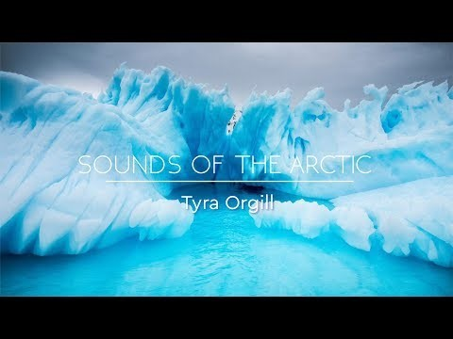

Slide 3
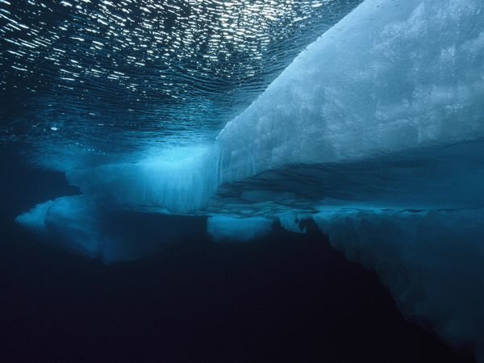

Slide 4
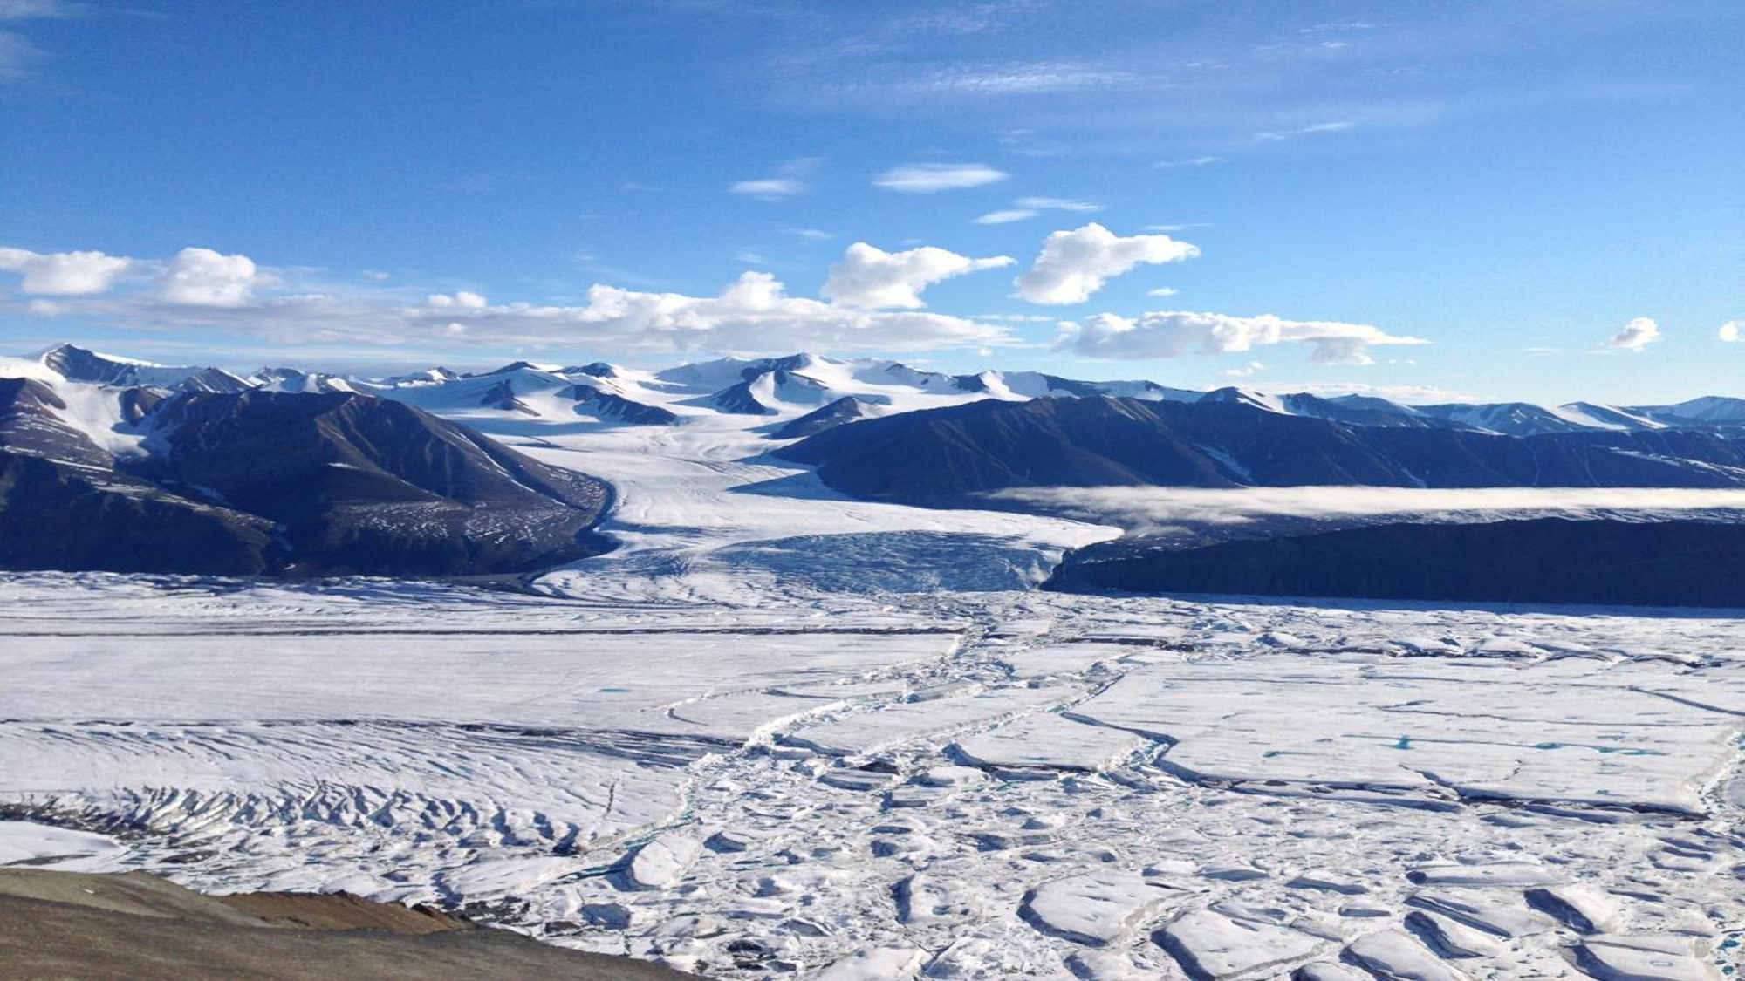
Can you use your PODD to help describe the Arctic? If you can, find three words

Slide 5

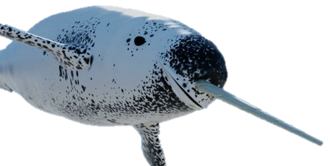
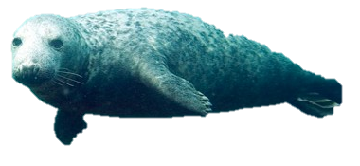
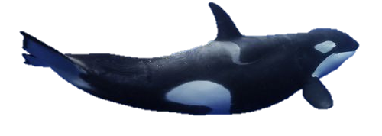
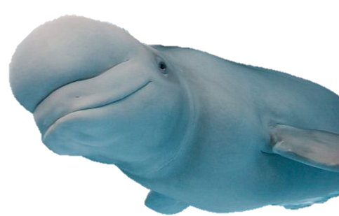
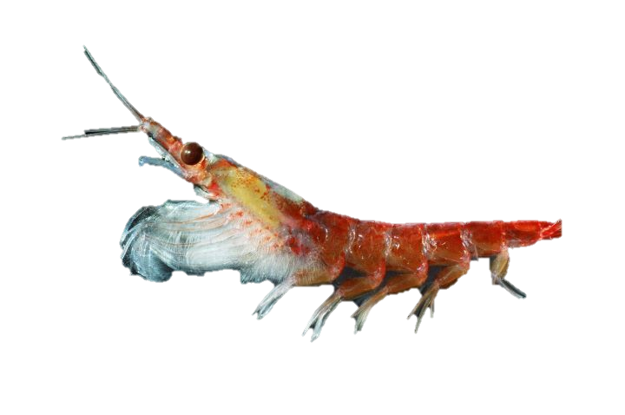
Seal
Narwhal
Blubber
Blubber
Orca
Blubber
Krill
Beluga Whale
Fast moving
Blubber

Slide 6

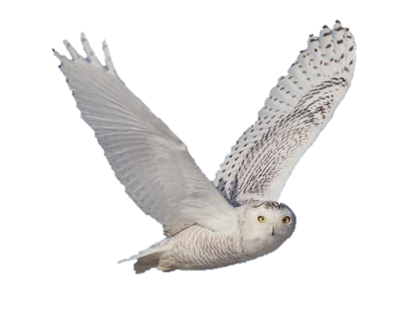
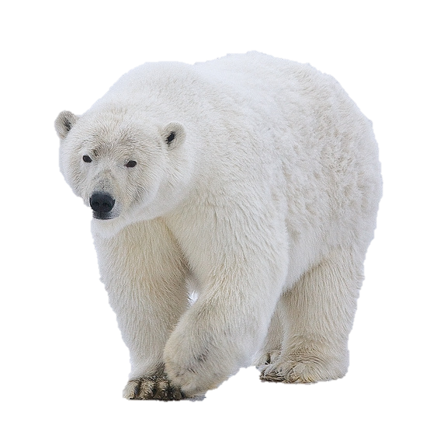
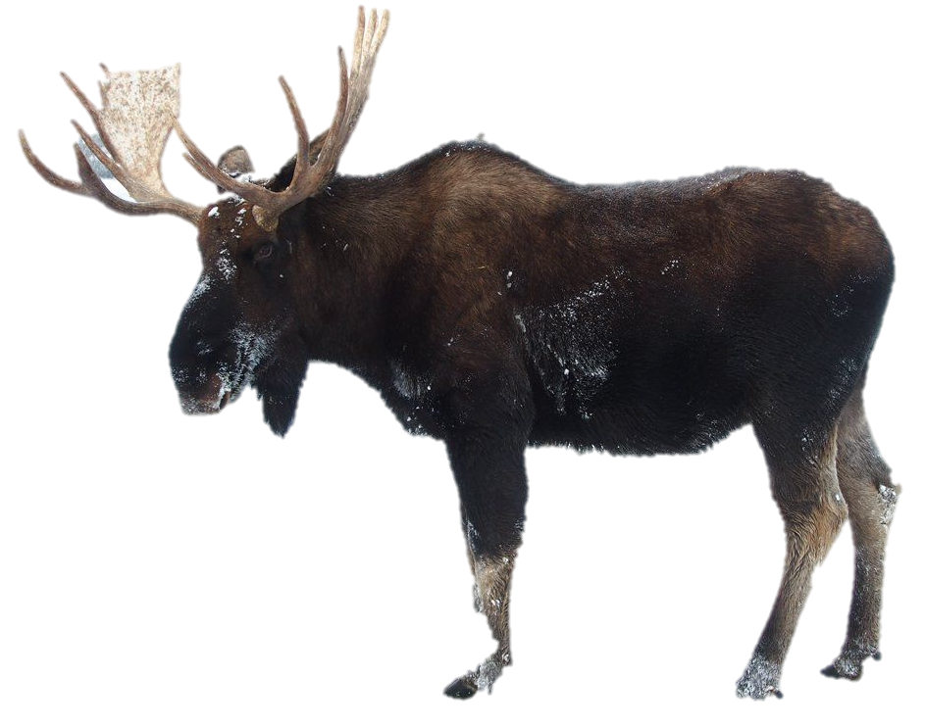
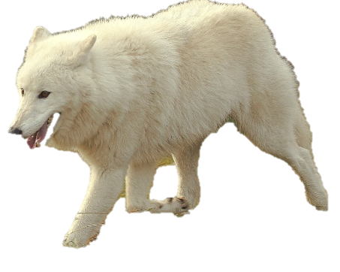
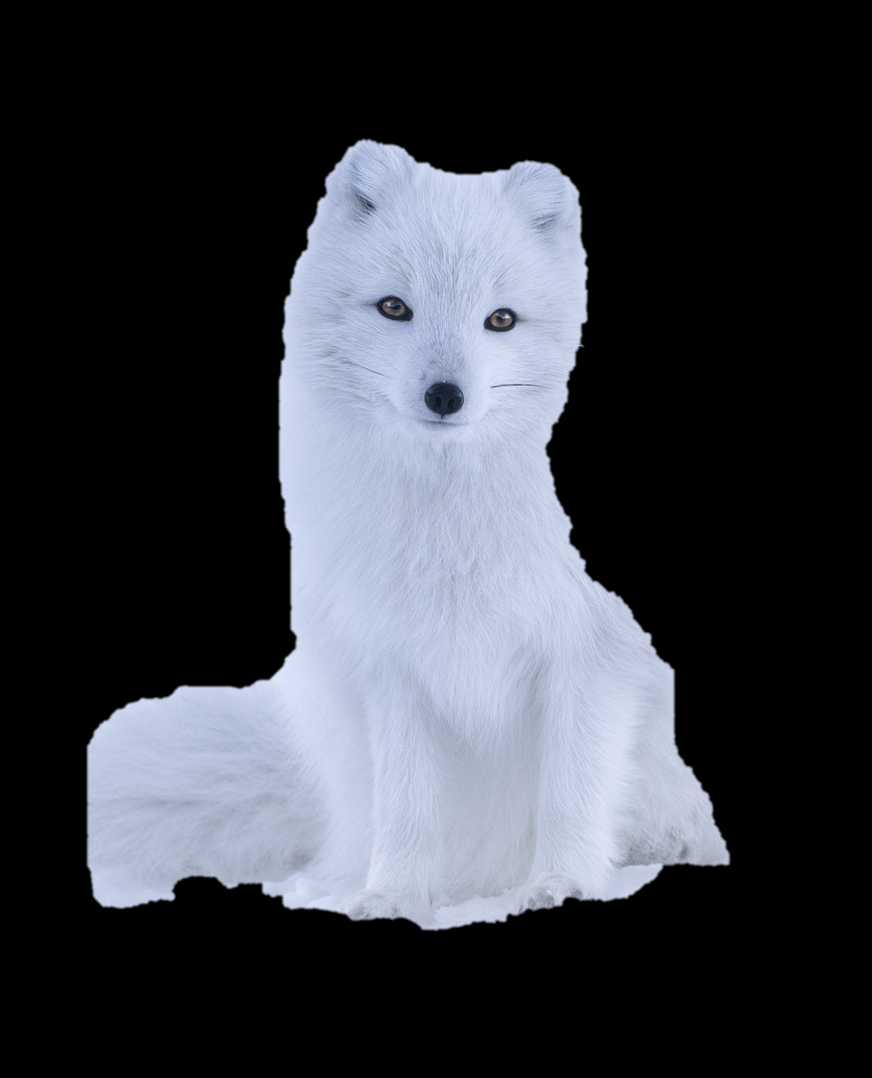
Snowy Owl
Feathers
Polar Bear
Moose
Arctic Wolf
Fur
Fur
Fur
Arctic Fox
Fur

Slide 7

Why do you think the animals need blubber or fur?

