Slide 1
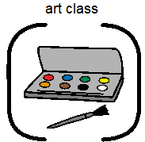

Slide 2
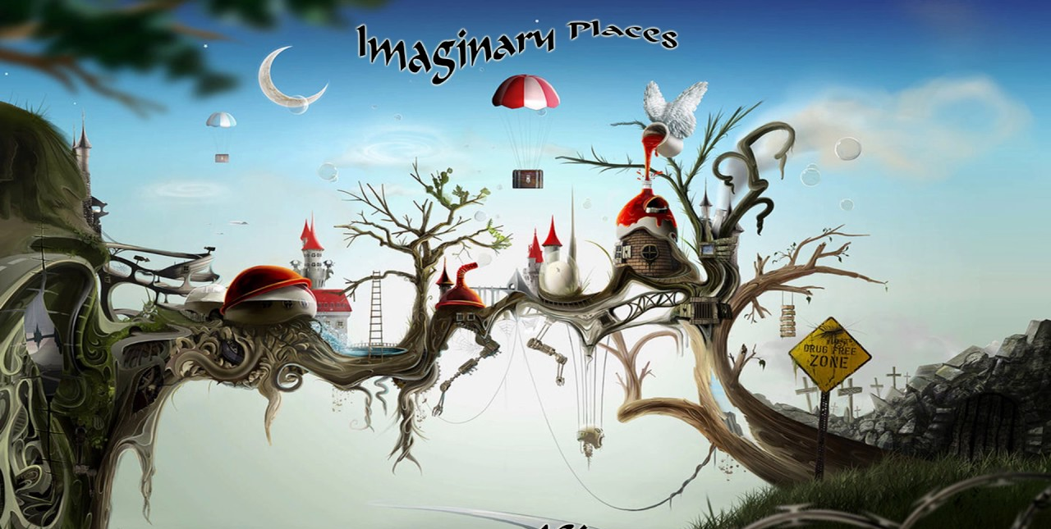
Imaginary Places

Slide 3
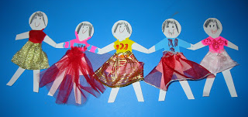
Use your paper dolls. You are going to take them to an imaginary place!

Slide 4
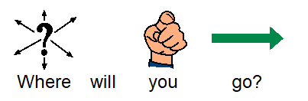
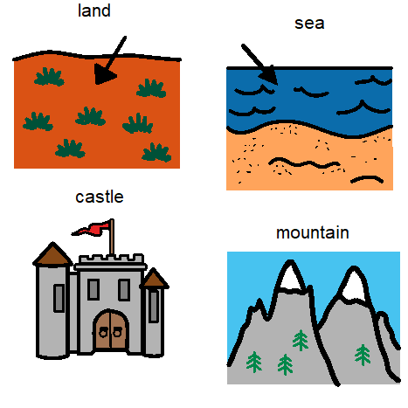
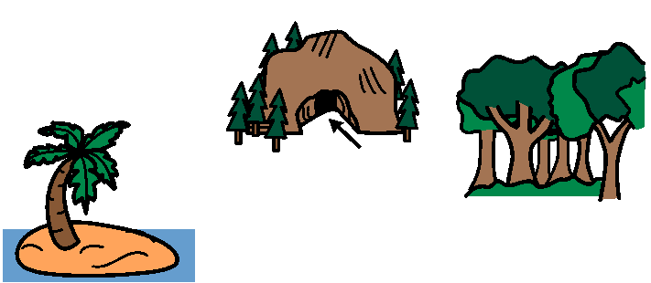
Choose from these or one of your own.

Slide 5
My imaginary place
My imaginary place is called (use alphabet page to create)
What does it look like? Describe the place
Colours?
What will I find there? What features?

Slide 6
Please find images from the internet to help you create your place.
If you have already finished this, please develop your imaginary place. Use colouring pens or paints to develop it.
You could also begin to use some junk modeling to create a 3D version of your imaginary place.

